Slide 1
Think- Pair- Share
What are some ways we use electrical energy?
Where does it come from? What are some sources of energy?
Notes:
The US is the 2nd largest consumer of electricity. China is first.

Slide 2
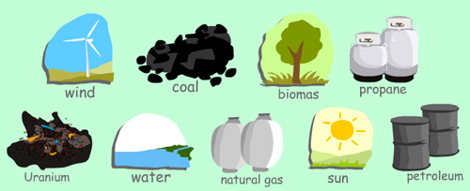
Foldable- Renewable and Nonrenewable Resources
Create a hamburger style foldable with two columns. Glue on pg. 119.
As you watch the video:
Identify and describe the types of renewable and nonrenewable resources.

Slide 3
Sources of Energy- Copy on Pg. 120
Renewable Resources- Renewable resources are natural resources that can be replenished in a short period of time. Examples- Wind, Water, Solar, Geothermal
Non renewable Resources-A nonrenewable resource is a natural resource that cannot be re-made or re-grown at a scale comparable to its consumption. Examples: Nuclear, Fossil Fuels (oil, coal natural gas)
Inexhaustible Resources-Inexhaustible resources are a resource that is present with unlimited amounts in the nature; they cannot be depleted or exhausted by human activity.
Conservation- The idea of saving energy to prevent the depletion of our natural resources.

Slide 4
Classwork
Use your notes and definitions to complete the handout.
Identify each source as renewable and nonrenewable and complete the question.

Slide 5
NONRENEWABLE AND RENEWABLE RESOURCES

Slide 6
HMMMM....
What do you think nonrenewable resources are?
Break it down...
Nonrenewable?
Resource?

Slide 7
NONRENEWABLE RESOURCES
A nonrenewable resource is a natural resource that cannot be re-made or re-grown at a scale comparable to its consumption.

Slide 8
NUCLEAR ENERGY
Nuclear fission uses uranium to create energy.
Nuclear energy is a nonrenewable resource because once the uranium is used, it is gone!

Slide 9
COAL, PETROLEUM, AND GAS
Coal, petroleum, and natural gas are considered nonrenewable because they can not be replenished in a short period of time. These are called fossil fuels.

Slide 10
HOW IS COAL MADE ???

Slide 11
HOW ARE OIL AND GAS MADE ???

Slide 12
WHAT WAS THE DIFFERENCE BETWEEN COAL AND OIL/GAS?
Click here

Slide 13
HMMMM....
If nonrenewable resources are resources that cannot be re-made at a scale comparable to its consumption, what are renewable resources?

Slide 14
RENEWABLE RESOURCES
Renewable resources are natural resources that can be replenished in a short period of time.
● Solar ● Geothermal
● Wind ● Biomass
● Water

Slide 15
SOLAR
Energy from the sun.
Why is energy from the sun renewable?

Slide 16
GEOTHERMAL
Energy from Earth’s heat.
Why is energy from the heat of the Earth renewable?

Slide 17
WIND
Energy from the wind.
Why is energy from the wind renewable?

Slide 18
BIOMASS
Energy from burning organic or living matter.
Why is energy from biomass renewable?

Slide 19
WATER or HYDROELECTRIC
Energy from the flow of water.
Why is energy of flowing water renewable?

Slide 20
SUMMARY
What are the differences between nonrenewable and renewable resources?
Create a Venn diagram

