Slide 1
NC Barrier Island’s
North Carolina’s unique estuarine shoreline

Slide 2
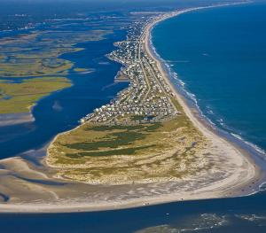
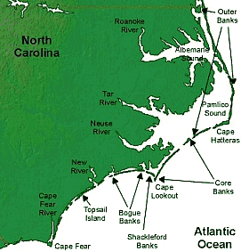
What are they and how did they form?
They act as a protective sand dam to protect the mainland from storms.
Barrier islands formed at the end of the last ice age.
Barrier islands are separated by channels or inlets between the islands.
The Albemarle- Pamlico basin is the 2nd largest estuarine environment on the East Coast.

Slide 3
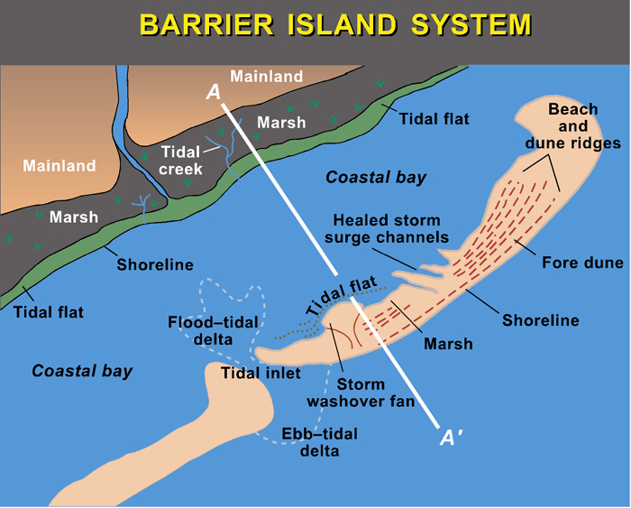

Slide 4
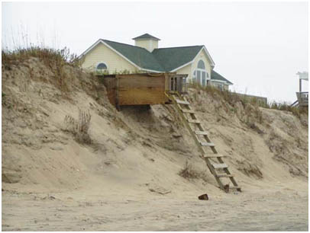
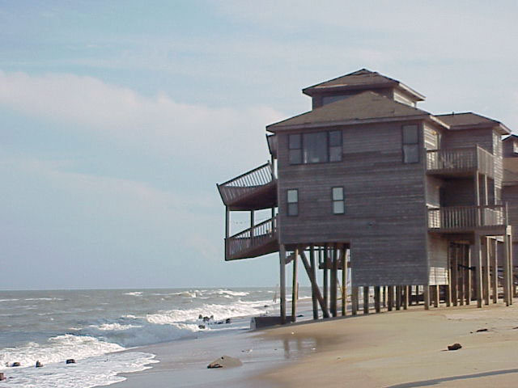
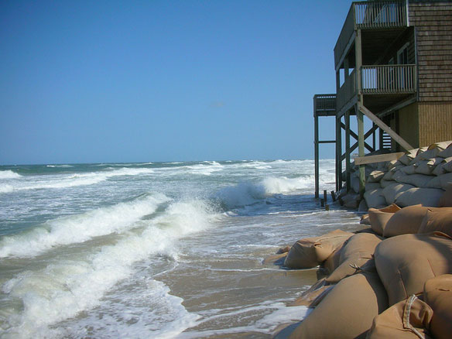
The Issue……

Slide 5
Weathering
the breakdown of the materials of Earth’s crust into smaller pieces. It can occur through chemical reactions such as excess CO2 , acid rain. . . AND physical means such as wind, water, . . . .

Slide 6
Erosion and Deposition
Erosion is the process by which water, ice, wind, or gravity MOVES fragments of rock and soil.
For every particle or fragment that is moved by erosion, the
load must be deposited.
Deposition changes the land by building it up while erosion changes it by tearing it down.

Slide 7
In other words…..
Sands are being carried by the wind and waves from our beaches.
Then deposited in other areas down the beach.
The barrier islands are slowly moving from North to South in a process called long shore drift.

Slide 8
Protection from Erosion
Natural Protection
Man Made Protection
Sand Dunes- The first line of defense against storm surge.
Maritime Forest- The second line of defense.
Hard Stablization- Sea walls, jetties
Soft Stablization- Sand Bags
Replenishment of sand
Relocation of buildings

Slide 9
Habitats of a Barrier Island
N.C. barrier islands act as a protective sand dam to protect the mainland from storms.
Barrier islands formed at the end of the last ice age. The melting ice caused sea level to rise and sediments were pushed up into ridges we call barrier islands.
The Albemarle- Pamlico basin is the 2nd largest estuarine environment on the East Coast.
Barrier islands are separated by channels or inlets between the islands.

Slide 10
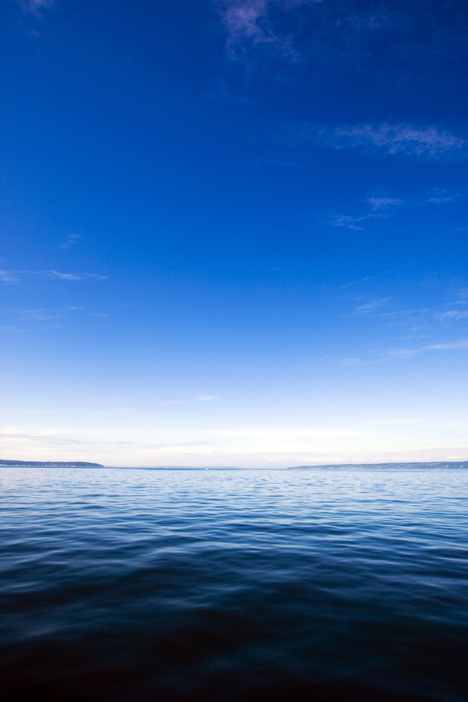
Ocean
The winds cause the waves and tides change how far the water comes into the beach each day

Slide 11
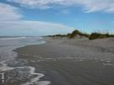
Beach or Berm
Land environment that changes in width 4 times a day with the tides. Many animal species make their home on the beach. In N.C. the sand is made of quartz and feldspar. Animals –ghost crabs, coquina

Slide 12
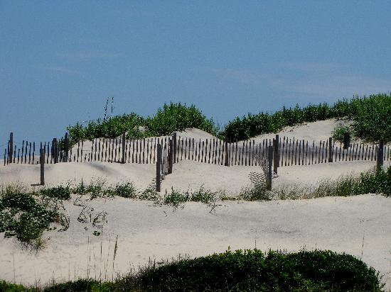
Sand Dune

Slide 13
Sand Dunes
Protective mounds of sand covered in beach grasses and vines to hold sand in place. This is first line of defense to a storm surge.ex. Pennywort, yaupon, sea oats

Slide 14
Maritime Forest
Full of small evergreen trees and oaks. The trees have adapted to the high winds and salty air. They act as the second line of defense from a storm.

Slide 15
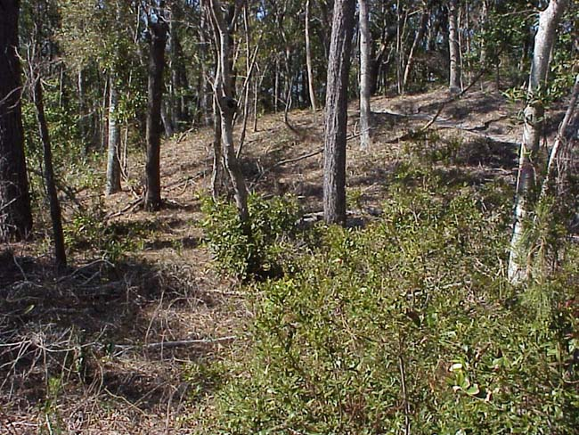
Maritime Forest

Slide 16
Salt Marsh
Flooded twice daily with the changing tides, this marsh environment is a mix of fresh and salt water, nutrient rich H₂S mud, and a great variety of plants, animals and detritus. Life has to adapt to being in and out of water and changing concentrations of salt. Ex. Cordgrass, spartina, perwinkle snails, sea lettuce . . .

Slide 17
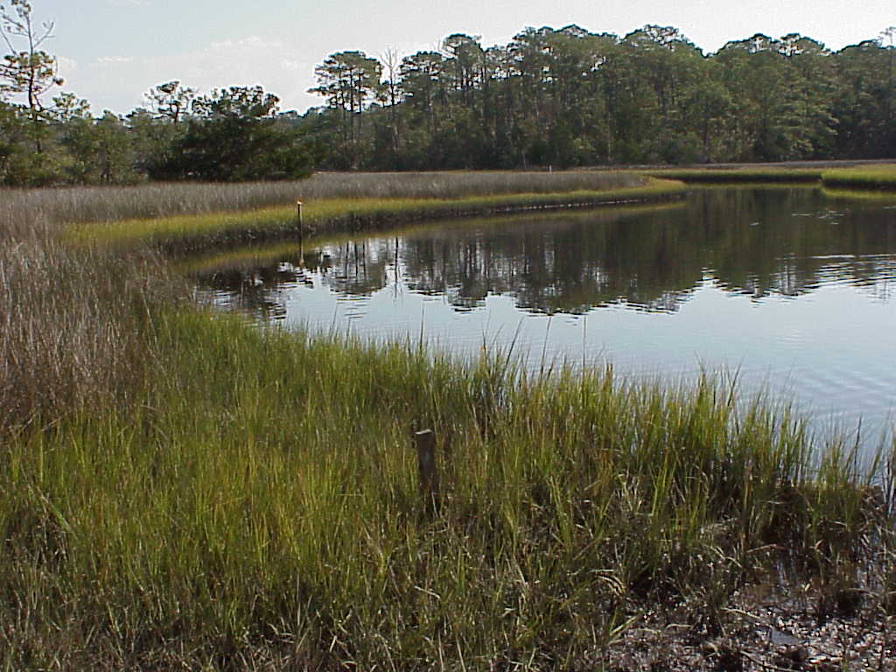

Slide 18
Estuary
Water environment that changes in salinity with the rain and dilution of river water and influx of ocean water daily. Water depth changes constantly. N.C’s sounds are very shallow.

Slide 19
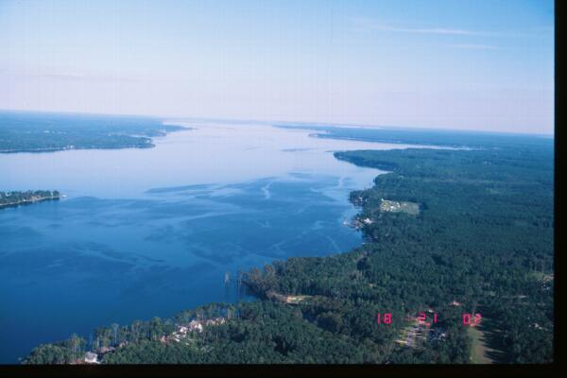

Slide 20
Hard Stabilization

Slide 21
Soft Stabilization

Slide 22
Beach Replenishment

Slide 23
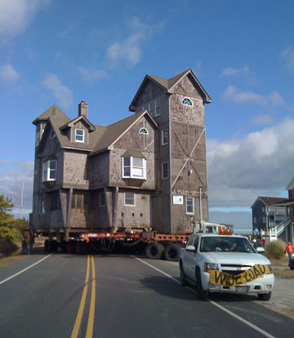
Relocation
Moved 1999 Moved 2010

Slide 24
Classwork/ Homework
Read and annotate the article by Emily Jack, “Coastal Erosion and the ban on hard structures”.
Complete the graphic organizer listing the pros and cons for each argument.
Homework-None (Finish the Shad Journal)

