Slide 1
Biomagnification
A Who's Who of pesticides is therefore of concern to us all. If we are going to live so intimately with these chemicals eating and drinking them, taking them into the very marrow of our bones - we had better know something about their nature and their power.”
Racheal Carson, “Silent Spring”

Slide 2
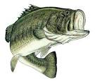
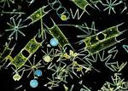
Activity
Each of you were assigned a cup. Each cup represents a species in this food chain.
How does energy flow in this food pyramid?
Who is the top predator?

Slide 3
Activity
We have an algal bloom in the class.
The zooplankton eat the algae.
The mosquito fish eat the zooplankton. Collect all the marbles from the zooplankton.
The Largemouth bass eat the mosquito fish. Collect all the marbles from the mosquito fish.
The Eagles eat the Largemouth bass. Collect all the marbles from the bass.

Slide 4
Activity
Where did all the marbles go?
If the marbles represented energy which organism requires/ acquired the most energy?
If the marbles represented a pollutant such as DDT, which organism acquired the highest concentration of pollutants?

Slide 5
Biomagnification
Some pollutants are worse than others…… they sneak up on you!

Slide 6
What is biomagnification?
Biomagnification: The increase in concentration of a substance from one link in a food chain to another
This is how we get a transfer of nutrients from one organisms to another, meaning higher order organisms contain more nutrients which is essential for growth. But this process can also be negative side, when harmful chemicals or pollutants are involved

Slide 7
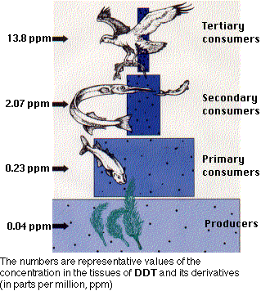
Case Study: DDT
DDT is a pesticide that was widely used until being banned in the U.S. in 1972
DDT accumulates in living tissue, particularly in fat tissue
High concentrations in some bird species caused failure of eggs by thinning the shells

Slide 8
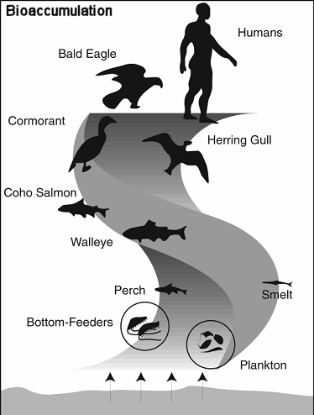
Case Study: PCBs
PCBs, or polychlorinated biphenyls, are a group of man-made chemicals.
Introduced in 1929 and widely used in electrical transformers, cosmetics, varnishes, inks, carbonless copy paper, pesticides and for general weatherproofing and fire-resistant coatings to wood and plastic.
The federal government banned the production of PCBs in 1976
PCBs can effect the immune system, fertility, child development and possibly increase the risk of certain cancers

Slide 9
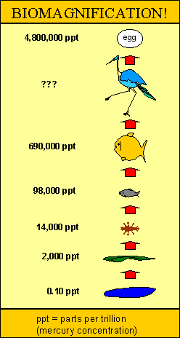
Case Study: Methyl Mercury
What makes methylmercury so dangerous?
Methylmercury is rapidly taken up but only slowly eliminated from the body by fish and other aquatic organisms, so each step up in the food chain (bio)magnifies the concentration from the step below. Bioaccumulation factors (BAF's) of up to 10 million in largemouth bass have been reported for the Everglades. Fish-eating birds, otters, alligators, raccoons and panthers can have even higher bioaccumulation factors.
U.S. Department of the Interior, U.S. Geological Survey, Center for Coastal Geology This page is: http://sofia.usgs.gov/sfrsf/rooms/mercury/achilles_heel/cause.html

Slide 10
Why are these pollutants harmful?
These pollutants are NOT broken down naturally in the environment.
They are stored in living organisms in their fat cells.
They can cause serious health problems when concentrations become too high.

Slide 11
FYI………
Avoid eating too much albacore tuna (light canned tuna is OK)
Avoid fish that eat larger fish such as shark, King Mackeral, or swordfish.
These may contain the largest amounts of mercury.

Slide 12
Classwork/ Homework
Read and annotate the passage on Minamata disease.
Answer the questions in complete sentences.

