Slide 1
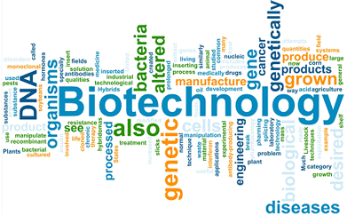
Biotechnology
http://vimeo.com/17125052

Slide 2
History of Biotechnology
Unit 9: Microbiology
http://vimeo.com/17125052

Slide 3
What is Biotechnology?
Biotechnology: the branch of molecular biology that studies the use of microorganisms to perform specific industrial processes; "biotechnology produced genetically altered bacteria that solved the problem"

Slide 4
What is Biotechnology?
Biotechnology: the use of the natural sciences to create solutions to global problems;
Biotechnology is used in fields such as agriculture, medicines and vaccines, and alternative fuels.

Slide 5
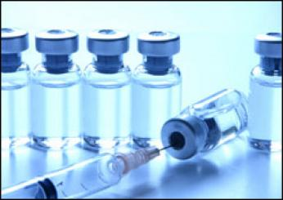
How is biotechnology used today?
Fighting disease
New treatments and therapies for multiple sclerosis and cystic fibrosis with the help of gene therapy.
New vaccines provide better protection against disease.

Slide 6
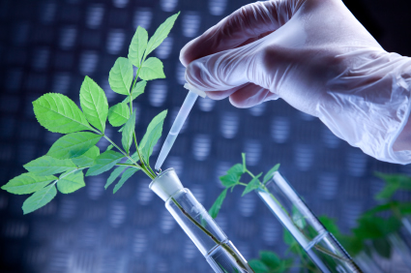
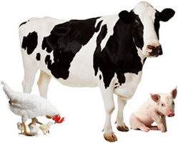
How is biotechnology used today?
Feeding the World
Genetically Modified crops are more resistant to insects, disease, and harsh weather increasing food production.
Animal vaccines against parasites and infectious disease.

Slide 7
How is biotechnology used today?
Fueling the world
The creation of enzymes to be used in the manufacturing of bio-ethanol, an alternative fuel.
The use of bacteria to help clean oil spills
Use of cells to help create biodegradable plastics.

Slide 8
Biotechnology In The First Part Of The 20th Century
1902: The term "immunology" first used
1906: The term "genetics" is used
1915: Bacterial viruses, called phages, are discovered
1919: The word "biotechnology" is first used
1927: Muller discovers that X-rays cause mutation
1928: Fleming discovers penicillin
1938: The term "molecular biology" is used
1941: The term "genetic engineering" is first used

Slide 9
Biotechnology in B.C.
500 BC: The Chinese use moldy curds as an antibiotic to treat boils
250 BC: The Greeks practice crop rotation to increase soil fertility
100 BC: Chinese use powdered chrysanthemum as an insecticide

Slide 10
Pre-20th Century Biotechnology
1590: Janssen invents the microscope
1663: Hooke discovers cells
1675: Leeuwenhoek discovers bacteria and protozoa
1797: Jenner inoculates a child with a viral vaccine to protect him from smallpox
1802: 1st time the term “biology” is used

Slide 11
Pre-20th Century Biotechnology
1830: Proteins, the building blocks of cells, are discovered
1833: The nucleus of the cell is discovered
1855: The E. coli bacterium is discovered
1855: Pasteur works with yeast, eventually proving they are living organisms
1863: Mendel discovers genes while working with peas. He lays the groundwork for genetics.

Slide 12
Pre-20th Century Biotechnology
1879: Flemming discovers chromatins
1883: The rabies vaccine is developed
1888: Waldyer discovers the chromosome

Slide 13
Biotechnology In The First Part Of The 20th Century
1902: The term "immunology" first used
1906: The term "genetics" is used
1915: Bacterial viruses, called phages, are discovered
1919: The word "biotechnology" is first used
1927: Muller discovers that X-rays cause mutation
1928: Fleming discovers penicillin
1938: The term "molecular biology" is used
1941: The term "genetic engineering" is first used

Slide 14
Biotechnology In The First Part Of The 20th Century
1942: The electron microscope is used and characterizes viruses that infect bacteria, called bacteriaphages
1944: DNA is shown to be the building block of the gene
1949: Pauling proves that sickle cell anemia is a "molecular disease" caused by a mutation

Slide 15
Biotechnology in the 1950s and 1960s
1953: Watson and Crick understand the structure of DNA
1954: Cell-culturing techniques are first used
1955: An enzyme involved in the production of a nucleic acid is isolated
1956: The fermentation process is perfected
1960: Messenger RNA is discovered
1961: The genetic code is understood

Slide 16
Biotechnology in the 1970s
1972: The DNA composition of humans is shown to be 99% similar to that of chimps and gorillas
1977: Genetically-engineered bacteria are used to make human growth protein
1978: North Carolina scientists, Hutchinson and Edgell, prove it is possible to introduce specific mutations at specific sites in a DNA molecule
1979: The first monoclonal antibodies are synthesized

Slide 17
Biotechnology in the 1980s
1980: The U.S. Supreme Court approves the patenting of genetically-engineered life forms
1980: The U.S. patent for gene cloning is awarded to Boyer and Cohen.
1981: The North Carolina Biotechnology Center is created—the 1st state-sponsored research center for biotechnology
1981: The first genetically-engineered plant is reported
1981: 1st mice to be successfully cloned
1982: Humulin, human insulin drug, produced by genetically-engineered bacteria (first biotech drug approved by the FDA)

Slide 18
Biotechnology in the 1980s
1983: The first artificial chromosome is made
1983: The first genetic markers for specific inherited diseases are found
1984: The DNA fingerprinting technique is developed.
1984: The first genetically-engineered vaccine is developed. 1986: The first biotech-derived interferon drugs for the treatment of cancer are synthesized
1988: Congress funds the Human Genome Project
1989: Microorganisms are used to clean up the Exxon Valdez oil spill

Slide 19
Biotechnology in the 1990s
1990: The first federally-approved gene therapy treatment is performed successfully
1992: The structure of HIV RT is elucidated
1993:The FDA declares that genetically engineered foods are "not inherently dangerous"
1994: The first breast cancer gene is discovered
1996: Scientists clone identical lambs from early embryonic sheep

Slide 20
Biotechnology in the 1990s
1998: Scientists clone three generations of mice from nuclei of adult ovarian cells
1998: Embryonic stem cells are used to regenerate tissue and create disorders that mimic diseases
1998: The Biotechnology Institute is founded by BIO as an independent, national, 501(c)(3) education organization
1999: The genetic code of the human chromosome is deciphered

Slide 21
Biotechnology 2000 and Beyond
2000: A rough draft of the human genome is completed
2000: Pigs are the next animal cloned by researchers to help produce organs for human transplant
2001: The sequence of the human genome is published in Science and Nature
2002: Scientists complete the sequence of the pathogen of rice, a fungus that ruins enough rice to feed 60 million people annually
2003: Dolly, the cloned sheep from 1997, is euthanized

Slide 22
Resources
http://www.biotechinstitute.org

