Slide 1
Disease
What is the difference between and infectious disease and noninfectious disease?
How are disease transmitted ?

Slide 2
Disease Query
Go around the room and find someone who knows someone or has ever had one of these diseases.
Put their initial in the square.
You can only fill one square.

Slide 3
Disease
Infectious
Disease
Noninfectious Disease

Slide 4
Disease
Any condition that abnormally effects the function of an organism.
Causes include pathogens (germs), environmental, and genetics.

Slide 5
Noninfectious Diseases
Non-infectious diseases (also called Non-communicable diseases ) are those diseases that are not caused by a pathogen and cannot be shared from one person to another.
Non-infectious diseases may be caused by either
the environment- : chemical exposure, carcinogens, air pollution, water pollution, food safety
nutritional deficiencies-
Overnutrition- is frequent overconsumption of food. Leads to obesity.
Malnutrition- when your body does not get enough nutrients.
lifestyle choices- diet, exercise, tobacco, alcohol, drugs, and stress
genetic inheritances- inheritance plays a part in determining lifespan and the likelihood of developing certain illnesses.

Slide 6
Infectious Disease
Infectious diseases are caused by pathogens.
A pathogen is a microorganism that causes a disease such as a virus, bacteria, protist or fungi.
Pathogens are transmitted through direct contact and indirect contact with an infected person, an infected animal, a contaminated object or food, water and soil.
A vector is an organism that passes a disease to humans.

Slide 7
How are Pathogens Spread?
The 4 Ways Pathogens Spread:
Infected People
Infected Animals
Contaminated Object
Soil, Food, and Water
Notes:
7

Slide 8
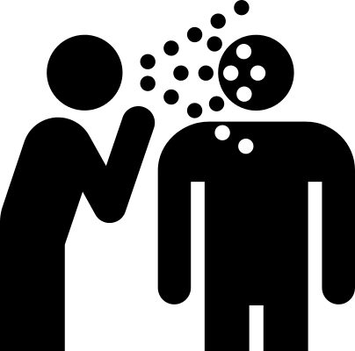
Infected People
Pathogens pass from one person to another person…
Directly - Kissing, Shaking Hands, etc.
and
Indirectly - Sneezing,
Coughing, etc.
Notes:
8

Slide 9
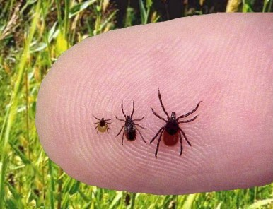
Infected Animals
Infected animals can bite a person and pass the pathogen to them.
Example: Ticks can transmit Bacteria to humans when they bite, giving the humans Lyme Disease.
Notes:
9

Slide 10
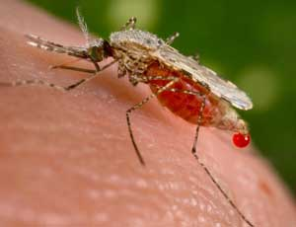
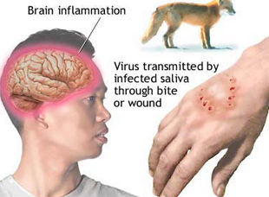
Vectors
Vectors - The hosts or carriers that spread pathogens and disease.
Examples: Mosquitos, Ticks, Dogs

Slide 11
Vector-borne Diseases
Vector-borne Disease – Any diseases that is spread to humans through direct contact with an infected animal.
Examples: Rabies from a dog bite, Lyme disease from a Tick, Malaria from a Mosquito

Slide 12
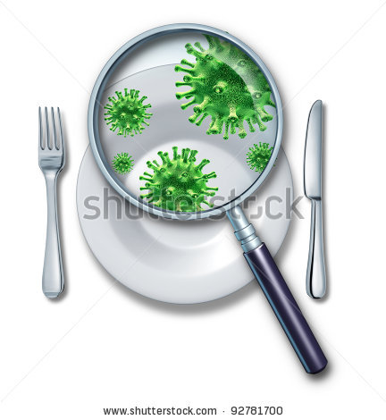
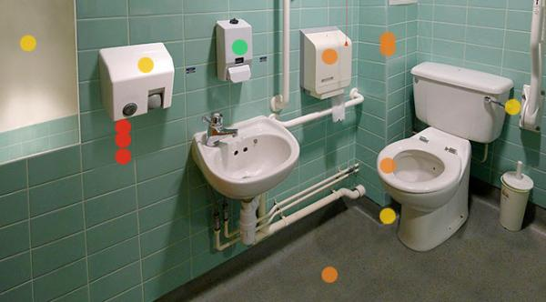
Contaminated Object
Pathogens that can survive outside the body are transferred from infected person, to an object, and then to another person.
Notes:
12

Slide 13
Soil, Food, and Water
Some pathogens occur naturally in the environment and can be transferred to people through soil, food and water.
Examples: Cholera and Dysentary are two deadly diseases that spread through food and water.
Notes:
13

Slide 14
Classwork
Using the links on your desk identify the following diseases as either infectious or noninfectious.
Choose a row or column to complete.

Slide 15
The Germ Theory
States that specific germs/ pathogens cause specific diseases.

Slide 16
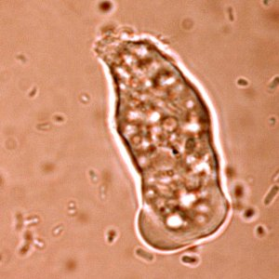
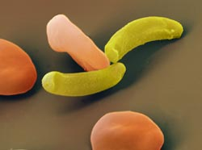
Protists
Entamoeba histolytica
Causes dysentery, a severe form of amebiasis associated with stomach pain, bloody stools, and fever.
Plasmodium, a one-celled parasite transmitted by a mosquito.
Causes malaria, which causes flu-like symptoms and intestinal problems.
Plasmodium attacking a red blood cell
Notes:
16

Slide 17
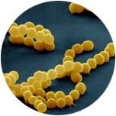
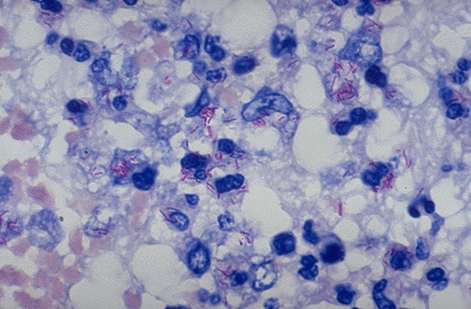
Bacteria
Streptococcus Bacterium
Causes strep throat, a painful sore throat and fever.
Mycobacterium tuberculosis
Causes tuberculosis, a highly contagious respiratory disease.
Notes:
17

Slide 18
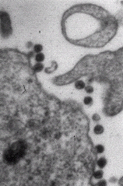
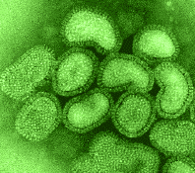
Viruses
Retroviridae - HIV (Human Immunodeficiency Virus)
Causes Acquired Immunodeficiency Syndrome (AIDS), which is a deadly disease that attacks the human immune system.
Orthomyxoviridae – Influenza virus
Causes the flu, which is a respiratory infection that often causes the infected person to have a fever, headache, and body aches.
Notes:
18

