Slide 1
Classifying Matter:
Atoms, Elements, Compounds, and Mixtures

Slide 2
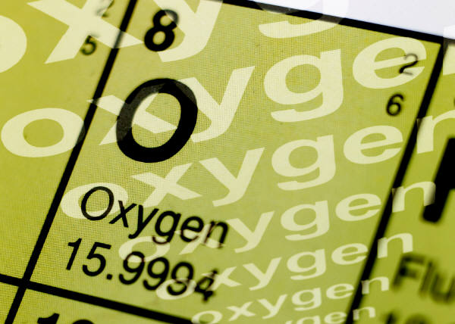
Pure Substances
A sample of matter that has definite chemical and physical properties.
Elements
Atoms
Compounds
Molecules

Slide 3
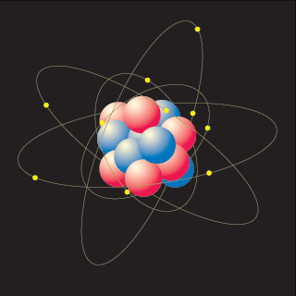
I. What is an atom?
Atoms are the basic unit of an element.
All elements are made up of tiny atoms
Review: What are the 3 types of matter?
  Solid, Liquid, and Gas

Slide 4
Atom
Atoms are the building blocks of all matter
Molecule
Atom
Subatomic
O
water
H
H

Slide 5
Subatomic Particles
 | Proton | Neutron | Electron
Location in the Atom
Mass
Charge

Slide 6
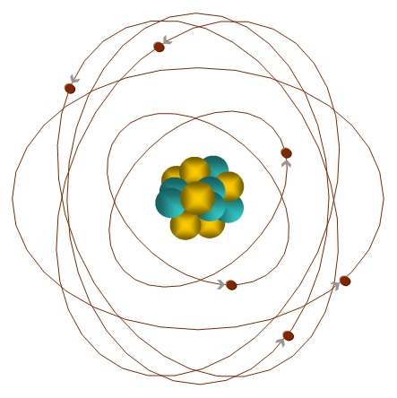
II. Structure of an atom
There are 3 subatomic particles in an atom
  Proton
  Neutron
  Electron
Can you label the protons, neutrons, and electrons on the atom above?

Slide 7
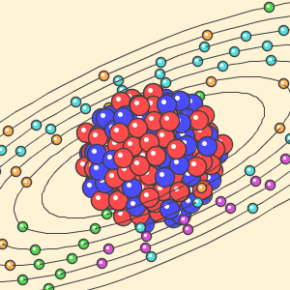
III. Atomic Nucleus
The nucleus is a dense area at the center of the atom
  Protons and neutrons are found in the atomic nucleus
Protons have a positive charge
Neutrons have no charge (neutral)

Slide 8
THE PROTON
Found in the nucleus
Heavy: 1 amu
Positive: +1
p⁺

Slide 9
THE NEUTRON
😐
Located in the nucleus.
Heavy: 1 amu
Neutral: 0 charge
N°

Slide 10
Nucleus is held together with nuclear energy
Electron cloud is full of zipping electrons

Slide 11
Nucleus: heavy but tiny part of atom.
Found in center of an atom and holds 2 important subatomic parts.
Outer Edge of Atom
½ Football Field
End Zone
Nucleus
50

Slide 12
IV. Electrons
Electrons have a relatively small mass compared to protons and neutrons
Electrons are found far away from the nucleus in an area called the electron cloud
Electrons have a negative charge

Slide 13
THE ELECTRON
Found in the electron cloud
Very light: 0 amu
Negative: -1
e⁻

Slide 14
V. How small is an atom?
Atoms are TINY!
20 million hydrogen atoms would fit inside the period at the end of this sentence.
You are made of billions and billions of atoms

Slide 15

Elements
pure substance that cannot be separated into simpler substance by physical or chemical means.

Slide 16
Compounds
Pure substance composed of two or more different elements joined by chemical bonds.
  Made of elements in a specific ratio
  that is always the same
  Has a chemical formula
  Can only be separated by
  chemical means, not physically
H₂O
NaCl
CO₂

Slide 17
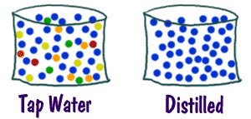
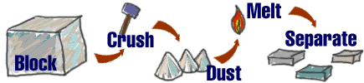
Mixtures
A combination of two or more pure substances that are not chemically combined.
substances held together by physical forces, not chemical
No chemical change takes place
Each item retains its properties
in the mixture
They can be separated physically
Chem4kids.com

Slide 18
Types of Mixtures
Homogenoeus Mixtures
Heterogeneous Mixtures
A homogeneous mixture is a mixture that is evenly distributed
Homogeneous mixtures are commonly called solutions.
  Solution = Solute + Solvent
    Solute: “stuff” being dissolved
    Solvent: “stuff” doing the dissolving
A heterogeneous mixture is a mixture that is unevenly distributed.
Examples:
  Ice tea
  Chex Mix

Slide 19
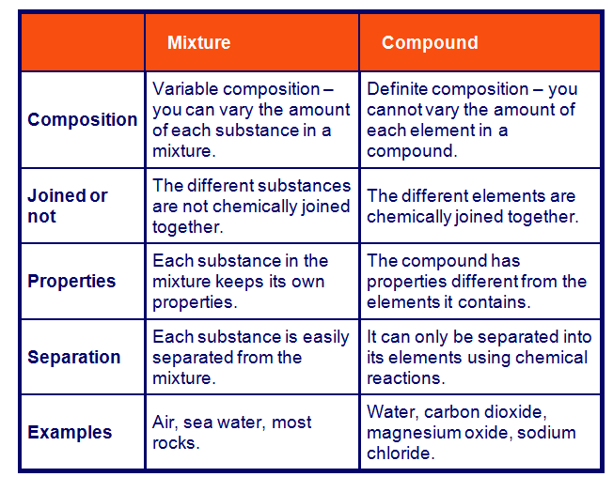
Mixtures vs. Compounds
http://www.bbc.co.uk/schools/ks3bitesize/science/chemistry/elements_com_mix_6.shtml

Slide 20
Can you identify the following?
You will be shown a series of photos. Tell if each photo represents an item composed of an element, compound, or mixture.
Review:
An atom is the smallest unit of matter.
An element contains just one type of atom.
A compound contains two or more different elements chemically joined together.
A mixture contains two or more different substances that are only physically joined together, not chemically.
  A mixture can contain both elements and compounds.

Slide 21
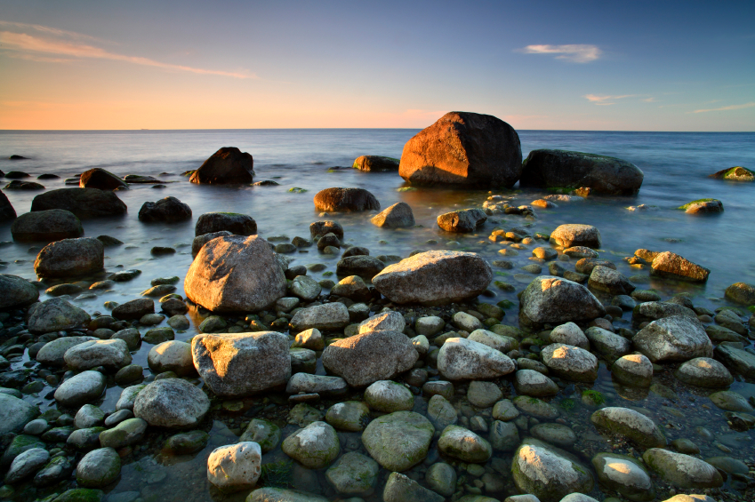
Element, Compound, or Mixture?
Rocks

Slide 22
Element, Compound, or Mixture?
Rocks

Slide 23
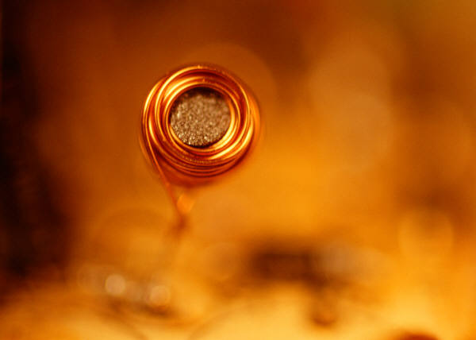
Element, Compound, or Mixture?
Copper

Slide 24
Element, Compound, or Mixture?
Copper
Cu

Slide 25
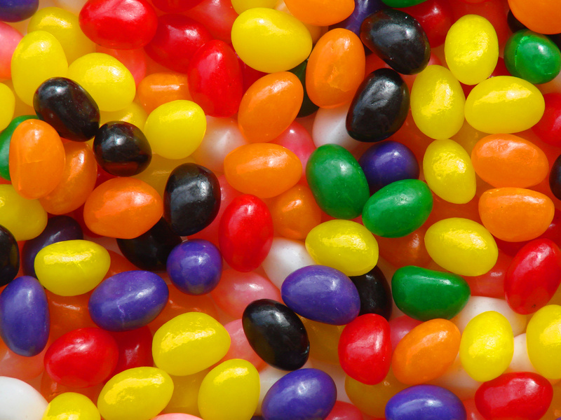
Element, Compound, or Mixture?
Jelly Beans

Slide 26
Element, Compound, or Mixture?
Jelly Beans

Slide 27
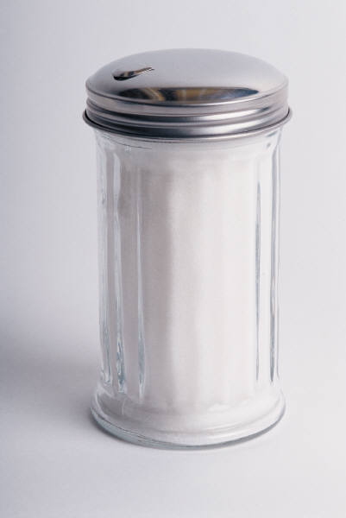
Element, Compound, or Mixture?
Table Sugar

Slide 28
Element, Compound, or Mixture?
Table Sugar
C₁₂H₂₂O₁₁

Slide 29
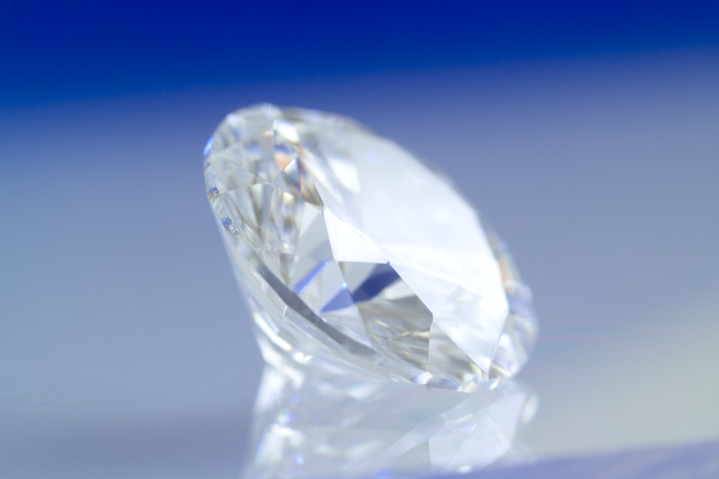
Element, Compound, or Mixture?
Diamond

Slide 30
Element, Compound, or Mixture?
Diamond
C

Slide 31
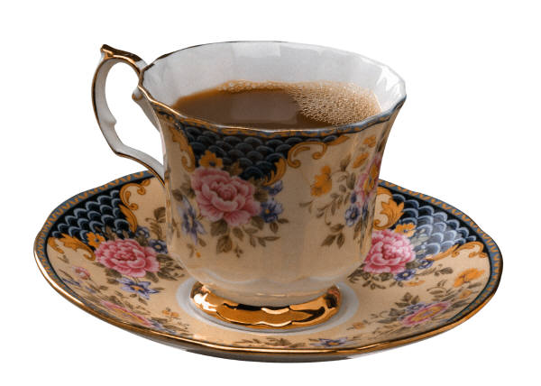
Element, Compound, or Mixture?
Tea

Slide 32
Element, Compound, or Mixture?
Tea

Slide 33
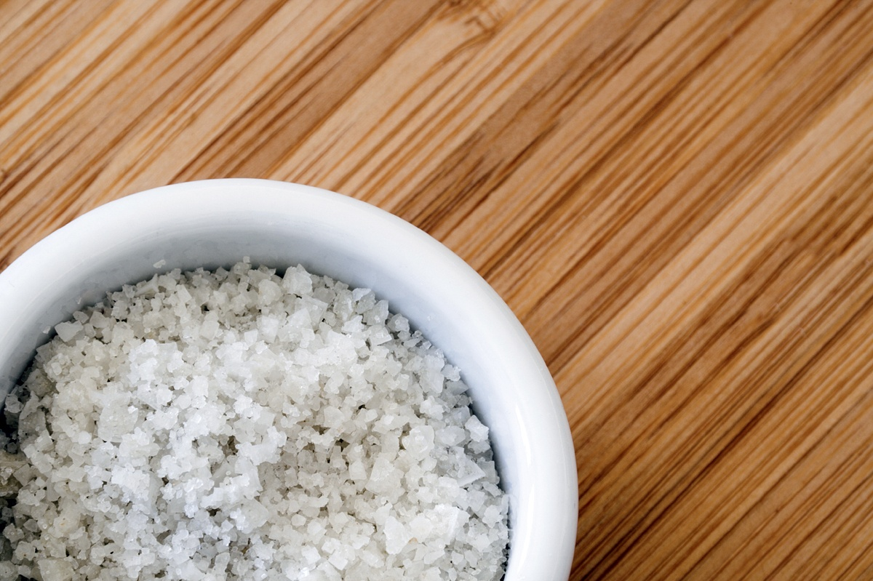
Element, Compound, or Mixture?
Salt

Slide 34
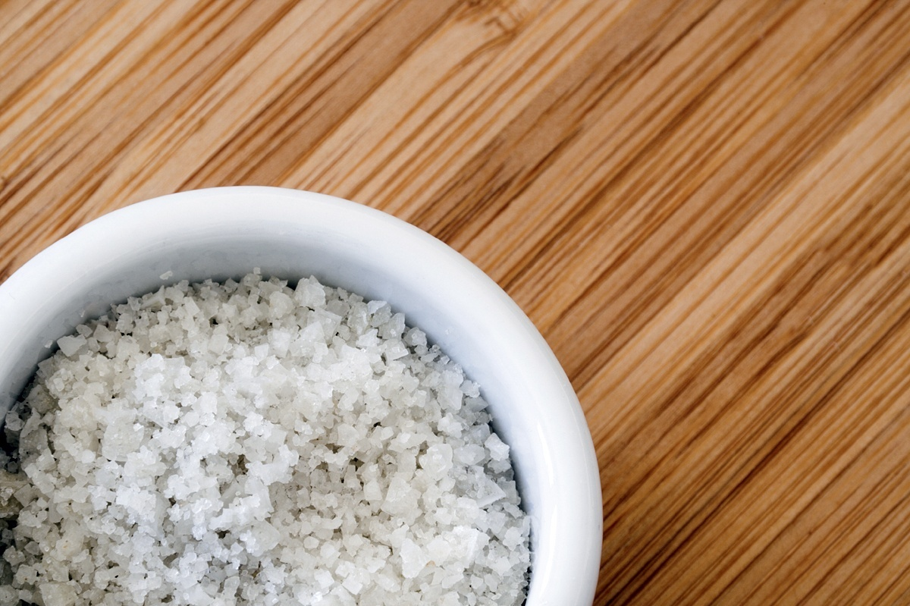
Element, Compound, or Mixture?
NaCl
Salt

Slide 35

Element, Compound, or Mixture?
Neon Gas

Slide 36
Element, Compound, or Mixture?
Ne
Neon Gas

Slide 37
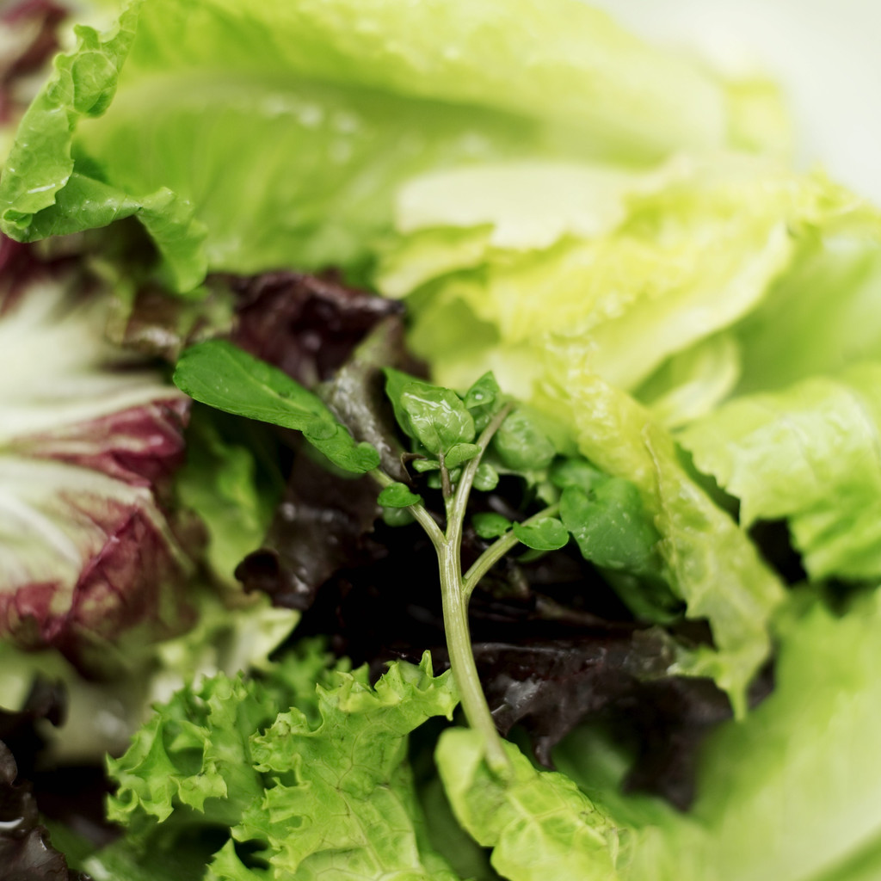
Element, Compound, or Mixture?
Salad

Slide 38
Element, Compound, or Mixture?
Salad

Slide 39
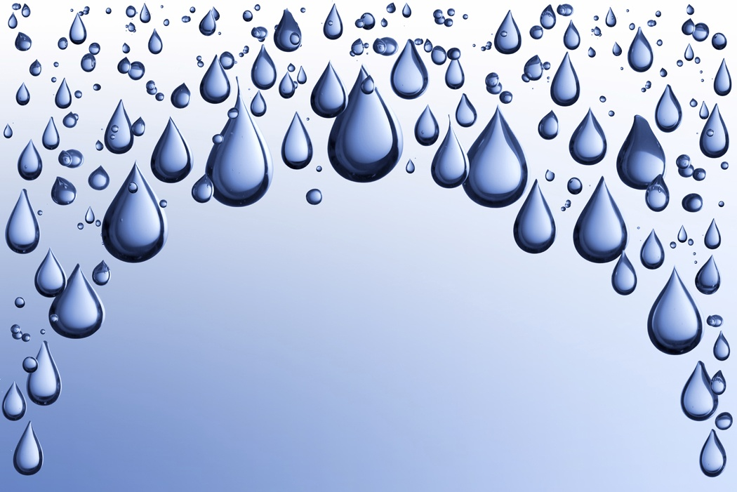
Element, Compound, or Mixture?
Pure Water

Slide 40
Element, Compound, or Mixture?
Pure Water
H₂O

Slide 41
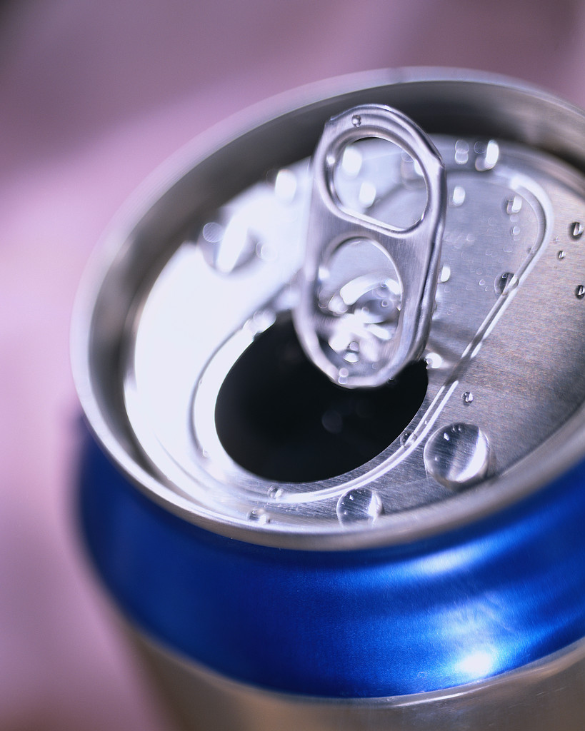
Element, Compound, or Mixture?
Aluminum

Slide 42
Element, Compound, or Mixture?
Aluminum
Al

Slide 43
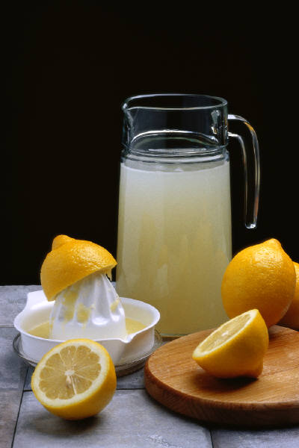
Element, Compound, or Mixture?
Lemonade

Slide 44
Element, Compound, or Mixture?
Lemonade

Slide 45
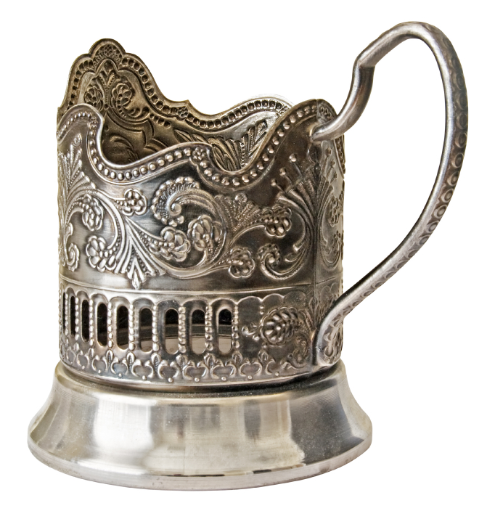
Element, Compound, or Mixture?
Silver

Slide 46
Element, Compound, or Mixture?
Silver
Ag

Slide 47
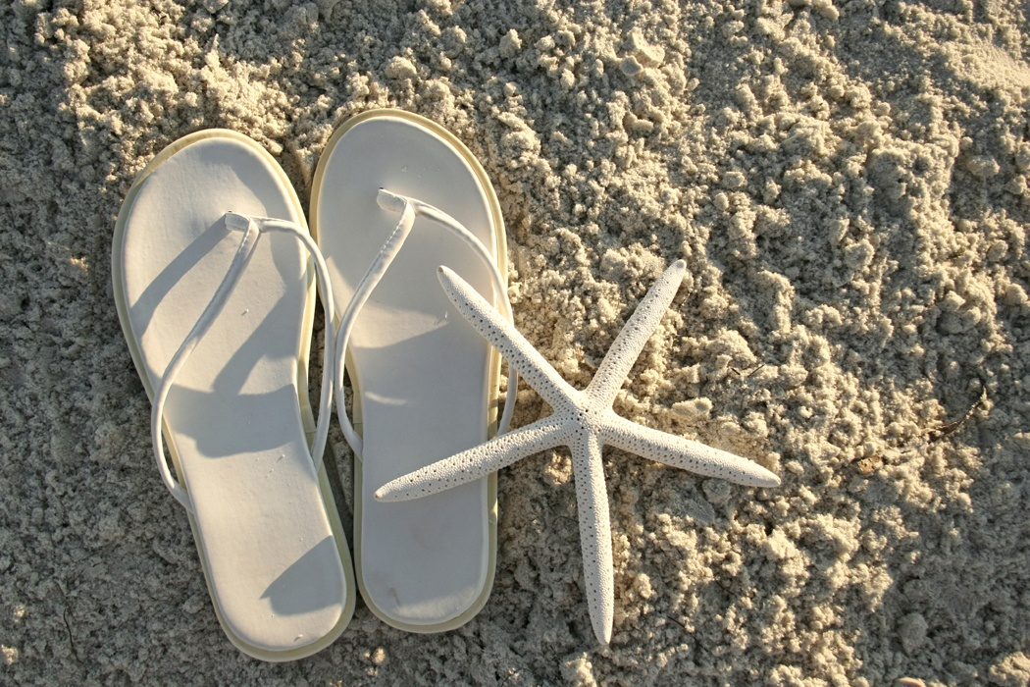
Element, Compound, or Mixture?
Sand

Slide 48
Element, Compound, or Mixture?
Sand

Slide 49
