Slide 1
Evolution, Natural Selection, and Genetic Variation
What is Evolution?
How does Natural Selection work?
Who helped to understand the process of Natural Selection?
What proof do we have that Natural Selection works?

Slide 2
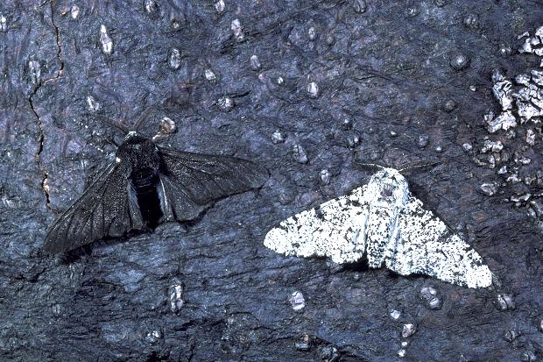
Peppered Moth Simulation
Read through the background information.
Complete the data chart using data from the simulation.
Complete the final Analysis
Glue on to pg. 117 of your notebook.

Slide 3
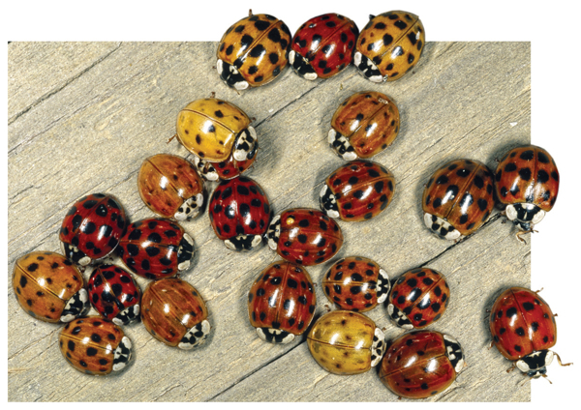
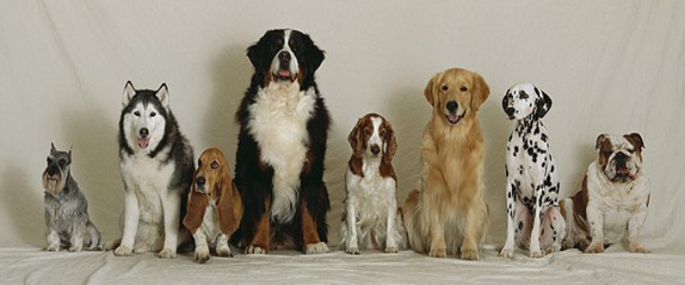
Species and Species Variation
Species- A group of organisms that are able to produce offspring that are healthy and capable of reproducing offspring.
Examples of different species:
Humans, blue whale, dogs, dogwood trees
Grey squirrels, white tail deer
Genetic Variation- Not all organisms of the same species look or act alike. Example: humans have different eye, skin and hair color.

Slide 4
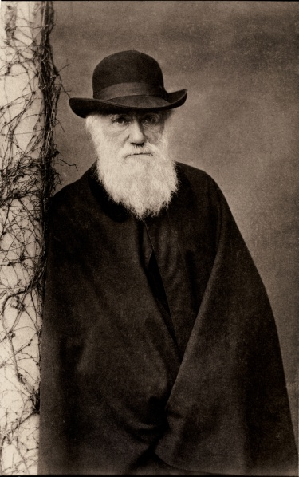
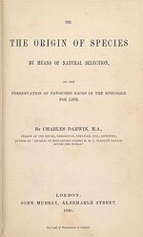
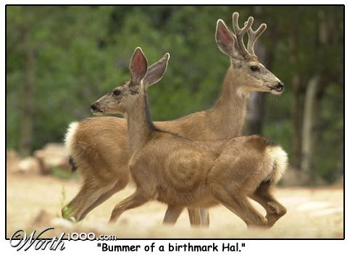
Charles Darwin and Natural Selection
Charles Darwin is a naturalist who wrote the book On The Origins of Species in 1859 . The book presented evidence and proposed a mechanism for biological evolution called natural selection.
Natural Selection- Natural selection is the gradual process by which certain traits in a population become more common as a function of reproductive success.

Slide 5
The Theory of Evolution says…..
Some organisms within a species are better suited for certain environments than others.
Organisms within a species that are not well suited for a certain environment will not survive. Aka “survival of the fittest”
If all of the organism within a species are unable to adapt to an environmental change, the species become extinct.

Slide 6
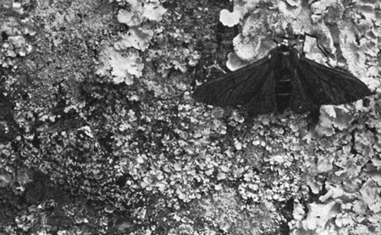
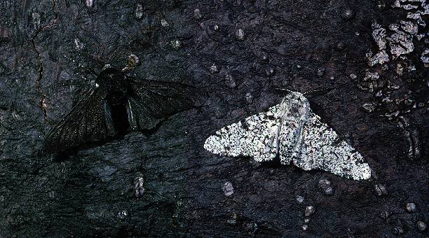
Natural Selection in Action
Peppered Moth
Antibiotic Resistance Bacteria
The peppered moth has two color variations, light colored and dark colored.
The dominant color is relates to the color of tree bark they are found in.
Camouphlage prevents predation which increases the number of moths best suited for the environment.
New diseases are on the rise as bacteria have adapted to antibiotic use.
Example: MRSA,

Slide 7
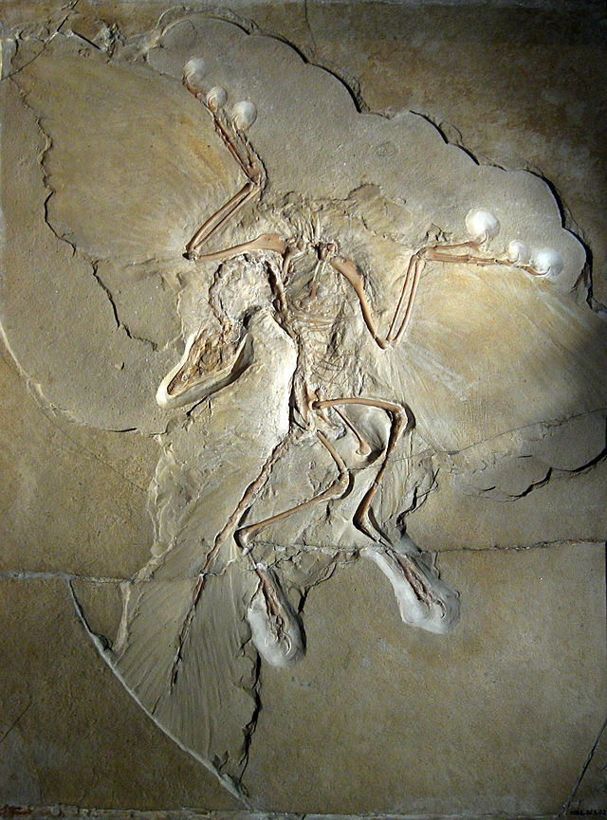
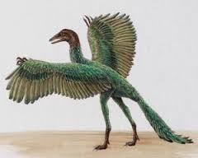
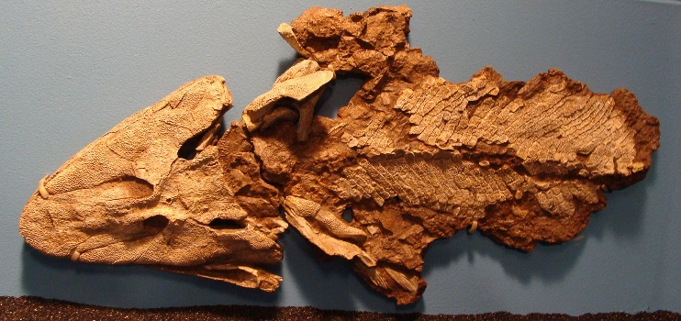
Transitional Fossils
A transitional fossil is any fossilized remains of a life form that exhibits traits common to both an ancestral group and its derived descendant group
Tiktaalik
Archaeopteryx, sometimes referred to by its German name Urvogel, is a genus of bird-like dinosaurs that is transitional between non-avian feathered dinosaurs and modern birds. Wikipedia

Slide 8
Classwork
Peppered Moth Activity- Using the peppered Moth cut out, Cut out the moth and choose a location in the room to camouflage it. You can use colored pencils or markers to help you.
Tape it to the location.
We will find them next week.

