Slide 1
Food and Energy
How do we get the energy we need?

Slide 2
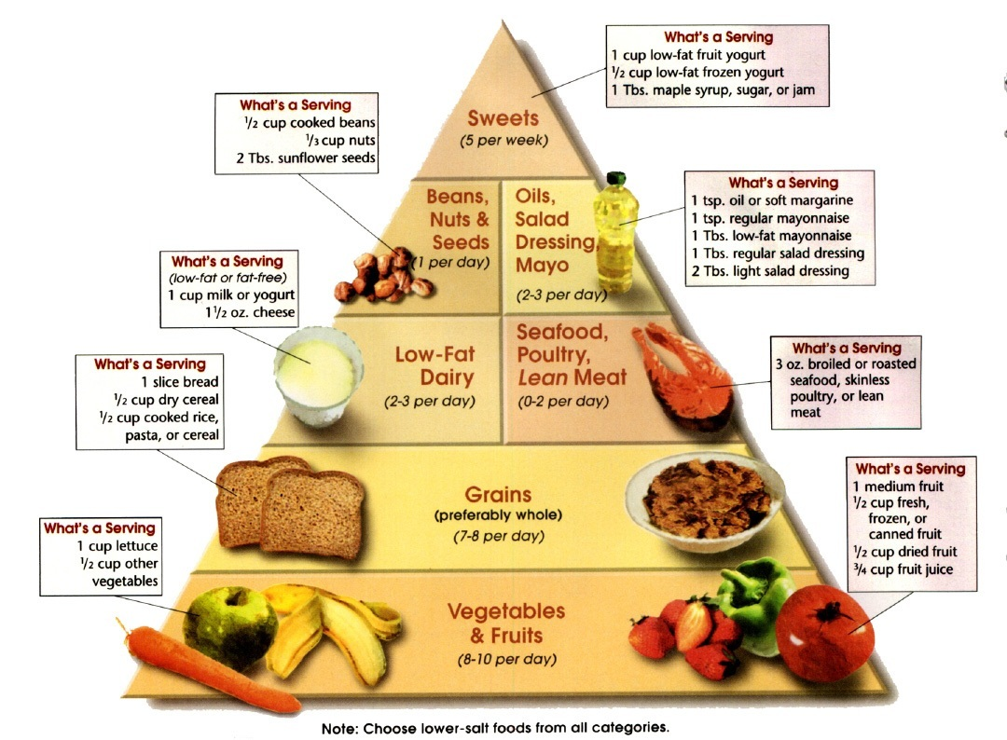

Slide 3
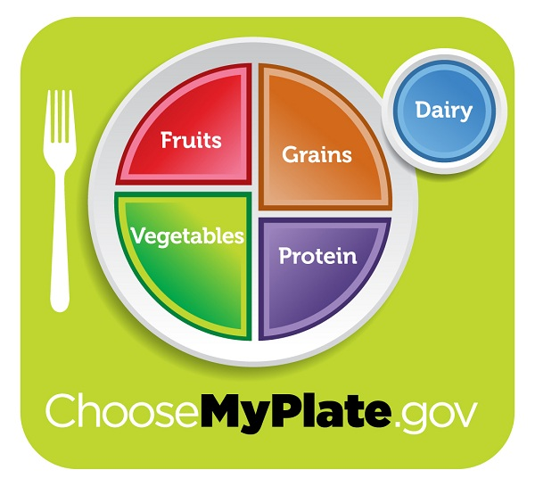
MyPlate illustrates the five food groups that are the building blocks for a healthy diet using a familiar image – a place setting for a meal.
Before you eat, think about what goes on your plate or in your cup or bowl.
Fill in your plate based on your food journal.
Did you have enough servings?

Slide 4
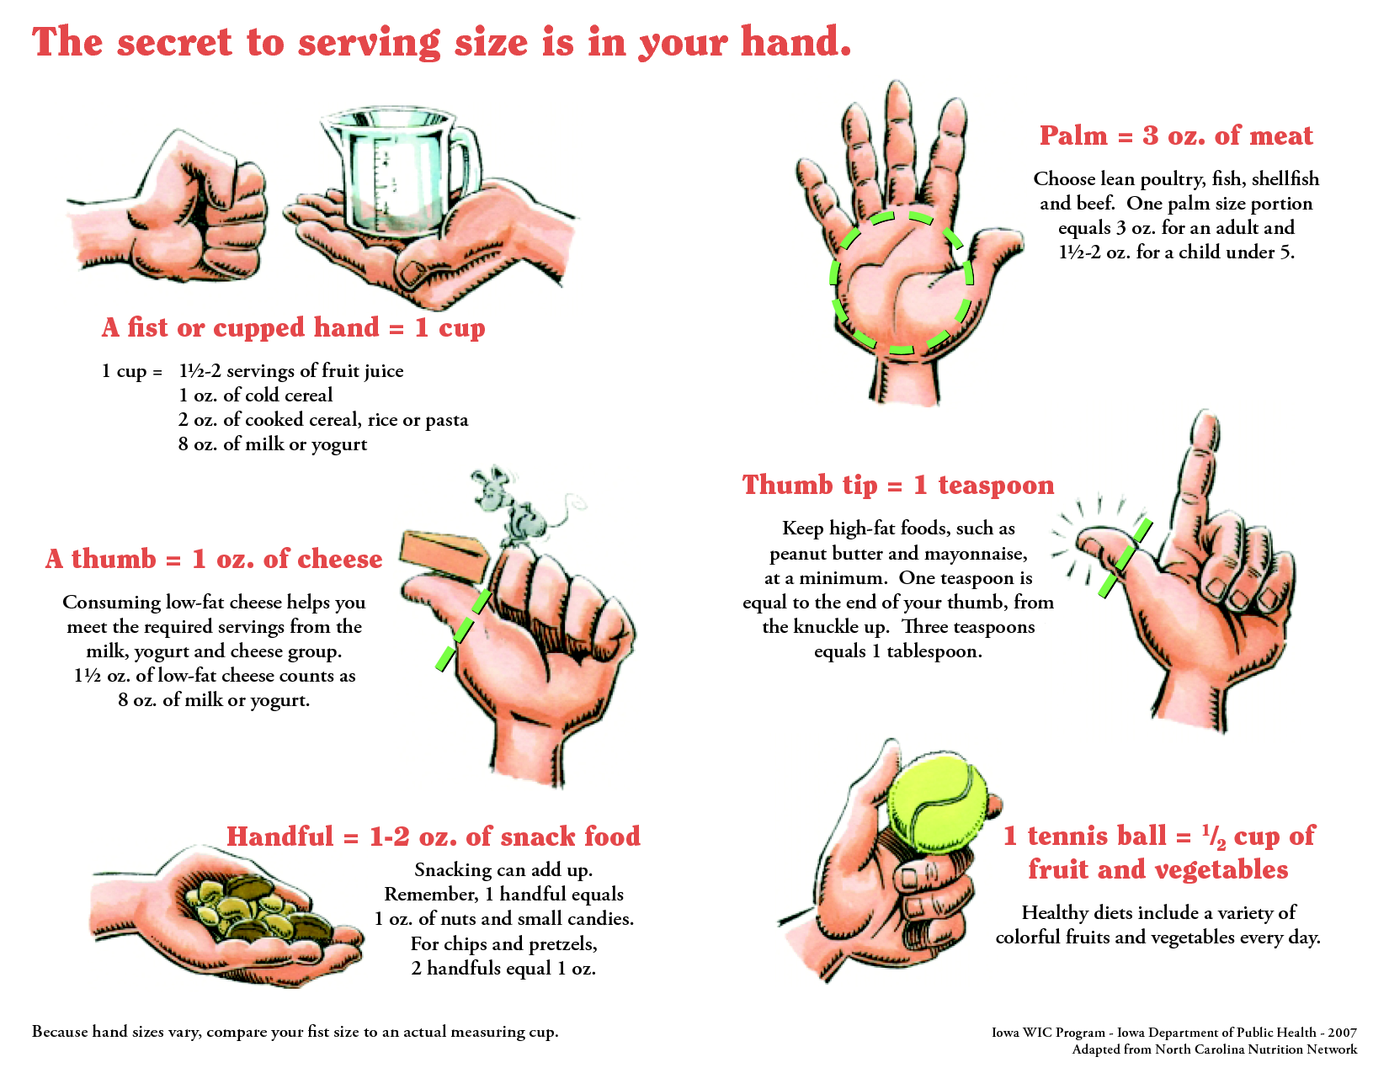

Slide 5
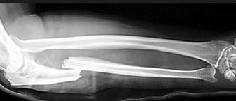
Why do we need food?
Materials for growing and repairing tissues.
Energy for everyday life

Slide 6
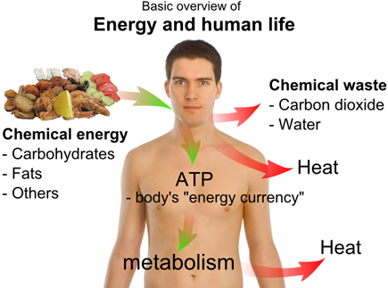
What are nutrients?
Substances in food that provide the raw materials and energy our bodies need.
Six necessary nutrients
Carbohydrates
Fats
Proteins
Vitamins
Minerals
Water

Slide 7
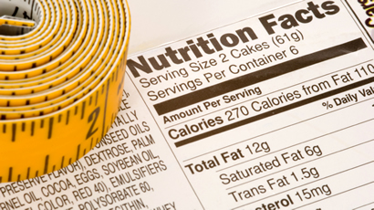
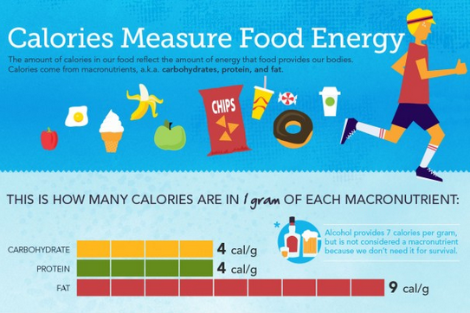
How do we get energy?
A Calorie is the measure of energy in foods.
Most individuals need 2000 Calories/ day.

Slide 8
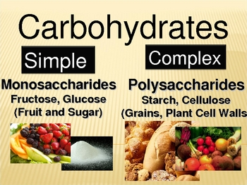
What are Carbohydrates?
Composed of carbon, oxygen and nitrogen.
Major source of energy
Provide the raw materials to make cell parts.
Two types
Simple Carbohydrates– sugar and glucose
Complex Carbohydrates- Starches including potatoes and rice

Slide 9
What exactly are fats?
Energy containing nutrients that are composed of carbon, oxygen, and hydrogen
Contains more that twice the energy of carbohydrates.
Important functions include:
Forms the cell membrane of our cells
Protects and supports internal organs and insulates the body.

Slide 10
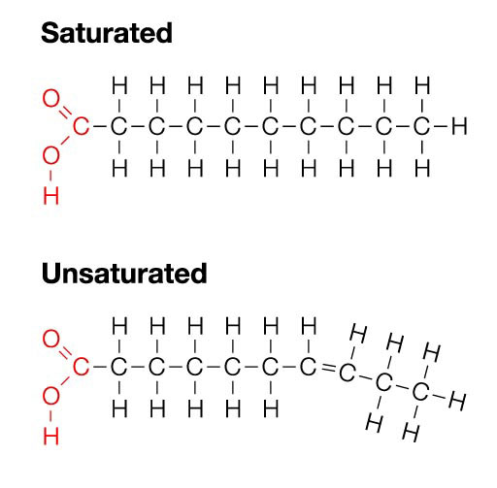
What are the types of fat?
Unsaturated- vegetable oils
Liquid in room temperature
Beneficial in certain amounts
Saturated- meats and dairy products
Solid at room temperature
Should be limited in your diet

Slide 11
What are proteins?
Nutrients that contain nitrogen, carbon, hydrogen and oxygen.
Needed for tissue growth and repair.
Important role in chemical reactions in cells– catalysts.
Source of energy but not as important as carbs and fats.
Complete proteins contains all essential amino acids– meats and eggs
Plant sources of proteins are incomplete
Amino acids are the building blocks of proteins.

Slide 12
What are Minerals and Vitamins
These are not food, but are necessary for organisms to carry out biological processes.
Minerals: (not made by living things)
Ca (calcium): used for muscle movement, for nerves to carry messages between the brain and every body part, for structural strength of bones and teeth
Iron: needed by red blood cells to carry oxygen, used by muscles to store oxygen.
Salt (NaCl): needed to help maintain correct fluid levels, transfer information in muscle and nerve fibers
Vitamins: (made by living things) most vitamins function as catalysts for reactions within the body. Many of the enzymes in your body don’t “work” unless their physical structure is changed by a vitamin

Slide 13
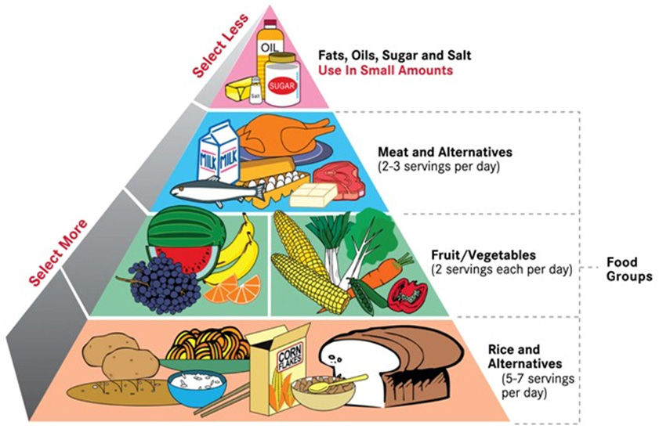
lipids
protein
carbohydrates
carbohydrates

