Slide 1
Geologic Time Scale
8th Grade Science

Slide 2
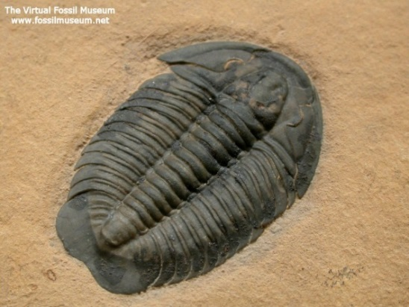
Geologic Time
Geologic time - Earth’s history is divided into units of time that make up the Geologic Time Scale.
Time units on the scale are based on the appearance (discovery) or disappearance (mass extinction) of types of organisms.
Example: Trilobites, a type of index fossils that live during specific periods of time.
Look at your Geologic Time Scale
When did Trilobites appear?
When did they go extinct?

Slide 3
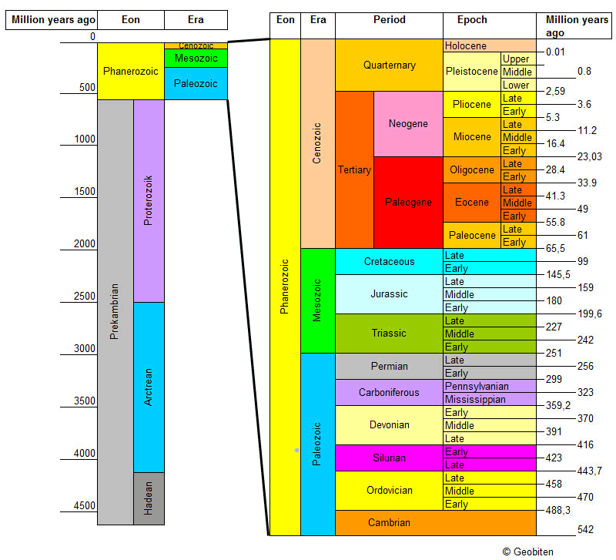
Geologic Time
Geologic time is divided into 4
major subdivisions:
Eons- longest subdivision; based on
abundance of fossils
Eras- marked by significant worldwide
changes in the types of fossils present in rock
Periods- Based on types of life existing
worldwide at a particular time
Epochs- characterized by differences in
life-forms, but differences can be regional
rather than global

Slide 4
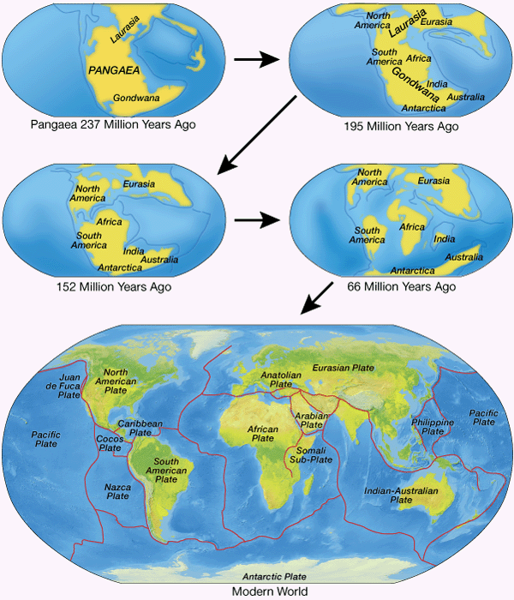
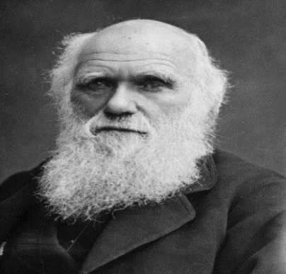
Changing over time
The Fossil Record indicates that species have changed and adapted over time.
Charles Darwin is responsible for proposing Natural Selection to explain change in species (Theory of Evolution).
The Plate Tectonic Theory explains how continents moving throughout time have influenced the environments of past organisms.

Slide 5
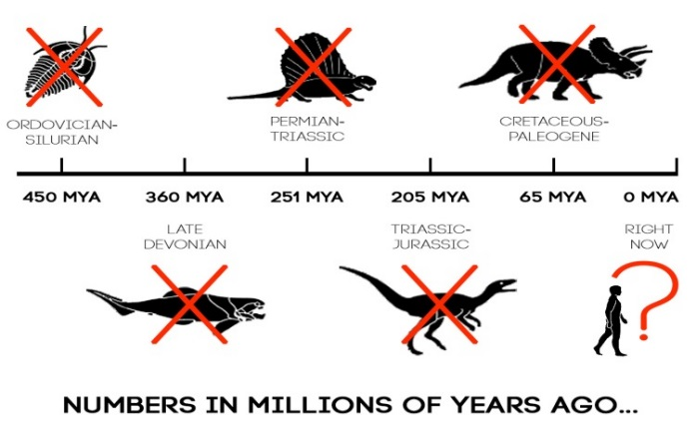
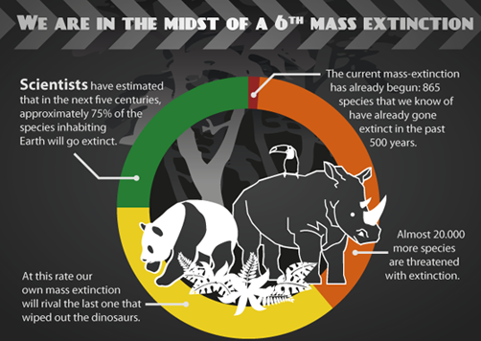
Mass Extinction
Mass Extinction - periods in Earth's history when abnormally large numbers of species die out simultaneously or within a limited time frame.
The end of an Era is marked by a Mass Extinction.
The most severe occurred at the end of the Paleozoic Era when 96% of all species perished.

Slide 6
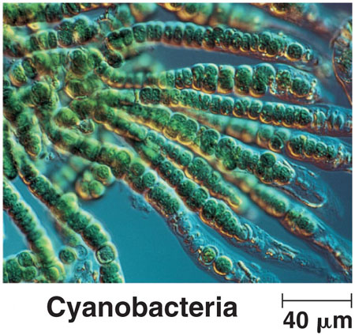
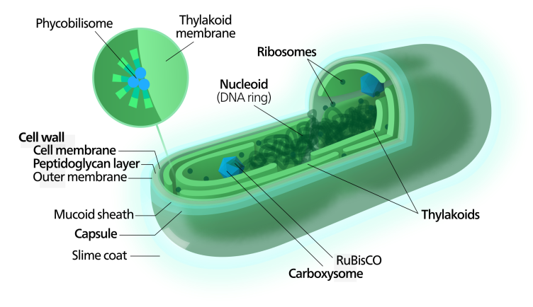
Precambrian Time 4 billion - 544 million years ago
Very few fossils remain from this time.
Many Precambrian rocks were deeply buried, causing the fossils in them to be changed by heat and pressure.
Most Precambrian organisms lacked hard parts.
Cyanobacteria are blue-green algae, one of the earliest life forms to appear.

Slide 7
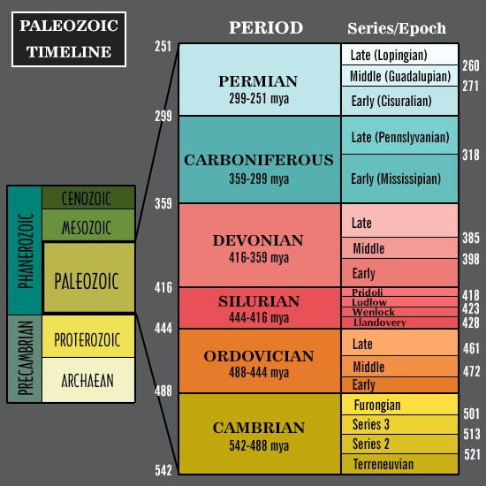
Paleozoic Era 540 - 245 million years ago
Invertebrates with shells evolved in the warm, shallow seas.
Amphibians evolved to survive in water and on land.
Reptiles evolved from amphibians to survive farther from water.
Plate Tectonics caused mountains to form as Pangaea comes together.
Most marine species became extinct at the end of the Paleozoic Era.
Mass Extinction = Marine Species like Trilobites and Ammonites

Slide 8
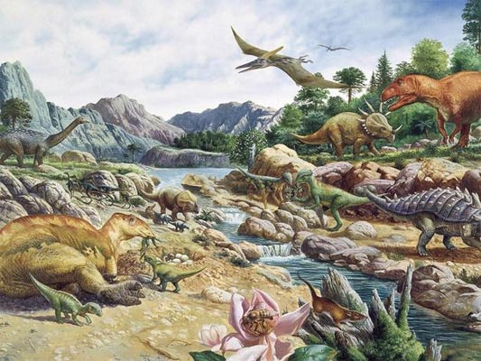
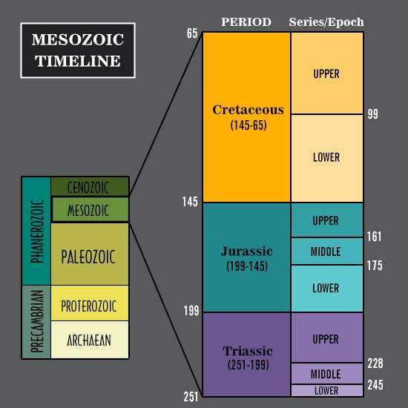
Mesozoic Era 245 - 65 million years ago
Pangaea separated into continents and the climate became drier.
Dinosaurs dominate.
Birds appear during the Jurassic Period.
Small, mouse-like mammals appear in the Triassic Period.
Flowering plants appeared during the Cretaceous period.
Due to extreme climate change from volcanic activity and meteors, the dinosaurs die off.
Mass Extinction = Dinosaurs

Slide 9
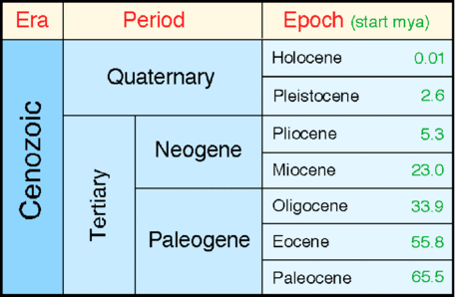
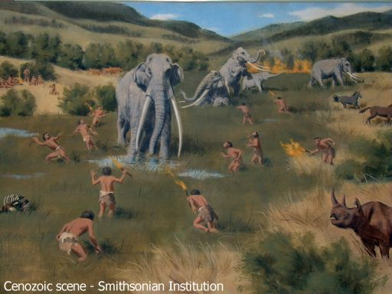
The Cenozoic Era 65 million years ago – Present Day
Many mountain ranges formed.
Colder climates; 3 Major Ice Ages occur during this Era.
Mammals continued to evolve.
Many species became isolated as the continents continued to separate.
Fossils of homo sapiens (humans) show their appearance about 400,000 years ago.
No Mass Extinction yet… when one occurs a NEW Era will begin.

Slide 10
Classwork
Using the book (pp. 346- 349) place the events in the appropriate era.
Determine what era they occur in and whether each is an example of a biological change or geological change.

