Slide 1
Graphing in Science
Graphs are pictures of you data and can reveal patterns and trends in data.

Slide 2
Types of graphs
Bar Graphs: Show comparison between collected data. The x data do not have to be numbers.
Histograms: show intervals between collected data. Both the x and y axis DO have to be numbers.
Pie Graphs: Show ratios of Parts to the Whole. The data has been converted into percentages
Line graphs: Show how the dependent (y) variable changes in response to the independent (x) variable
Scatter plots: Show a relationship between quantitative data collected in an experiment. Shows coordinate points and a line of best fit.

Slide 3
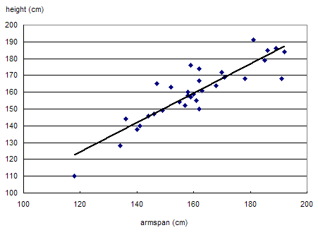
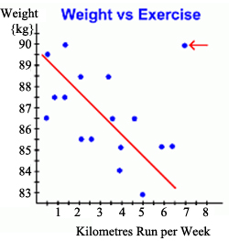
Relationship between data
Positive Correlation: show that as one data set increases the other increases
Negative Correlation: shows that as one data set increases the other decreases.
A line of best fit emphasizes the overall trend of the data as whole.

Slide 4
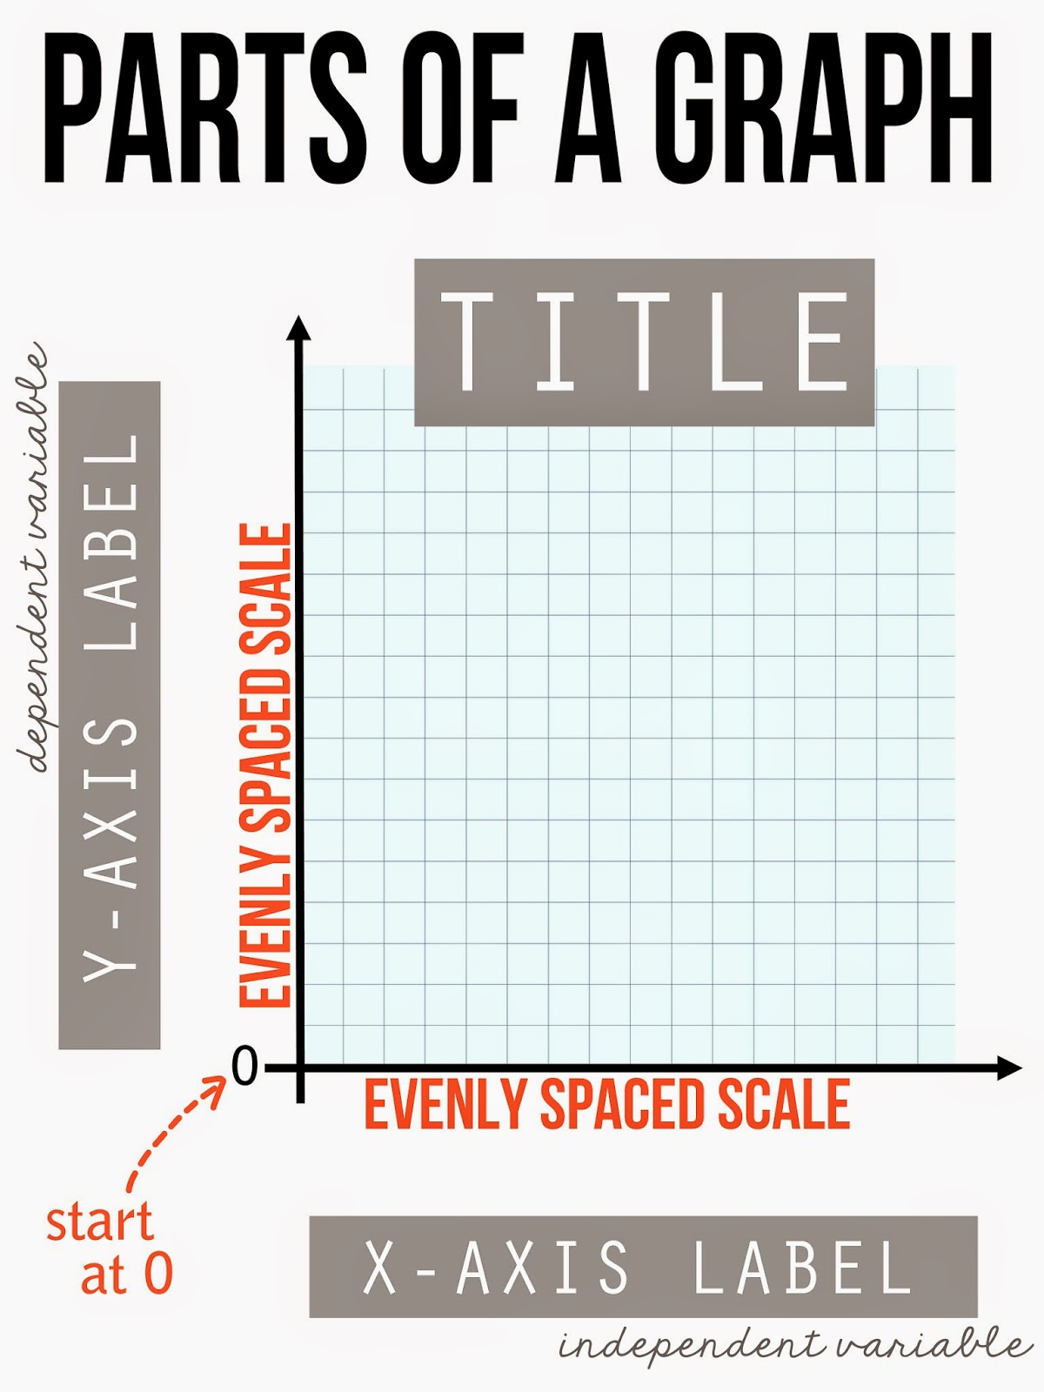
Parts of a graph
Horizontal axis is for the x coordinates
Vertical axis is for the y coordinates
Origin is the point where x and y axes meet.
X axis is the independent variable
Y axis is the dependent variable
All axes should be labeled including the Unit of measurement
All graphs need equally spaced intervals called a scale. Each axis may have a different scale.
All graphs should have a title. ( Dependent vs. Independent)
Data points show the locations of a piece of data

Slide 5
Graphing Practice
Complete the foldable.
Each skill with your partner! Make sure to read the directions and use your notes to help you.

Slide 6
The Scientific Method
What are the steps in the scientific method?
What variables are necessary in the scientific method?

Slide 7
Designing an experiment
Scientists design experiments to explain cause and effect relationships in nature.
These changing quantities are called variables. A variable is any factor that changes. An experiment usually has 3 variables: independent, dependent and controlled.
The independent variable is the one that is changed by the scientist. As the scientist changes the independent variable, he or she observes what happens.
The dependent variable acts in response to the independent variable. ( which variable dependents on the other to happen?

Slide 8
The steps of the scientific Method
1. Make an Observation
2. Develop a Hypothesis
3. Make an experiment
4. Cary out the experiment and analyze the results
5. Draw conclusions

Slide 9
Vocabulary
Control Group- Part of an experiment that serves as a basis of comparison to determine the effects of the variable (ex. Plants that don’t receive miracle-gro or receive regular sunlight)
Constants—Factors in the experiment that remain the same for all parts of the experiment (ex. Type of plant, type of soil, amount of light)
Experimental Group- The set up that contains the independent variable. Usually a large sample is needed to make sure that results are correct (ex. For average height of 14 year old boys, measured 100 people is more accurate than measuring 10)

Slide 10
Vocabulary (Con’t)
Independent Variable- In the x-axis, the variable being acted upon (ex. changing the color of light)
Dependent Variable- In the y axis, the variable that changes as a result of the independent variable. This is what you measure and observe in the experiment (ex. The height of the plants)
Scientific Theory- A well- supported hypothesis that has been tested many times, and has not been found to be incorrect (ex. Darwin’s theory of evolution by natural selection)

Slide 11
Problem-Does the color of light effect the growth of plants? Hypothesis?
Experiment
Manipulating/ Independent variable variable?
Responding/ dependent variable?
Control?
RED
BLUE
GREEN
?
Height (AVG)
15.6 cm
16.1 cm
14.6 cm
20.3 cm
Conclusions?

