Slide 1
Nature’s Natural Filter
Explain what makes soils such as gravel and sand permeable.
Define groundwater.
Describe three ways we can obtain groundwater.

Slide 2
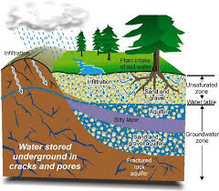
How Water Moves underground
Underground water comes from precipitation
Water trickles down between particles of soil and through cracks and spaces in layers of rock

Slide 3
Effects of Different Materials
Different types of rock and soil have different sized spaces, or pores, between their particles. These are described as their porosity.
Materials that allow water to pass through easily are called permeable.
Sand or gravel
Materials that do not allow water to pass through easily are called impermeable.
Clay or granite

Slide 4
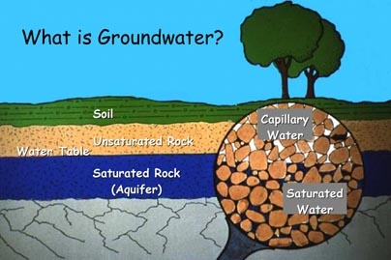
Water Zones
Water passes through the permeable material until it reaches the impermeable layer
It begins to fill in the spaces in the permeable layer above it.
The permeable layer that is filled is called the saturated zone.
The top of the water is called the water table, it does not always stay at the same level.
Any rock and soil above the water table is the unsaturated zone.
Label the diagram on the back. Include the aquitard, the saturated zone and the unsaturated zone.

Slide 5
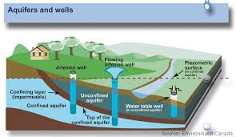
Bringing Up Groundwater
An aquifer is an underground layer of rock or sediment where water has collected.
They range in size from a small patch to an area the size of several states.

Slide 6
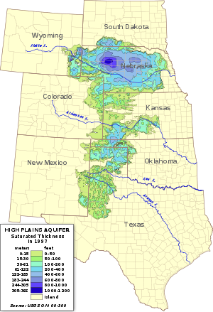
Bringing Up Groundwater
Of the largest, the Ogallala, is under the Midwest plains, from South Dakota to Texas.
Water is the aquifer is not still, it is continuously moving.
People can get water from an aquifer by drilling a well below the water table.
When water is pumped out it lowers the water table. And the aquifer must be recharged when new water from the surface enters the aquifer.

Slide 7
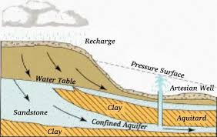
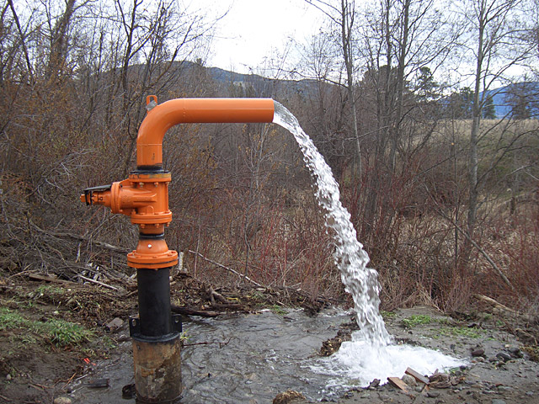
Bringing up water (con’t)
Water that has collected between impermeable layers is under great pressure.
If you drill the water can flow out because of the pressure within he aquifer, this is called an artesian wells.

Slide 8
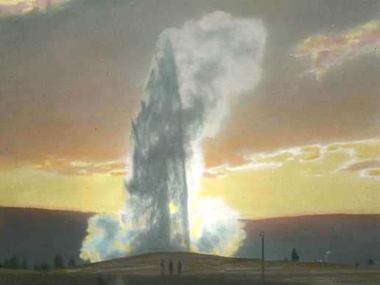
Bringing up water (con’t)
Springs are a place where groundwater bubbles or flows out of cracks in the rock.
Some springs can have warm or even hot water which has been heated by rocks deep underground.
A geyser is a hot spring in which the water is under pressure, as the pressure builds it will eventually erupt into the air gushing hot water and steam.
Old Faithful is a famous geyser in Yellowstone National Park.

Slide 9
Compare how we get our water. (p. 83- 85)
Well
Artesian Well
Spring/ Geyser

Slide 10
Exit Tickets
Answer the EQ questions on the board.
Explain what makes soils such as gravel and sand permeable.
Define groundwater.
Describe three ways we can obtain groundwater.

