Slide 1
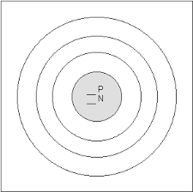
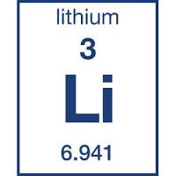
How to Make a Bohr model.
Atomic Number
P= ______ e= ____
Atomic Mass
P= ____ N= ___
Remember:
Atomic number = # of protons and electrons
Atomic mass= 3 of protons and neutrons
Draw the nucleus.
Write the number of protons (P) and neutrons (N) with in the nucleus.
Draw dots to represent the electrons in their shells beginning with the first shell.
1st shell= 2 electrons
2nd Shell = 8 electrons
3rd- 5th shell= 18 electrons
5th- 7th shell= 32 electrons.
Valence electrons= electrons on the outer shell

