Slide 1
Four Corners
Where is most of the water on Earth found? Oceans, Rivers, Lakes, Ice
Where is most of the freshwater on Earth found? Oceans, Rivers, Lakes, Ice
Where is most of the accessible freshwater located? Oceans, Rivers, Lakes, Ice

Slide 2
The Structure of Hydrosphere
Unit 3: Part 3
8th Grade Curriculum – Developed for NCDPI - 2008

Slide 3
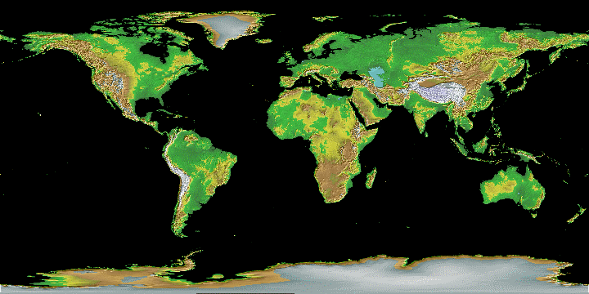
Hydrosphere- All the water on Earth

Slide 4
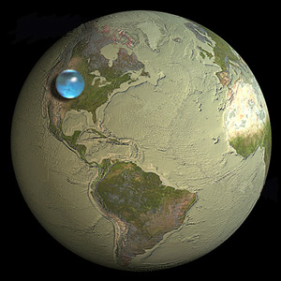
How much of the Earth’s surface is water?
Earth is The Water Planet or is it?…
75% of the Earth's Surface Is WATER.

Slide 5
Think- Pair - Share
List as many sources of freshwater as you can. These should be natural sources of freshwater.

Slide 6
The Structure of Hydrosphere
Oceans—97% of water found here
Fresh water—3% of water found here
Potable water- 0.03%
Fresh water distribution:
Ice: 76%
Surface .4%
Groundwater: 23%
Atmosphere and soil: 0.002%

Slide 7
Understanding Where Your Water Is Located—Oceans and Ice
What bodies of water hold the largest amount of water?
Oceans—the largest bodies of water on Earth (contain salt water only)
Desalination- the process in which salt is removed from saltwater
What features house water as ice?
Icebergs: a large piece of freshwater ice floating in open waters
Glaciers: any large mass of ice that moves slowly over land
*permanent snow areas also “house” water as ice

Slide 8
Distribution of Earth’s Water

Slide 9
Four Corners
Where is most of the water on Earth found? Oceans, Rivers, Lakes, Ice
Where is most of the freshwater on Earth found? Oceans, Rivers, Lakes, Ice
Where is most of the accessible water located? Oceans, Rivers, Lakes, Ice

Slide 10
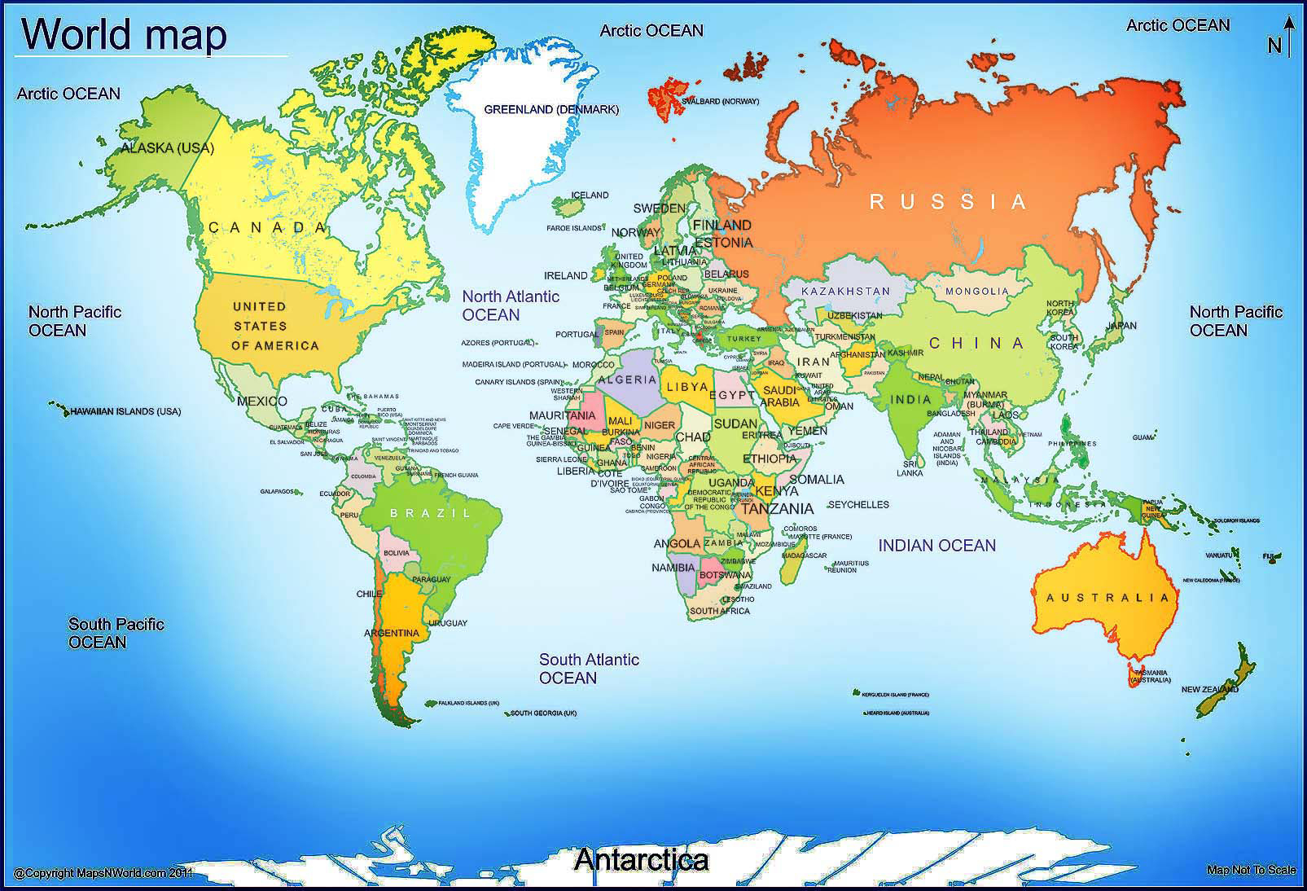
Global Water Crisis

Slide 11
The Hydrologic Cycle
What processes are part of the Hydrologic Cycle?
Explain how the Hydrologic Cycle impacts the Global Water Crisis.

Slide 12
Water Cycle Journey
Cloud-1
Mountain 2
Ocean 3
Stream/ River 4
Groundwater 5
Animal 6
Plant 7
Go to your assigned station. This is destination 1.
Choose a slip of paper out of the bag and read the statement. Record your station, directions, and destination on your log.
Stay at your station until I call “cycle”.

Slide 13
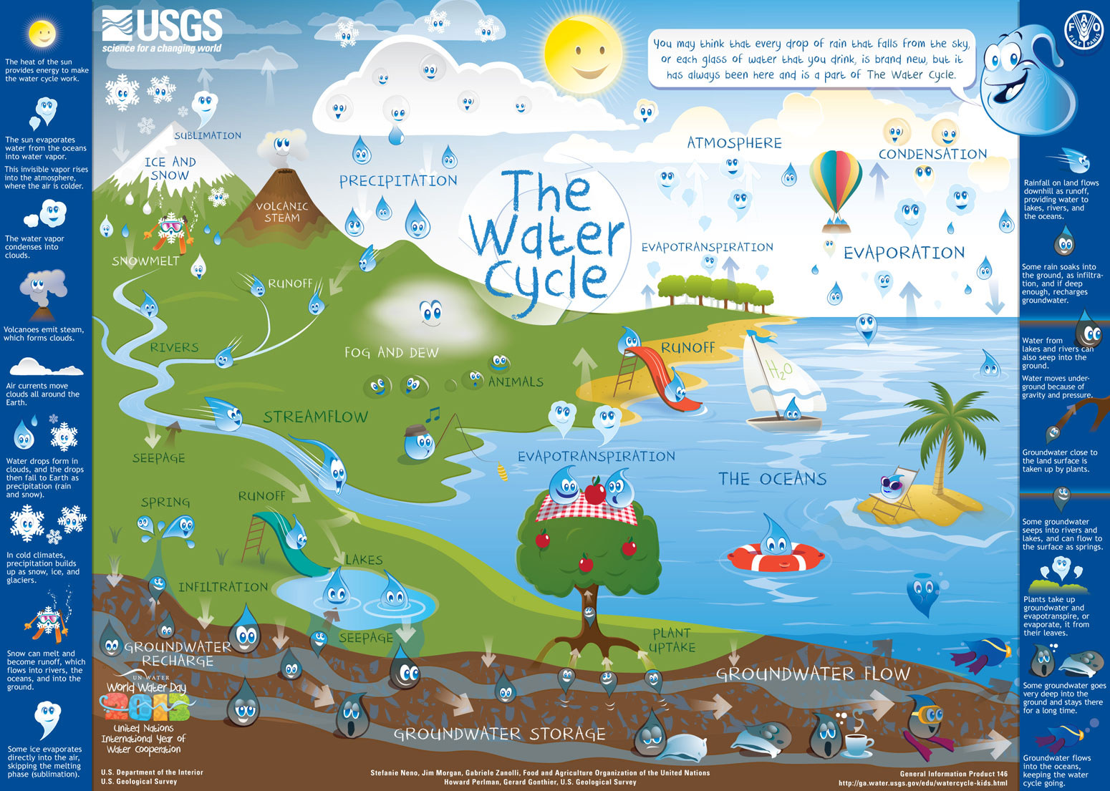
The Hydrologic Cycle

Slide 14
The Water Cycle
Water is the ultimate recycled product. It is constantly renewed and purified through the natural process of the water cycle.
Water falls from clouds as precipitation in the form of rain, snow, sleet, ice, . . .
http://www.youtube.com/watch?v=Yw275056JtA

Slide 15
Water Cycle
It can be: absorbed into the soil and stored as groundwater; it can runoff into rivers, streams, the ocean; it can evaporate back into clouds; it can be condensed from the air as dew it can be transpired by plants into the atmosphere; it can be stored in the polar ice caps.
The process continues over and over again each time cleaning and renewing the water.

Slide 16
Water Cycle- Vocabulary
Transpiration- The process of evaporation from plants is called transpiration.(In other words, it’s like plants sweating.)
Infiltration- When precipitation falls to the ground and is absorbed by the soil creating layers of water called groundwater.

Slide 17
What powers the water cycle?

Slide 18
Processes of the Hydrologic Cycle
Evaporation-The process involving a change in the state of matter from a liquid to a gas.
Condensation- The process involving a change in state from a gas to a liquid. during the process of photosynthesis.
Precipitation- Rain, snow, sleet or hail

Slide 19
Assessment
Identify the following processes involved during each step. Write them on the right hand side.
Evaporation, Condensation, Transpiration, Runoff, Precipitation, Infiltration, OTHER
Create a story or comic using the rubric provided.

Slide 20
Properties of Water
What makes water unique?
What are some of water’s unique properties?

Slide 21
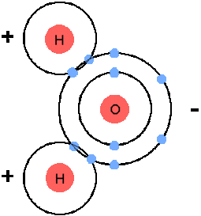
Properties of Water
Polarity-water consists of 2 hydrogen atoms which have a slight + charge and 1 Oxygen with a slight – charge. This causes water to be attracted to other polar molecules and gives water its many unique properties. These electrical forces gives water many of its unique Properties.

Slide 22
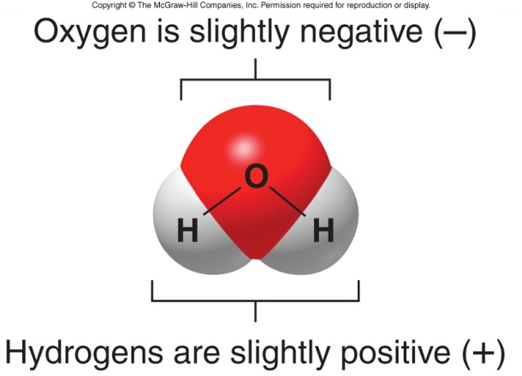
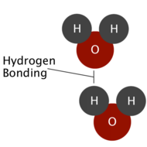
Properties of Water
Structure of Water
Water molecules will attract each other.

Slide 23
Properties of Water
Solubility- The ability of a substance(solute) to dissolve in a solvent creating a solution. Water is called the Universal Solvent because it dissolves so many substances.
Polar Substances dissolves polar substances.

Slide 24
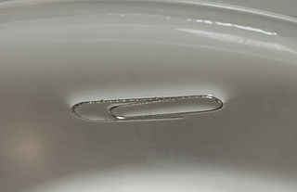
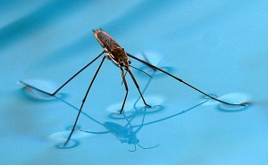
Properties of Water
Cohesion- water molecules “stick” together due to polarity. ex. # of drops of water on a penny
Surface Tension- is a property of cohesion. Water molecules are sticky and they bead together at the surface. These “sticky” molecules create surface tension. Ex. Water strider can “walk” on water

Slide 25
Properties of Water
Adhesion- the ability of to stick to other substances. Ex. Water glass sticks to coaster
Capillary Action-the ability of water to defy gravity and climb uphill. Ex. Think about how the roots of a plant deliver water and nutrients up to the stem and leaves.

Slide 26
Properties of Water
Density Anomaly- compares the mass to the volume in a ratio. Water has a density of 1 g/cm³ so it is used as a comparison for substances that sink or float.
Buoyancy-the upward force that keeps objects afloat. When placed in water an object will float if its buoyancy is greater than its weight and sink if weight is greater than its buoyancy.

Slide 27
Properties of Water
Specific Heat-the amount of heat to raise 1 gram of a material 1⁰C. Water has a specific heat of 4.179 J/g⁰C.ex.ocean water may not reach 25⁰C till late July even though there have been 20 days with temperature of 35⁰C.

Slide 28
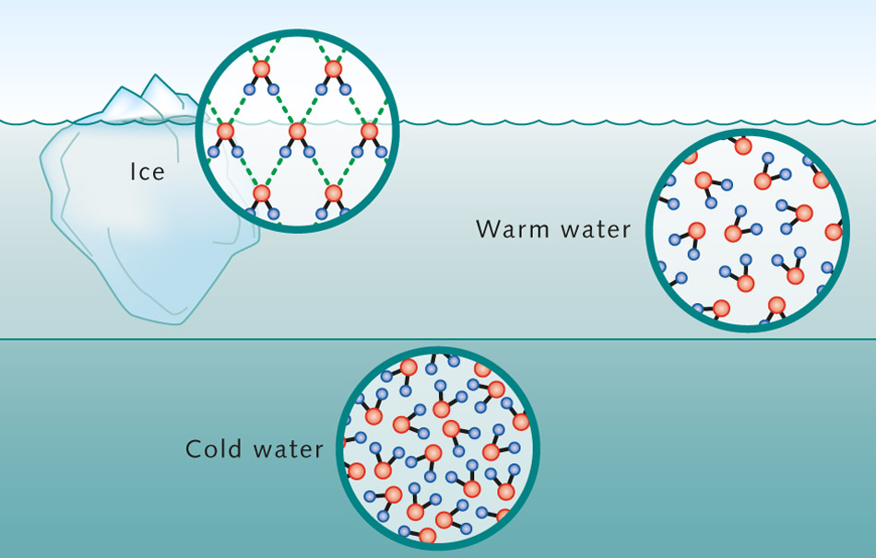
Classwork
Use pp. 47- 51 to complete p. 15 in the notebook.

Slide 29
Surface Water
Freshwater we can see!!

Slide 30
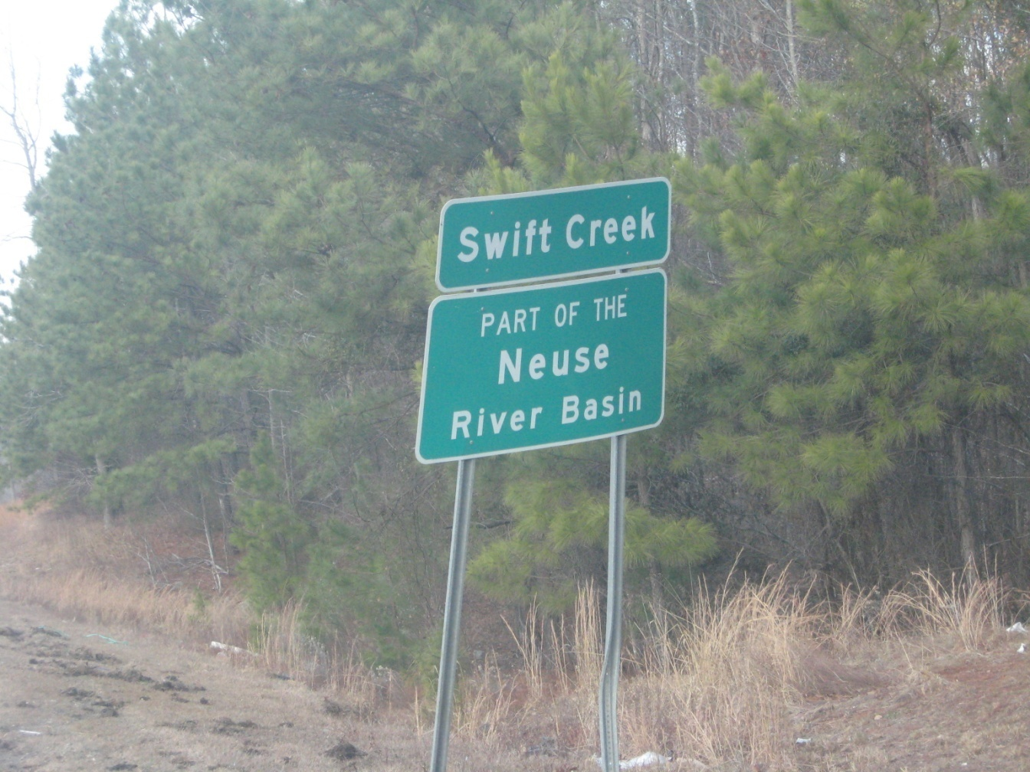
Your ecological address:

Slide 31
Fresh Water Locations—Rivers, Streams, and Lakes
What is a river?
A large channel along which water is continually flowing down a slope—made of many streams that come together called tributaries. The main river and its tributaries are called a River System
What is a stream?
A small channel along which water is continually flowing down a slope—made of small gullies
What is a lake?
A body of water of considerable size contained on a body of land
A reservoir is a man made or natural lake used for drinking water

Slide 32
What are the features of a River System?
A river system is made up of a larger river and the tributaries that run into it.
A river basin is h eland area that surrounds the river system and supplies water to the river system.
A divide is a landform that separates two watersheds. (ex. Hills, mountains, etc.)

Slide 33
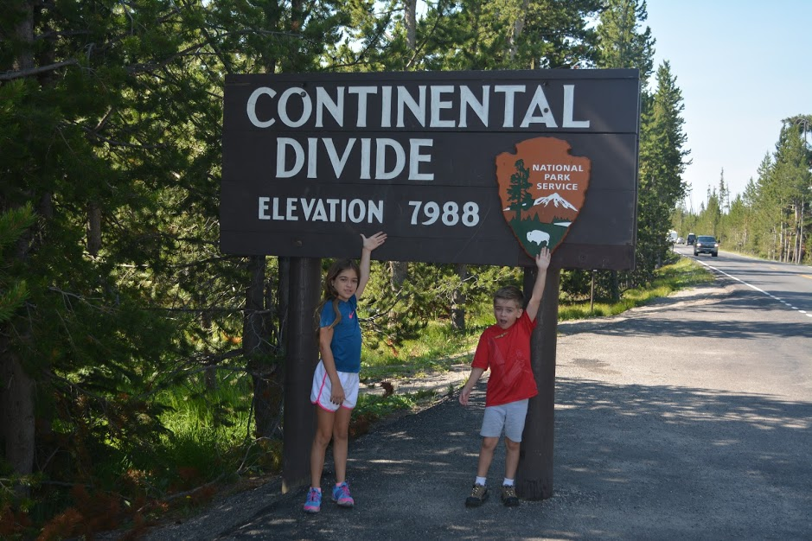
Yellowstone N.P. ,Wyoming

Slide 34
Fresh Water Locations—Surface Water
What is the difference between a watershed and a river basin?
Both terms describe land that drains into a river, stream or lake
River Basin: the term used to describe an area that drains into a large river
Watershed: the term used to describe an area that drains into a smaller river or stream

Slide 35
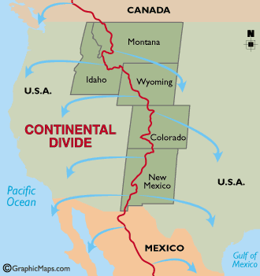
What is the difference between a river basin and a watershed?
Both terms describe land that drains into a river, stream or lake
River Basin: the term used to describe an area that drains into a large river
Watershed: the term used to describe an area that drains into a smaller river or stream
A divide is a landform that separates two watersheds. (ex. Hills, mountains, etc.)
Drainage Basins and Watersheds

Slide 36
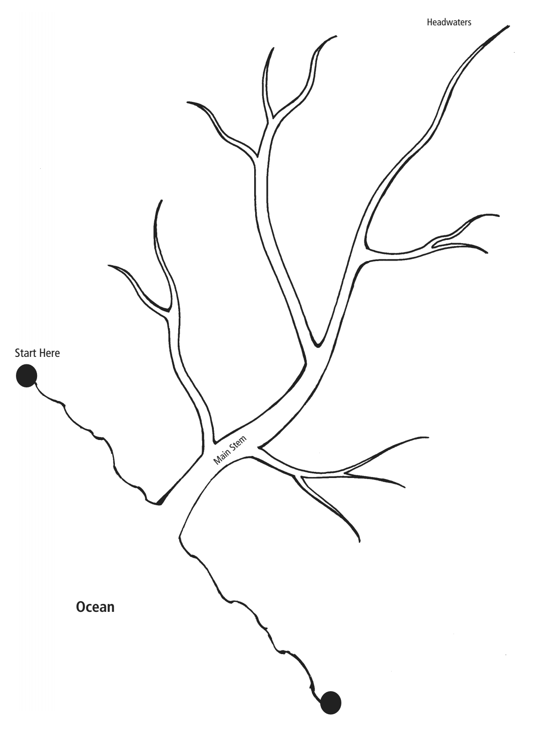
Parts of a River System
Label the tributaries, main river and mouth.
Draw a Line around the river system indicating where the divide may be.

Slide 37
What is the difference between a river basin and watershed?
A river basin is: is the portion of land drained by a river and its tributaries. It encompasses all of the land surface dissected and drained by many streams and creeks that flow downhill into one another, and eventually into a large body of water such as the Atlantic Ocean.
Larger river basins are made up of many interconnected watersheds (smaller basins)
Example: Cape Fear and Neuse River Basins are made of many small watersheds Crabtree Creek, Swift Creek, Walnut Creek
Smaller rivers dump into the larger river within the basin. These are called tributaries.
The water in a watershed runs to the lowest point—a river, stream, lake, or ocean

Slide 38
Fresh Water Locations—River Basins and Watersheds
Larger river basins are made up of many interconnected watersheds
Example: Cape Fear and Neuse River Basins are made of many small watersheds
The water in a watershed runs to the lowest point—a river, stream, lake, or ocean

Slide 39
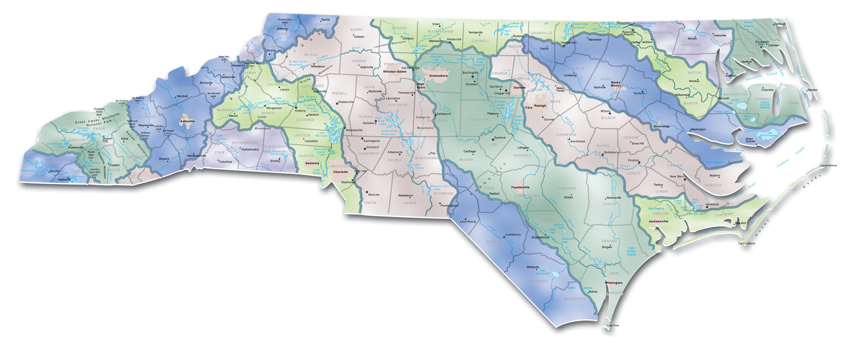
North Carolina’s 17 River Basins
My ecological address is:
Neuse River Basin
Cape Fear River Basin

Slide 40
North Carolina’s 17 River Basins
My ecological address is:
Neuse River Basin
Cape Fear River Basin

Slide 41
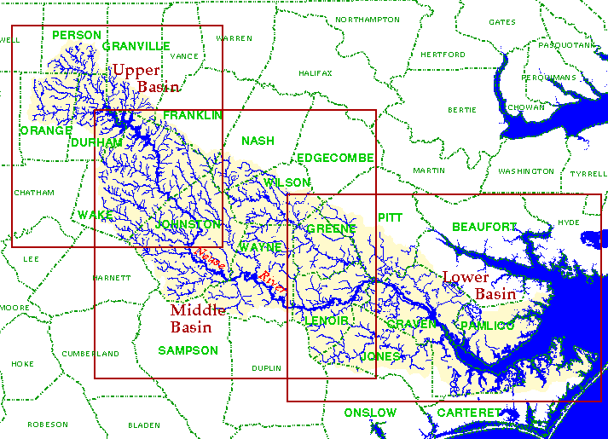
Neuse River Basin and Watersheds

Slide 42
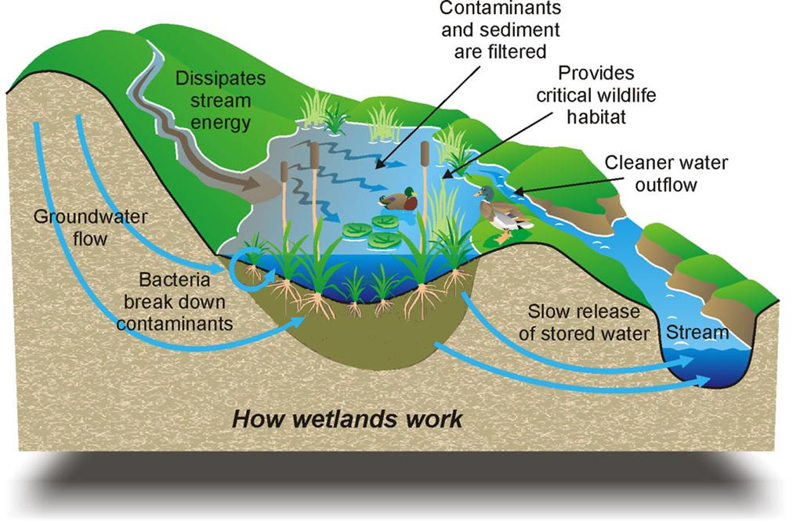
Other Surface Waters- Wetlands
What is a wetland?
An area where the water table is at, near or above the land surface long enough during the year to support adapted plant growth.
(hydric plants and hydric soil) means WET with water
Wetlands are the most diverse ecosystems on earth.
Wetlands are natural filters of water in the water cycle. (act like sponges)
Importance of Wetlands

Slide 43
Other Surface Waters
What are the types of wetlands?
Swamps, bogs, and marshes
Swamp: a wetland dominated by trees ex. Great Dismal Swamp
Bogs: a wetland dominated by peat moss ex. NC Mountains
Marshes: a wetland dominated by grasses ex. Salt Marshes on NC Coast

Slide 44
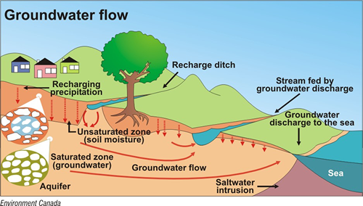
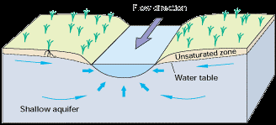
The Surface and Groundwater Connection
The water found in cracks and pores in sand, gravel, rocks below the Earth’s surface is considered groundwater.
Groundwater supplies almost half of the water found in our rivers and streams and can often supply water to a stream in times of drought.
Surface water can help to recharge groundwater as well.
http://www.water.ca.gov/groundwater/groundwater_basics/gw_sw_interaction.cfm

Slide 45
summary

Slide 46
Water Pollution and Biomagnification

Slide 47
Water Pollution
Water pollution is the addition of any substance that negatively effects the water and living things in the water. The amount of potable water depends on the quality of the water.
Examples of water pollution include: treated wastewater, runoff, toxic chemicals, municipal sewage, motor oil from cars, fertilizers, detergents, pesticides, . . . .

Slide 48
Water Pollution
When waste is deposited in water, solids particles settle to bottom and the concentration of the chemical is diluted by the water. Water naturally renews itself through the water cycle & filtration through wetland environments.
When too much nutrient waste that is high in nitrates & phosphates enter the water, algae can begin to grow uncontrollably due to the “nutrient” matter.
Eutrophication occurs when the lake or pond or stream is overtaken by algae. It has a “green scum” covering the surface and chokes out oxygen from entering the water for fish and thus fish kills can occur.

Slide 49
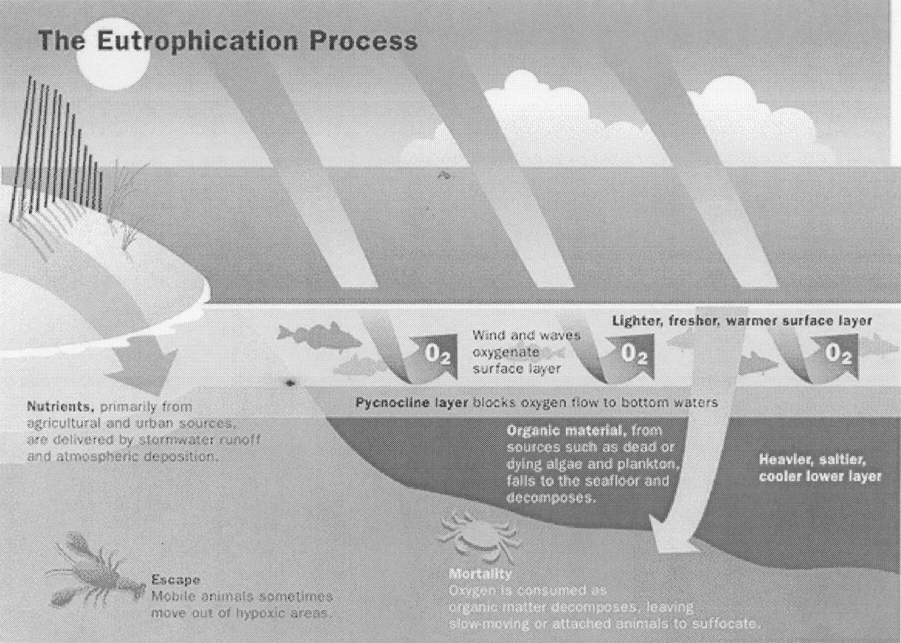
Eutrophication

Slide 50
Water Pollutionhttp://www.youtube.com/watch?v=eHeUN6rr_us
Water Pollution
Sediment pollution is the number one cause of water pollution in NC rivers. What would cause sediment runoff?
How would sediment harm the water quality?
Effluent describes any waste material
discharged into the environment. http://www.youtube.com/watch?v=tU_nx2A1WhQ

Slide 51
Point and Non Point Source Pollution
Point source pollution- can be traced to its point of origin. It can be a pipe, smokestack, culvert,underground container that is pouring or leaking smoke, industrial waste, or storm sewer wastewater into a body of water
Non point source pollution- cannot be traced to a single point of origin. Ex. Your car exhaust or engine leaks oil, leftover salt from a winter storm runs into the river, boat dumps its sewage into river after a day on the water, . . .

Slide 52
Biomagnification
When chemicals enter the environment through groundwater or surface water, they can enter the food chain.
First level producers absorb the chemical, then the first level consumers eat the producer and absorb more of the chemical. At each level of the food chain, more of the chemical is absorbed and the impact on the organism is magnified.

Slide 53
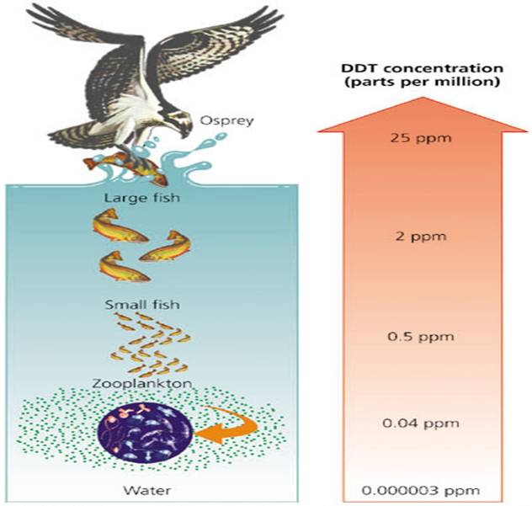

Slide 54
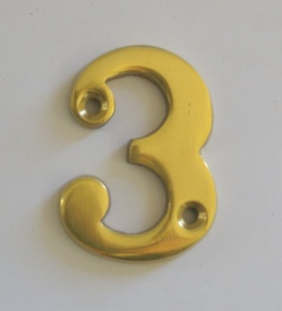
3-2-1 Summarize!!!
Write 3 facts you wrote in your notes in complete sentences.
Write 2 facts given to you verbally that you did NOT write down in complete sentences.
Write 1 question that presented itself to you while taking notes.

