Slide 1
The Sea Floor and Beyond….

Slide 2
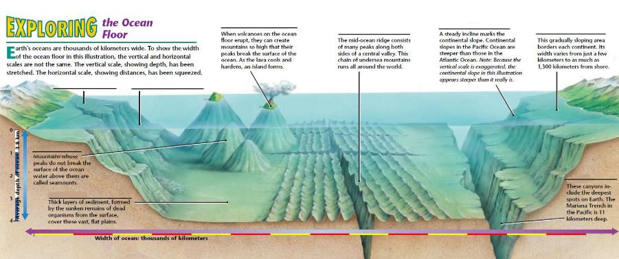
Features of the Ocean Floor

Slide 3
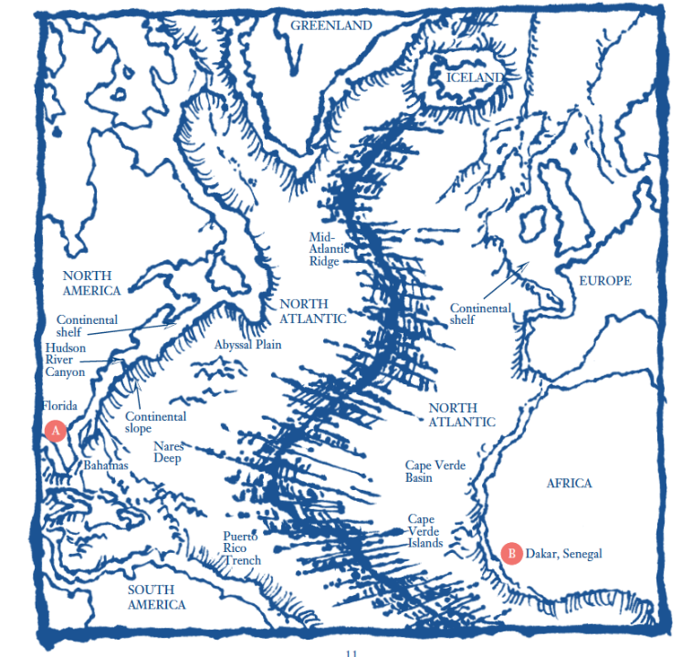

Slide 4
There are harsh conditions present in the deep sea. What adaptations have marine life developed in order to survive the abyss?
Adaption- any alteration in the structure or function of an organism or any of its parts that results from natural selection and by which the organism becomes better fitted to survive and multiply in its environment.

Slide 5
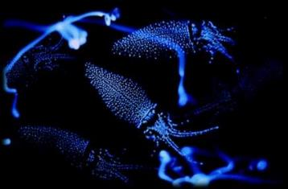
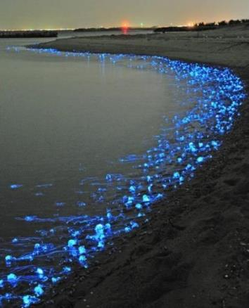
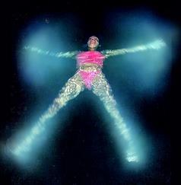
Bioluminescence is the emission (releasing) of light by animals through special cells called photophores. Photophores on fish are used mainly for attracting food, finding a mate or confusing predators.

Slide 6
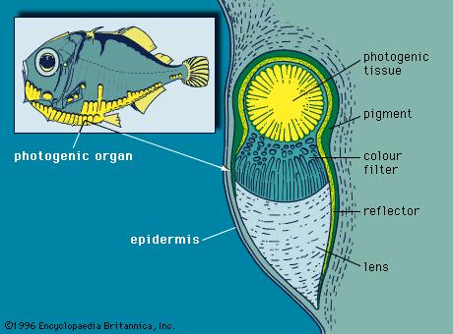
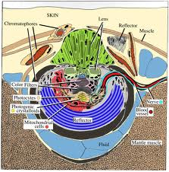
Bioluminescence is formed through a chemical reaction.

Slide 7
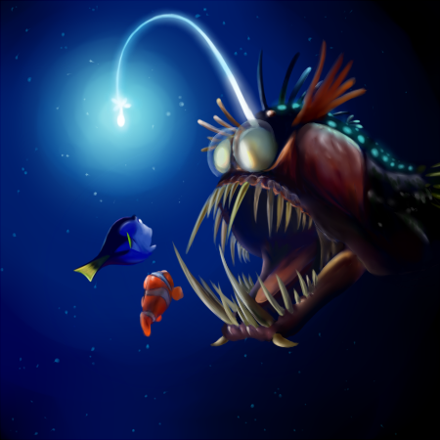
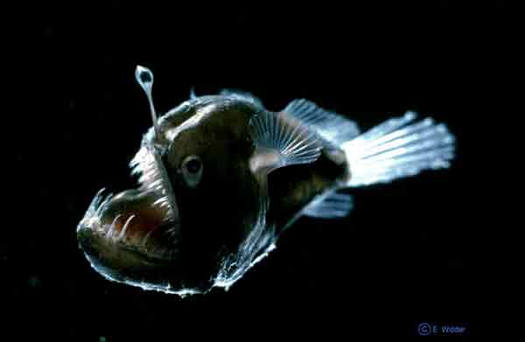
Bioluminescent deep sea creatures also use lures for attracting prey

Slide 8
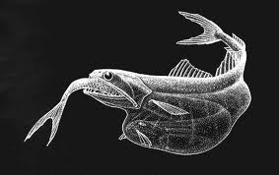
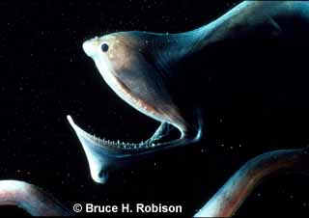
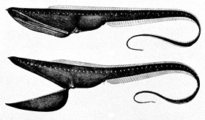
Prey is rare in the deep sea, so feeding has also become highly specialized with adaptations such as large mouths, distensible stomachs, and needlelike teeth.
The gulper eel

Slide 9
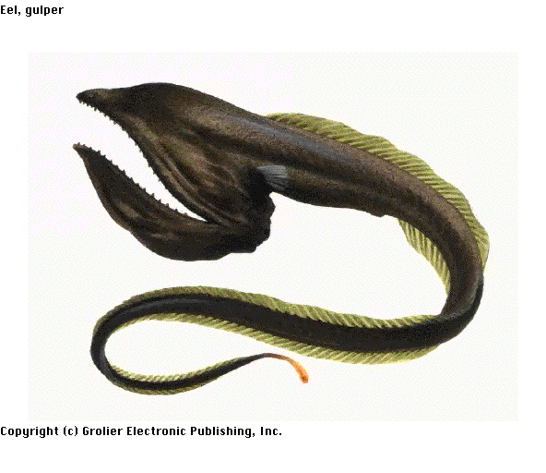
A wide mouth can also be used like a net to catch many smaller prey at once.
The gulper eel’s mouth is so large that it can swallow organisms much bigger than itself whole. Once swallowed, the gulper eel’s stomach will stretch to fit its meal.

Slide 10
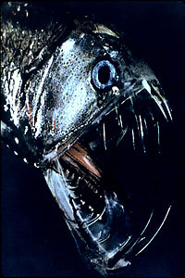
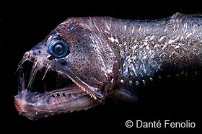
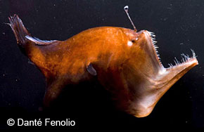
Some organisms in the deep ocean have long, needle like teeth that point inward, keeping prey from being able to escape once caught.
Viper fish and deep sea angler fish
Some fish actually have teeth so long and sharp that they can never close their mouths completely!

Slide 11
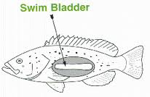
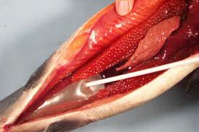
Pressures are very high in the deep-sea environment. To adapt, deep sea fish do not have swim bladders. If they do have one it is filled with lipids (fats) instead of gas. Gases could compress and collapse under the pressure, but the fats will stay solid.
If deep sea organisms are brought to the surface, their bladders may burst because of the change in pressure.

Slide 12
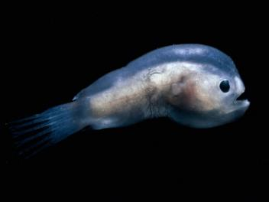
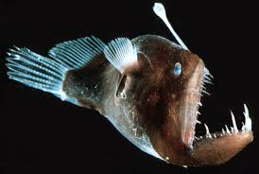
Mating is particularly difficult in the deep sea, so fish have developed certain adaptations specifically to help carry on their species.
Ex: The deep-sea anglerfish.
The male anglers are small and act as parasites. They attach themselves to the female and fuse into her circulatory system (they share blood). She supports them both while the male is there solely to fertilize the female’s eggs.
Male
Female

Slide 13
What are the 7 adaptations?
Bioluminescence
Lures
Distensible stomachs
Unhingable jaws
Needle-like teeth
Mating strategies
Swim Bladders

