Slide 1
The Scientific Method
Aka. Scientific inquiry
EQ- What process do scientists use to investigate the world?

Slide 2
What do you think it means?
The most incomprehensible thing about the world is that it is comprehensible.
-Albert Einstein

Slide 3
What is Science?
Science is the total collection of knowledge gained by man’s observations of the universe.
Science tries to answer the questions How? and What?. (not why?)

Slide 4
What is the scientific method?
It is a process that is used to find answers to questions about the world around us.

Slide 5
Is there only one “scientific method”?
No, there are several versions of the scientific method.
Some versions have more steps, while others may have only a few.
However, they all begin with the identification of a problem or a question to be answered based on observations of the world around us and provide an organized method for answering the question.

Slide 6
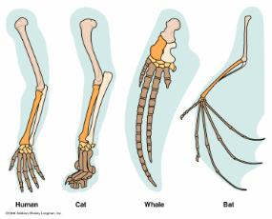
Posing a Question
What do you want to know or explain?
Use observations you have made to write a question that addresses the problem or topic you want to investigate.

Slide 7
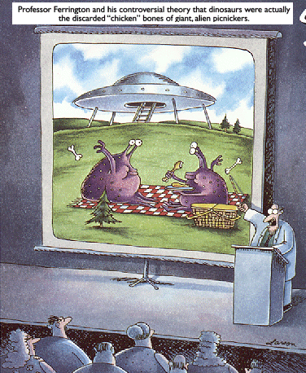
What is a hypothesis?
It is an educated guess based on observations and your knowledge of the topic.

Slide 8
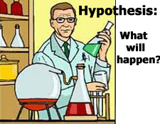
Making a Hypothesis
What do you think will happen?
Predict the answer to your question or the outcome of the experiment.

Slide 9
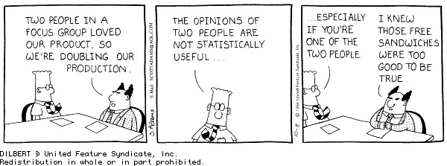
Create an Experiment
How will you test your hypothesis?
Develop a step by step procedure for a reliable experiment and address safety rules.

Slide 10
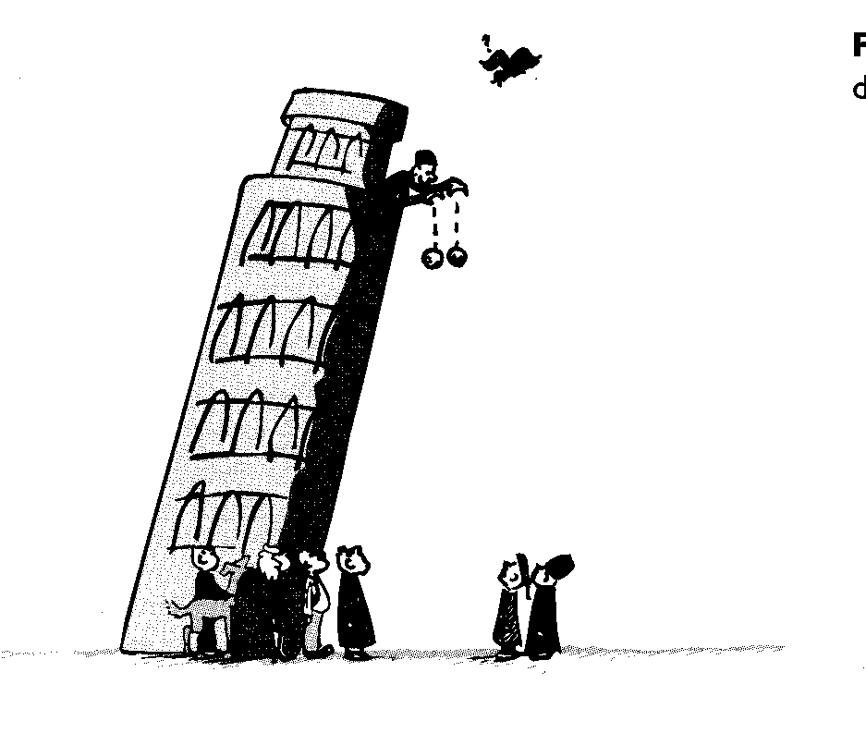
Perform an Experiment
Follow the steps in your procedure to perform your experiment. Record data and observations!

Slide 11
Parts of an Experiment
Variable: something that changes in an experiment.

Slide 12
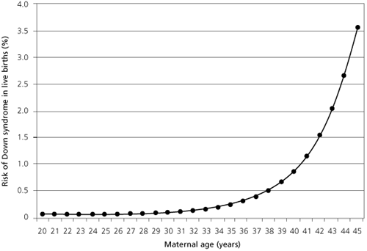
Parts of an Experiment
Independent variable: the variable that the experimenter controls.
Also called the manipulated variable
Graphed on the x-axis

Slide 13
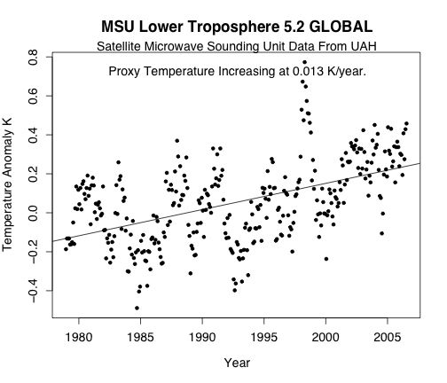
Parts of an Experiment
Dependent variable: the variable used to measure the effect of the independent variable
Graphed on the y-axis
The variable used to measure.

Slide 14
Parts of an Experiment
Constant: a factor that does not change when other variables change.
Scientists change one independent variable, and keep all other conditions constant.

Slide 15
Parts of an Experiment
Control Group: the standard by which the test results can be compared.
Often the natural condition

Slide 16
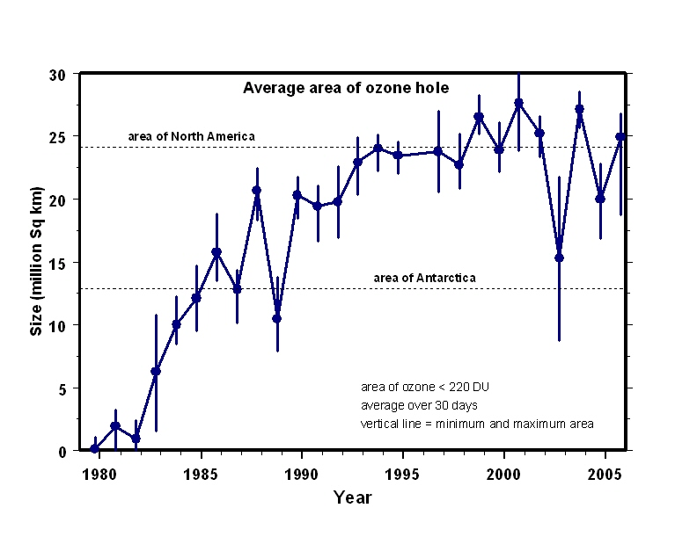
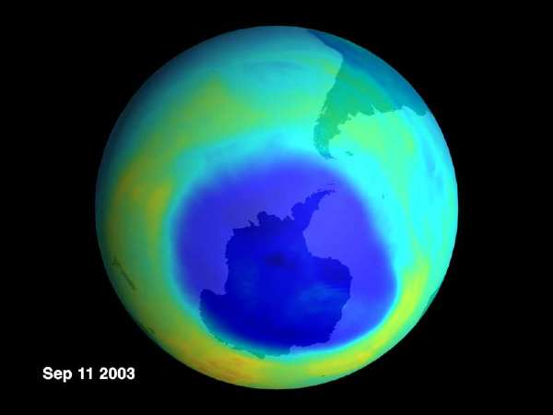
What is data?
It is information gathered during an experiment.

Slide 17
Analyze the Data
Is the data reliable? Does your data and observations from the experiment support your hypothesis?
Yes
COMMUNICATE your results
Write a conclusion that summarizes the important parts of your experiment and the results.
No
Is your data inaccurate or flawed?
Modify the Experiment
Rewrite your procedure to address
the flaws in the original experiment.

Slide 18
Theory vs. Law
Scientific Theory: A well tested explanation for a wide range of observation or experimental results.
Scientific Law: A scientific law is a statement that describes what scientists expect to happen every time under certain conditions.(Example- Newton’s Laws.)

Slide 19
Problem-Does the color of light effect the growth of plants? Hypothesis?
Experiment
Manipulating/ Independent variable variable?
Responding/ dependent variable?
Control?
RED
BLUE
GREEN
?
15.6 cm
16.1 cm
14.6 cm
20.3 cm
Conclusions?

Slide 20
Now you try:
A scientist wants to see if caffeine will effect the heart rate of human. He feeds one group caffeine pills every day, increasing the dose by 10 mg per day for 10 days. The other group is given a sugar pill. He measure their heart rate each evening. Each individual eats the same diet and does not exercise during the 10 day experiment.
What is the control?
What is the independent variable?
What is the dependent variable?
List the constants?

Slide 21
Now you try…
Spongebob Experiments
Identify the parts of an experiment in the SpongeBob experiment handout.
Today’s Formative Assessment.

