Slide 1
Skills of a Scientist
How can we think more like a scientist?
Who are scientists today?

Slide 2
Draw a scientist
Draw your perception of a scientist in your notebook (pg. 5). What are they wearing? Where are they working? What equipment are they using?

Slide 3
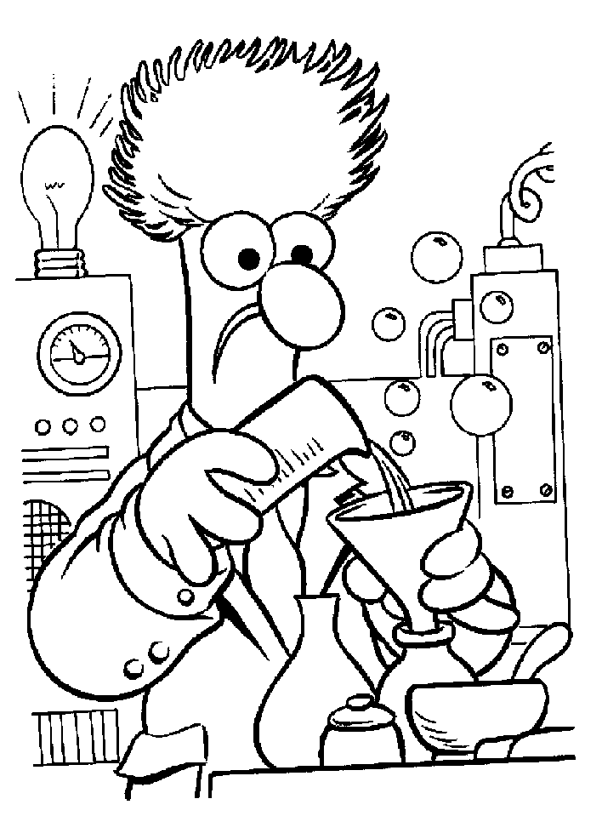
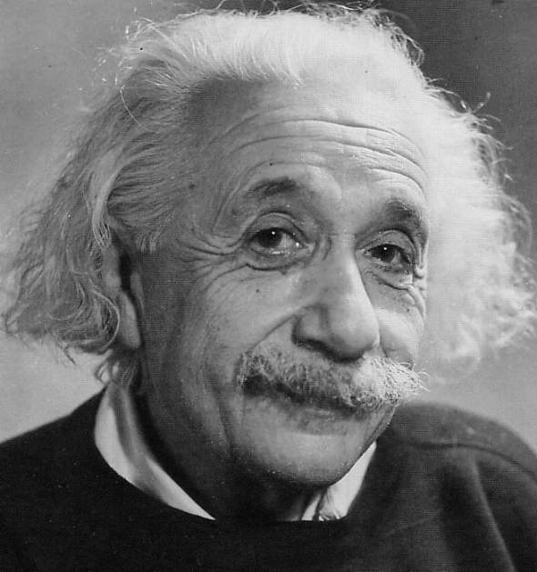
Typical Scientist?

Slide 4
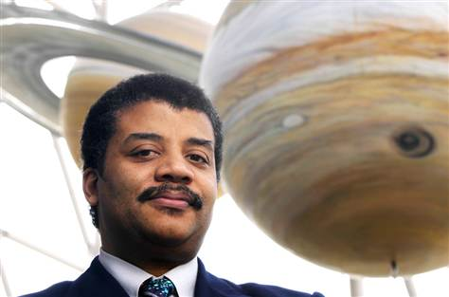
Neil deGrasse Tyson
Astrophysicist - Director of the Hayden Planetarium at the American Museum of Natural History on Manhattan's Upper West Side.

Slide 5
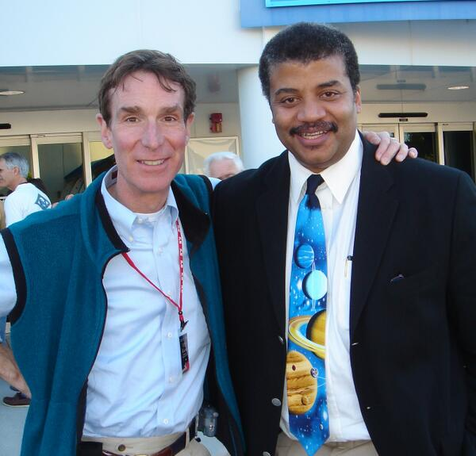
Bill Nye – The Science Guy

Slide 6
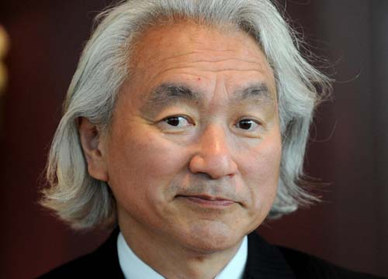
Michio Kaku
American theoretical physicist

Slide 7
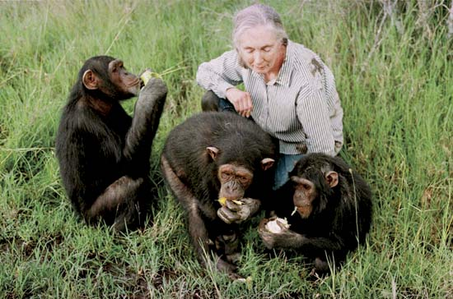
Jane Goodall - Primatologist

Slide 8
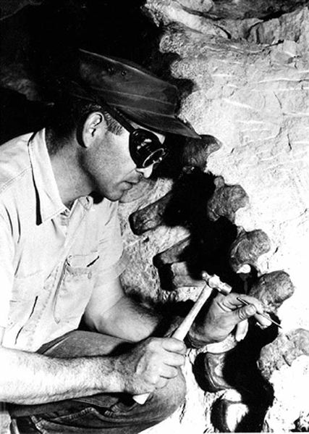
Paleontologist

Slide 9
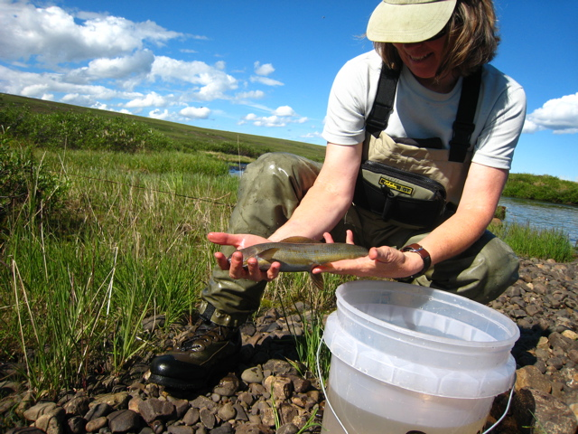
Fisheries Biologist

Slide 10
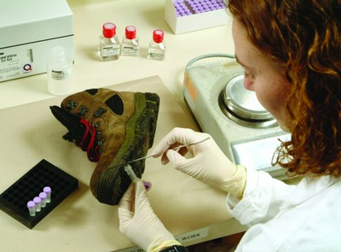
Forensic Scientist

Slide 11
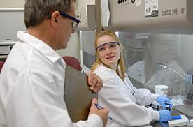
Virologist

Slide 12
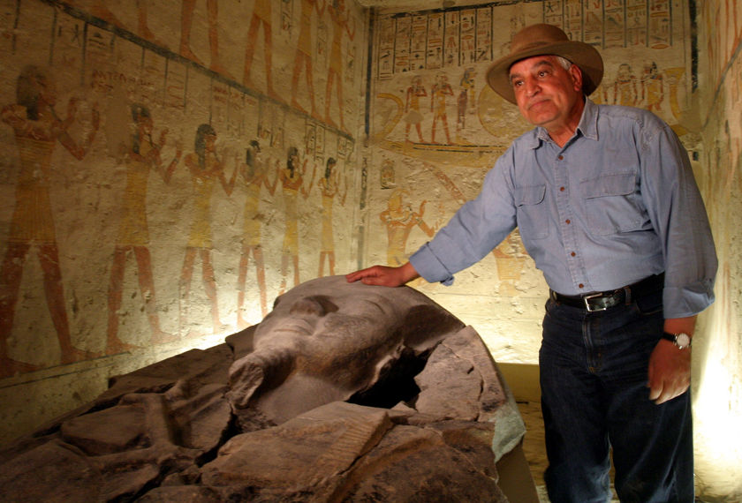
Archeologist

Slide 13
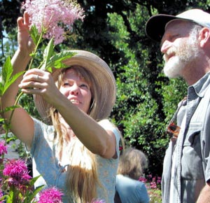
Botanist

Slide 14
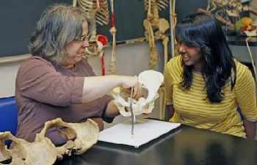
Anthropologist – UD K. Rosenberg

Slide 15
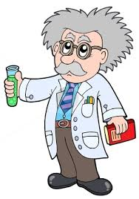
Draw a scientist
Male
White
Grey Hair
Lab coat
Lab equipment
Inside a Lab

Slide 16
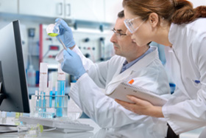
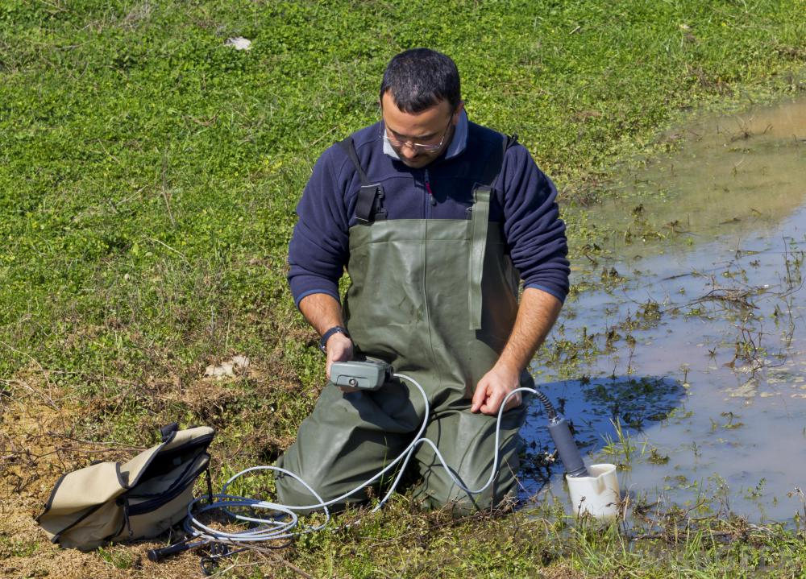
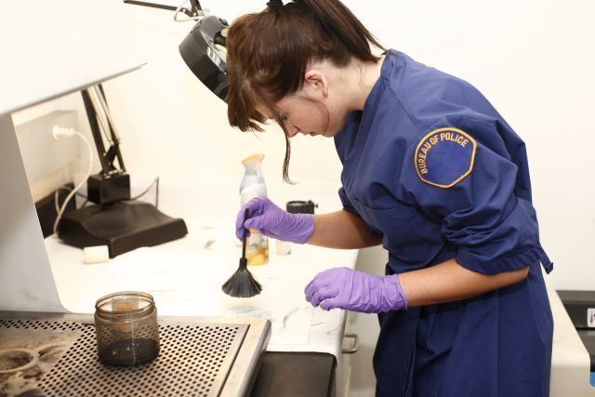
Drawing a scientist

Slide 17
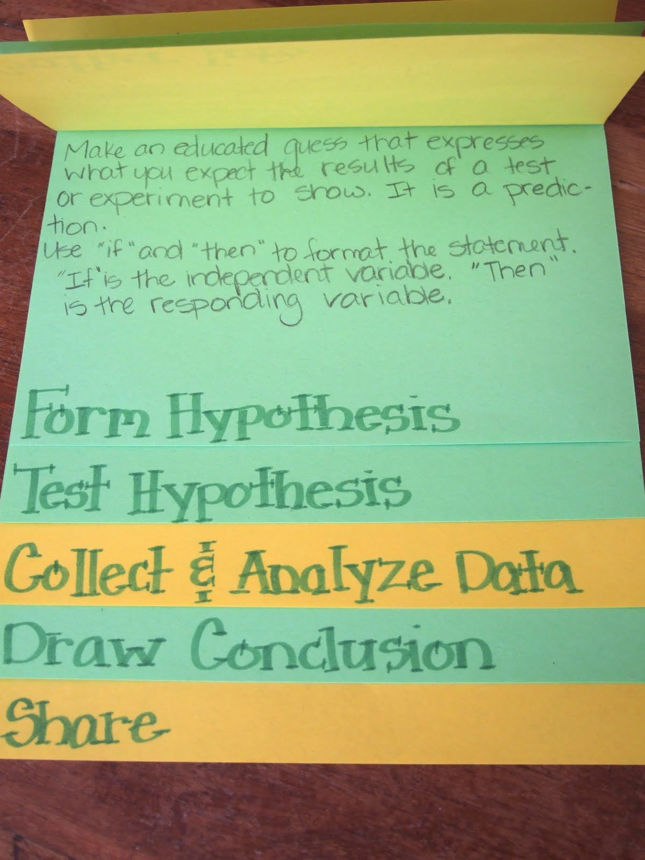
Making a tab foldable
Get out three pieces of paper.
Align them on top of each other so you can only see about one inch of the paper below it.
Fold the paper hamburger style so you now have 6 distinct tabs.
Staple the top and label each tab- Observation, Inference, Classify, Order, Measurement.
Title- Skills of a Scientist should be on the front

Slide 18
Notebook p. 4
Title the page: Skills of a Scientist
Observation
Inference
Classify
Order
Measure

Slide 19
Observation
Definition- Using your five senses to gather information.
Examples- The trees contain green leaves, There are three birds perched on the limb.
Types-
Quantitative- a measured quantity- refers to a numerical value
Qualitative- a description in words of your observation

Slide 20
Inference
Definition- The interpretation of an observation
Example- If you observe your dog barking you may conclude someone in at the door.

Slide 21
Classify
Definition- Grouping together items that are alike.
Examples- A librarian classifies books by subject.

Slide 22
Order
Definition- To place objects, ideas, or events in a logical sequence based on common characteristics.
Examples- Historical events are usually placed in chronological order.

Slide 23
Measurement
Definition- to determine a specific value or quantity using an accurate and reliable tool
Example- Using a triple beam balance to measure the mass of a penny.
Using a stopwatch to determine how fast you can run.

Slide 24
What’s in the bag?
Describe the contents in the bag.
Why is making accurate observations important?

Slide 25
Paste the foldable in your notebook (page ____)

Slide 26
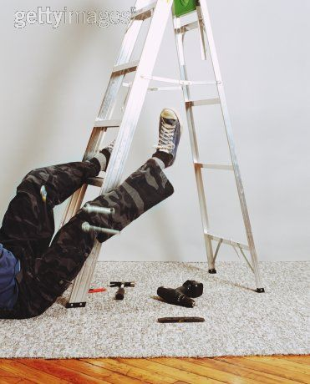
Notebook p. 3
Look at the picture below and write three inferences, three qualitative observations and three quantitative observations.

Slide 27
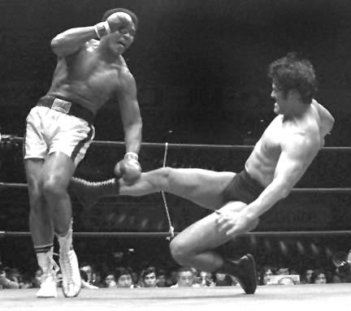

Slide 28
Homework
Complete handout identifying whether each statement is an inference or an observation.

Slide 29
All of science is nothing more than the refinement of everyday thinking.
Albert Einstein

Slide 30
Homework
Make a list of at least 10 of your favorite animals.
Classify or group them by the number of legs they have.
Put them in order by size.
Choose your favorite animal and write 2 observations and 2 inferences about them.

