Slide 1
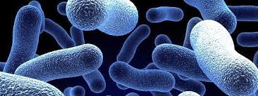
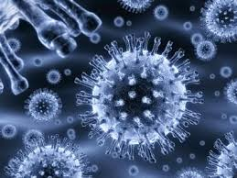
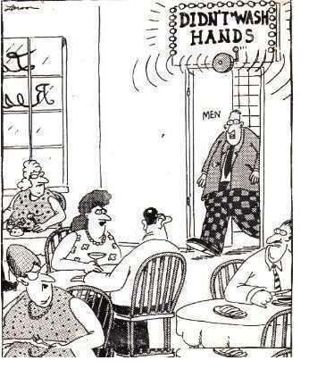
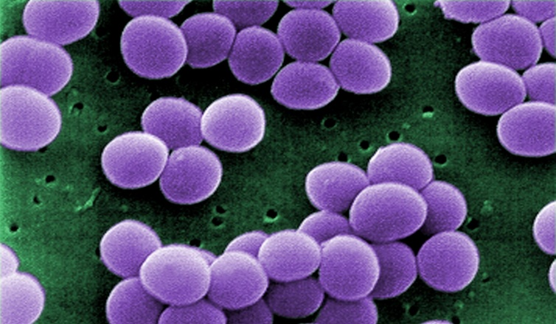
Types of Pathogens
Describe the characteristics of different types of pathogens.
Classify pathogens by their characteristics.

Slide 2
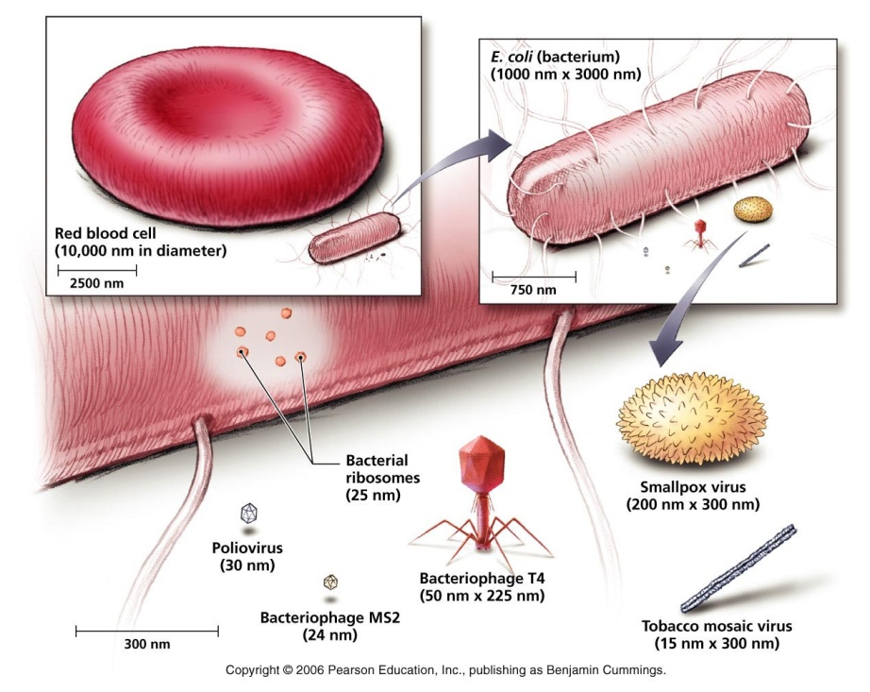
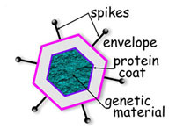
Viruses
Viruses are a tiny, nonliving particle that enters and then reproduces inside a living cell.
A virus is composed of genetic material (DNA or RNA) inside a protein coat.

Slide 3
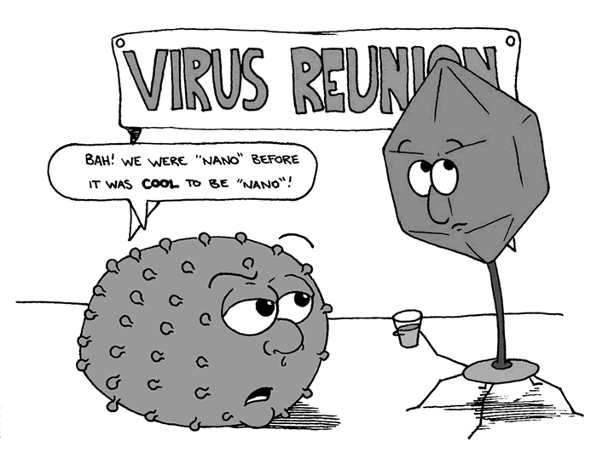

Slide 4
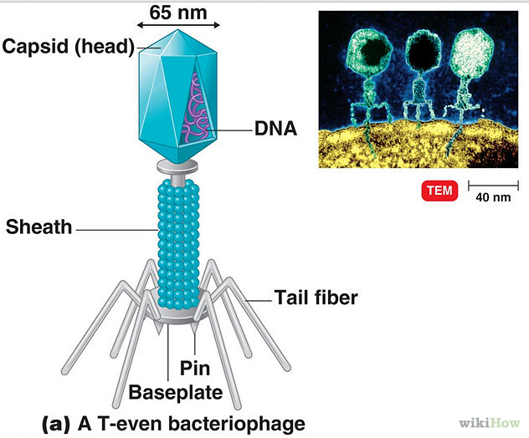
Viruses
Viruses are specific to certain host cells.
A bacteriaphage is a virus that infects bacteria.
A virus must infect a host cell in order to use the cells materials to reproduce more viruses.
Viruses can cause disease.

Slide 5
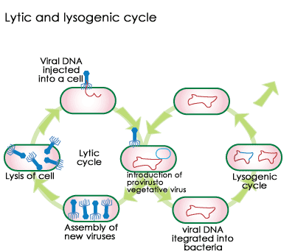
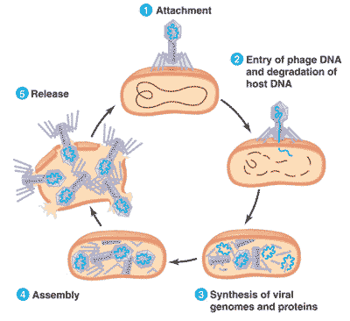
Viruses
Active vs. Hidden viruses
Active viruses multiply immediately after injecting its genetic material into the host cell. Example- Influenza virus
Hidden viruses can wait to multiply even after injecting its genetic material into the host. Example- Cold Sore

Slide 6
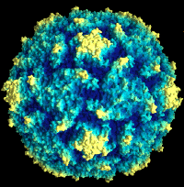
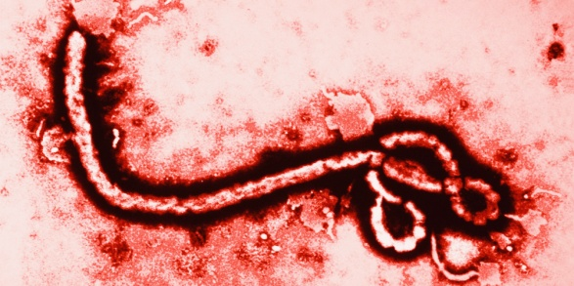
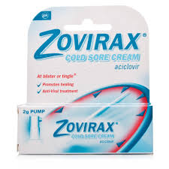
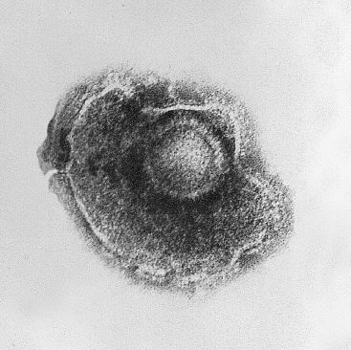
Viruses
Diseases caused by viruses include:
Influenza, polio, chicken pox, Ebola, and AIDS
Treatments: antiviral medications

Slide 7
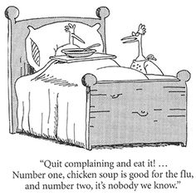
Viruses

Slide 8
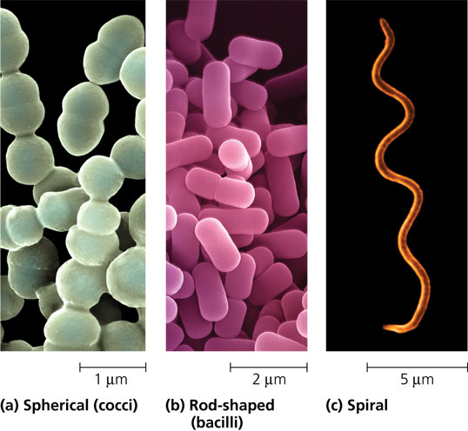
Bacteria
Bacteria are single celled organisms but can form chains or clumps of independent cells.
Shapes include rod, sphere, and spiral.
They are prokaryotes, the genetic material is not found in a nucleus, but floats freely in the cytoplasm.
Bacteria do NOT contain organelles other than ribosome’s.

Slide 9
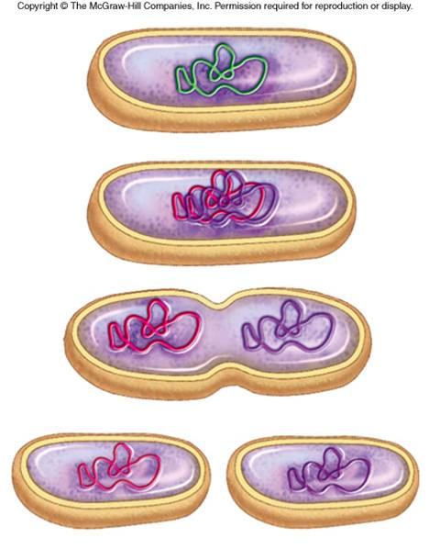
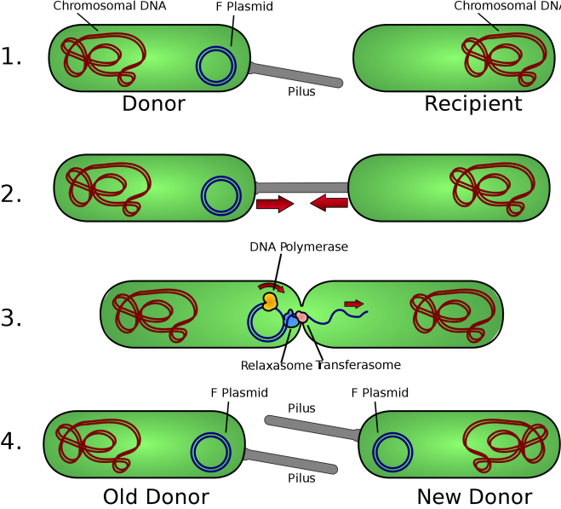
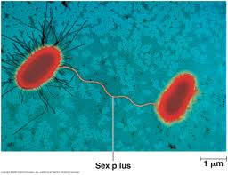
Bacteria
Bacteria can reproduce through sexual and asexual reproduction.
Asexual- called Binary fission- A cell first duplicates its genetic material and then divides into two identical cells.
Sexual- called Conjugation- Bacterium transfers some of its genetic material into another bacterium through a thin, threadlike bridge that joins the two cells.

Slide 10
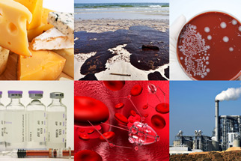
Bacteria
Bacteria may have simple, single stranded flagella that rotates and allows the bacteria to move.
Bacteria can cause disease but are also useful in oxygen and food production, environmental recycling and medicine production.
Antibiotics are chemicals that kill bacterial cells.

Slide 11
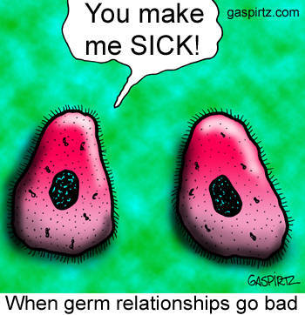
Bacteria
Examples: :Rabies, Lyme Disease and Leprosy.
Treatments: antibiotics such as Penicillin, amoxicillin, or others

Slide 12
Protist
Most protists are single celled organisms, but some are multi cellular.
Protists are eukaryotes; they have a distinct nucleus containing genetic material.
Protists may contain flagella or cilia that allow the cell to move. Some contain pseudopods which are temporary bulges of the cell used for movement and trap food.

Slide 13
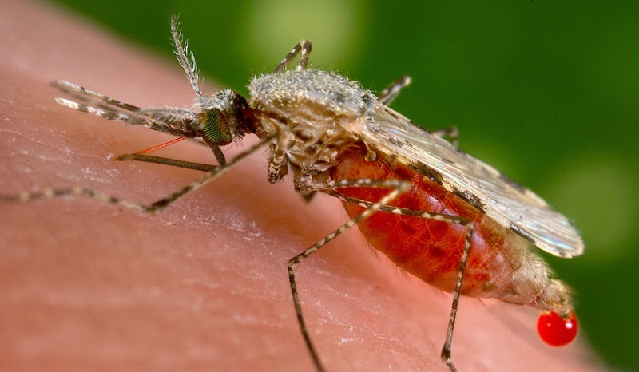
Protists
Many Protists are carried by a vector, a carrier of a disease that passes it on to a human host ie. mosquito, tick.
Diseases caused by Protists include: Malaria (Plasmodia)
Amoebic Dysentery (Entamoeba histolytica)
Giardiasis (Giardia lamblia)
Treatment of Protozoan infectious:

Slide 14
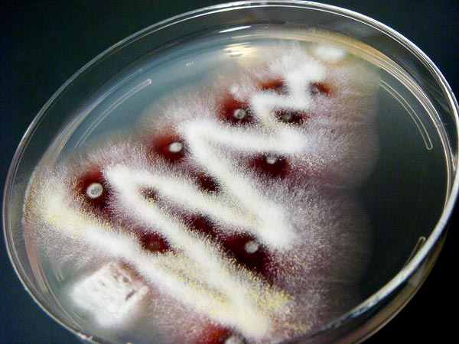
Fungus
Most fungi are eukaryotes, they have a distinct nucleus.
They obtain energy from their environment, meaning they are heterotrophes.
They live in wet, moist environments.

Slide 15
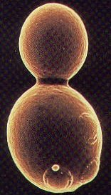
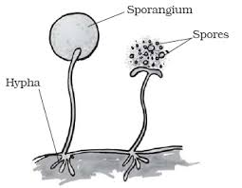
Fungus
Reproduction: They reproduce through both sexual and asexual reproduction.
Asexual reproduction- similar to mitosis and binary fission certain fungi go through budding or create spores.
Sexual reproduction- fungi will exchange DNA and produce spores with the new DNA.

Slide 16
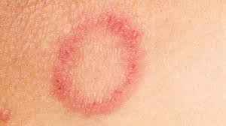
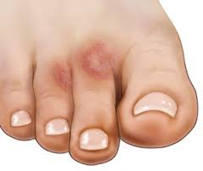
Fungus
Examples of Fungal infections are ringworm, and Athlete’s foot (Tinea).
Treatments include antifungal medications.

Slide 17
Classwork
On page 83 of your notebook:
Pathogen | Card # | Reason
Virus
Bacteria
Protist

Slide 18
Classwork
1. Using the Cards at your desk classify each microorganism based on their description.
Virus | Bacteria | Protist

