Slide 1
Weekly Warm up
November 13- 20, 2018

Slide 2
November 13, 2018 Day 8
DC Field trip form due November 9, 2018 including first payment of $75.00.
Warm up ?’s
Things to Do at the beginning of class…
Define biomagnification.
Why are you more likely to find more PCB’s in largemouth bass then in zooplankton?
Work on your warm up.
Glue pp. 29 and 30 in your notebook

Slide 3
November 14, 2018 Day 9
DC Field trip form due November 9, 2018 including first payment of $75.00.
Warm up ?’s
Things to Do at the beginning of class…
Define a solute and solvent.
Describe how to do a serial dilution?
Work on your warm up.
Turn in homework packet.

Slide 4
November 15, 2018 Day 9
DC Field trip form due November 9, 2018 including first payment of $70.00.
Warm up ?’s
Things to Do at the beginning of class…
Identify 7 different factors/ indicators we use to determine water quality.
Which organization establishes the standards we have for water quality?
Work on your warm up.

Slide 5
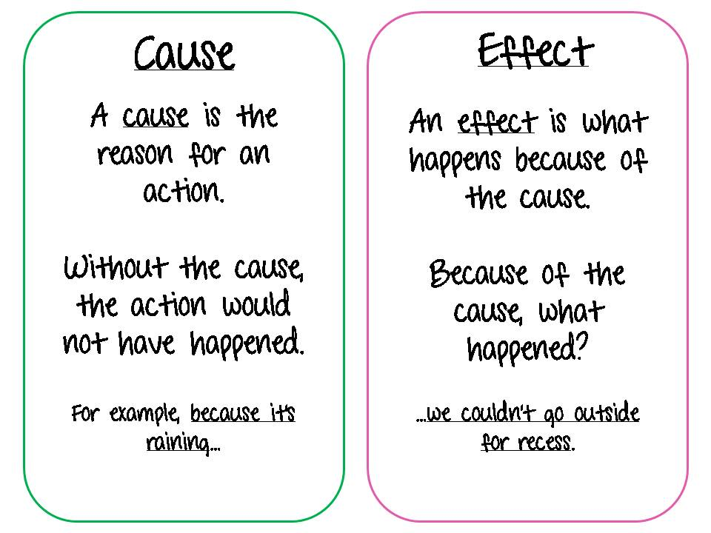
What is cause and effect?

Slide 6
November 16, 2018 Day 10
DC Field trip form due November 9, 2018 including first payment of $70.00.
Warm up ?’s
Things to Do at the beginning of class…
During the summer the Neuse River’s water temperature starts to increase. What effect does this have on dissolved oxygen?
Work on your warm up.

Slide 7
November 19, 2018 Day 11
DC Field trip form due November 9, 2018 including first payment of $70.00.
Warm up ?’s
Things to Do at the beginning of class…
True or False. Temperature of a river system may change due to season, sediment and shoreline vegetation.
What is the pH range of an acid? Base?
Work on your warm up.
Milner video

Slide 8
November 20, 2018 Day 12
DC Field trip form due November 9, 2018 including first payment of $70.00.
Warm up ?’s
Things to Do at the beginning of class…
True or False. Macroinvertebrates make good bioindicators because they are easy to catch and are sensitive to pollution.
You discover a variety of different organisms in a stream. What might you conclude about the water quality?
Work on your warm up.
Turn in warm up!

