Slide 1
Weekly Warm up
October 15- 26, 2018

Slide 2
October 15, 2018 Day 30
Warm up ?’s
Things to Do at the beginning of class…
List natural sources of freshwater.
What is the ultimate source of freshwater?
Work on your warm up.
Turn in last weeks warm up to the bin.

Slide 3
October 16, 2018 Day 32
Warm up ?’s
Things to Do at the beginning of class…
From your list which sources of freshwater are examples of moving water.
How does elevation help to create these moving sources?
Work on your warm up.
Record your homework

Slide 5
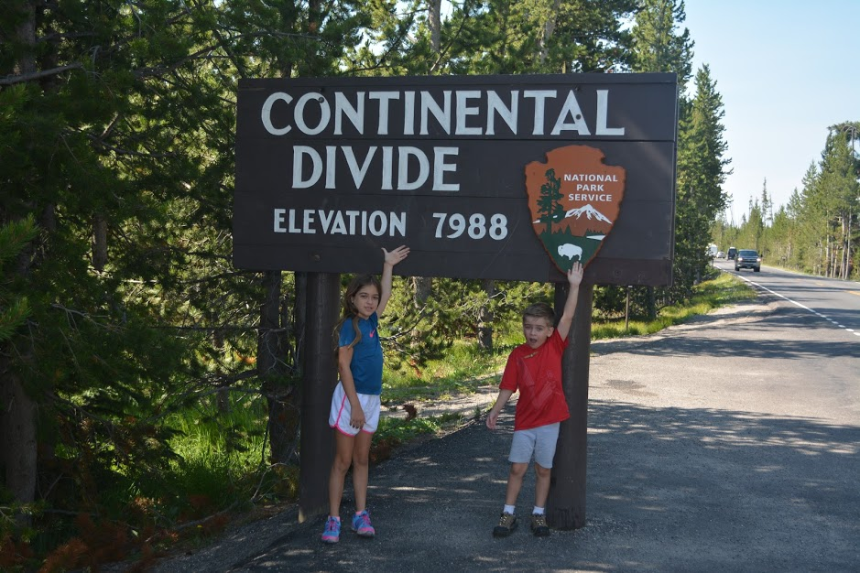

Slide 6
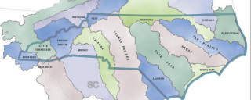

Slide 7
October 16, 2018 Day 32
Warm up ?’s
Things to Do at the beginning of class…
What type of landform would a divide be?
How does elevation determine where a river flows?
Work on your warm up.
Record your homework

Slide 8
October 17, 2018 Day 33
Warm up ?’s
Things to Do at the beginning of class…
List the 4 river basins completely found in NC.
What is the land area around a river system called?
Work on your warm up.
Record your homework

Slide 9
October 18, 2018 Day 34
Warm up ?’s
Things to Do at the beginning of class…
Where would I find the mouth of a river? The headwaters?
Which body of water did your river basin drain into?
Work on your warm up.
Record your homework

Slide 10
October 19, 2018 Day 35
Warm up ?’s
Things to Do at the beginning of class…
List the three types of wetlands.
Give two reasons why they are important.
Work on your warm up.
Turn in homework packet
Finish your reading from p. 19 in notebook.

Slide 11
October 22, 2018 Day 36
End of quarter is Tuesday, October 30.
All make up work is due Friday, October 26, 2018
Warm up ?’s
Things to Do at the beginning of class…
How does precipitation flow to a river or other body of water?
Work on your warm up.

Slide 12
October 23, 2018 Day 37
End of quarter is Tuesday, October 30.
All make up work is due Friday, October 26, 2018
Warm up ?’s
Things to Do at the beginning of class…
How does stormwater runoff impact our river systems?
Give examples of three different pollutants from the presentation yesterday.
Work on your warm up.
Turn in Homework.
Glue in pp. 21 and 22 in your notebook.

Slide 13
October 24, 2018 Day 37
End of quarter is Tuesday, October 30.
All make up work is due Friday, October 26, 2018
Warm up ?’s
Things to Do at the beginning of class…
What is groundwater?
Give an example of a permeable type of soil.
Work on your warm up.

Slide 14
October 25, 2018 Day 37
End of quarter is Tuesday, October 30.
All make up work is due Friday, October 26, 2018
Warm up ?’s
Things to Do at the beginning of class…
List one way an aquifer can be recharged.
How might water be discharged from an aquifer?
Work on your warm up.
Get ready for the quiz. You can clear your desk when you finish the warm up.

Slide 15
October 25, 2018 Day 39
End of quarter is Tuesday, October 30.
All make up work is due Friday, October 26, 2018
Warm up ?’s
Things to Do at the beginning of class…
How is our surface and groundwater interconnected?
Give an example of a pollutant that effects both ground and surface water.
Work on your warm up.
Turn in warm up.

Slide 16
October 23, 2018 Day 37
End of quarter is Tuesday, October 30.
All make up work is due Friday, October 26, 2018
Warm up ?’s
Things to Do at the beginning of class…
Work on your warm up.
Turn in Homework.

