Slide 1
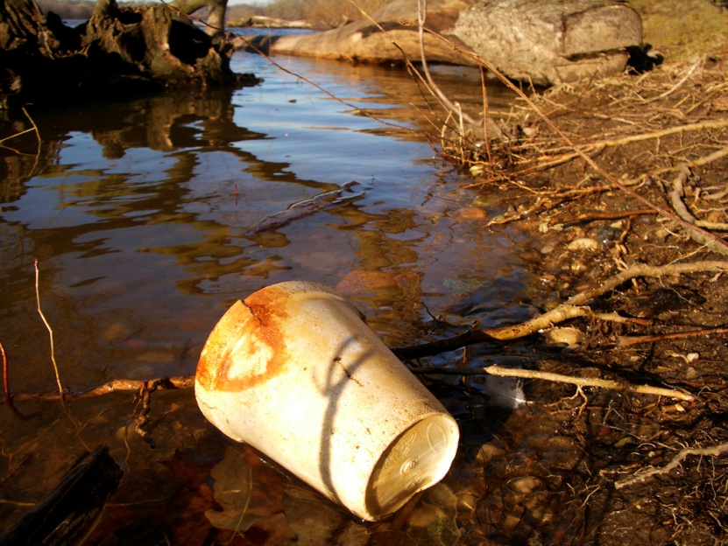
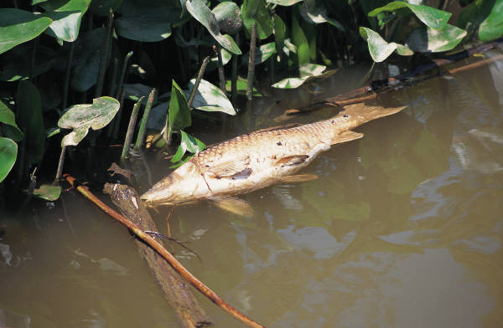
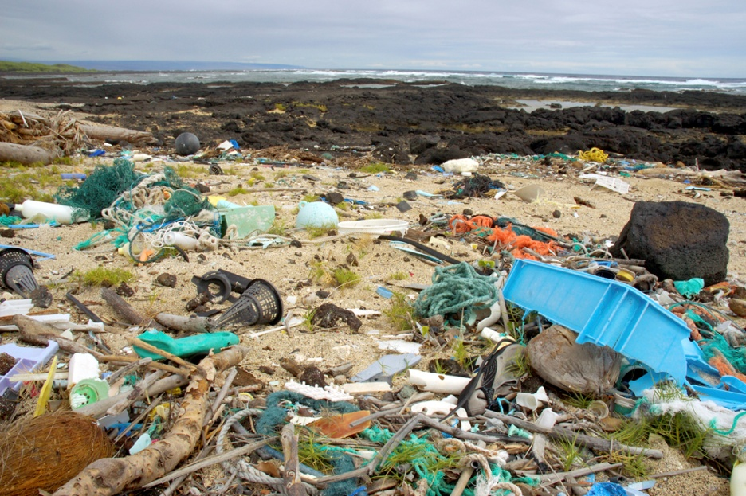
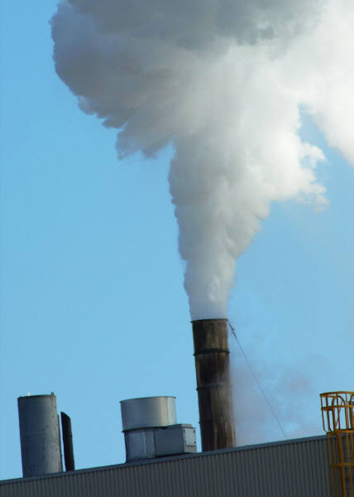
Water Pollution
Top 7 Superfund Sites

Slide 2
Water Pollution
Water pollution is the addition of any substance that negatively effects the water and living things in the water. The amount of potable water depends on the quality of the water.
Examples of water pollution include: treated wastewater, runoff, toxic chemicals, municipal sewage, motor oil from cars, fertilizers, detergents, pesticides, . . . .

Slide 3
Freshwater Pollutants
Kind of Pollutants | Examples | Sources
Disease causing organisms | E. coli, Giardia, bacteria | Human and animal waste, runoff from farms
Pesticides and fertilizers | DDT, nitrates, phosphates | Agricultural and residential runoff
Industrial chemicals | PCB’s, Carbon tetrachloride | Industrial effluent/ waste
Metals | Lead, Mercury, Copper | Industrial effluent/ waste
Petroleum products | Oil, Gasoline | Road runoff,

Slide 4
Water Pollution
Sediment pollution is the number one cause of water pollution in NC rivers. What would cause sediment runoff?
How would sediment harm the water quality?
Effluent describes any waste material
discharged into the environment.

Slide 5
Water Pollution
When waste is deposited in water, solids particles settle to bottom and the concentration of the chemical is diluted by the water. Water naturally renews itself through the water cycle & filtration through wetland environments.
When too much nutrient waste that is high in nitrates & phosphates enter the water, algae can begin to grow uncontrollably due to the “nutrient” matter.
Eutrophication occurs when the lake or pond or stream is overtaken by algae. It has a “green scum” covering the surface and chokes out oxygen from entering the water for fish and thus fish kills can occur.

Slide 6
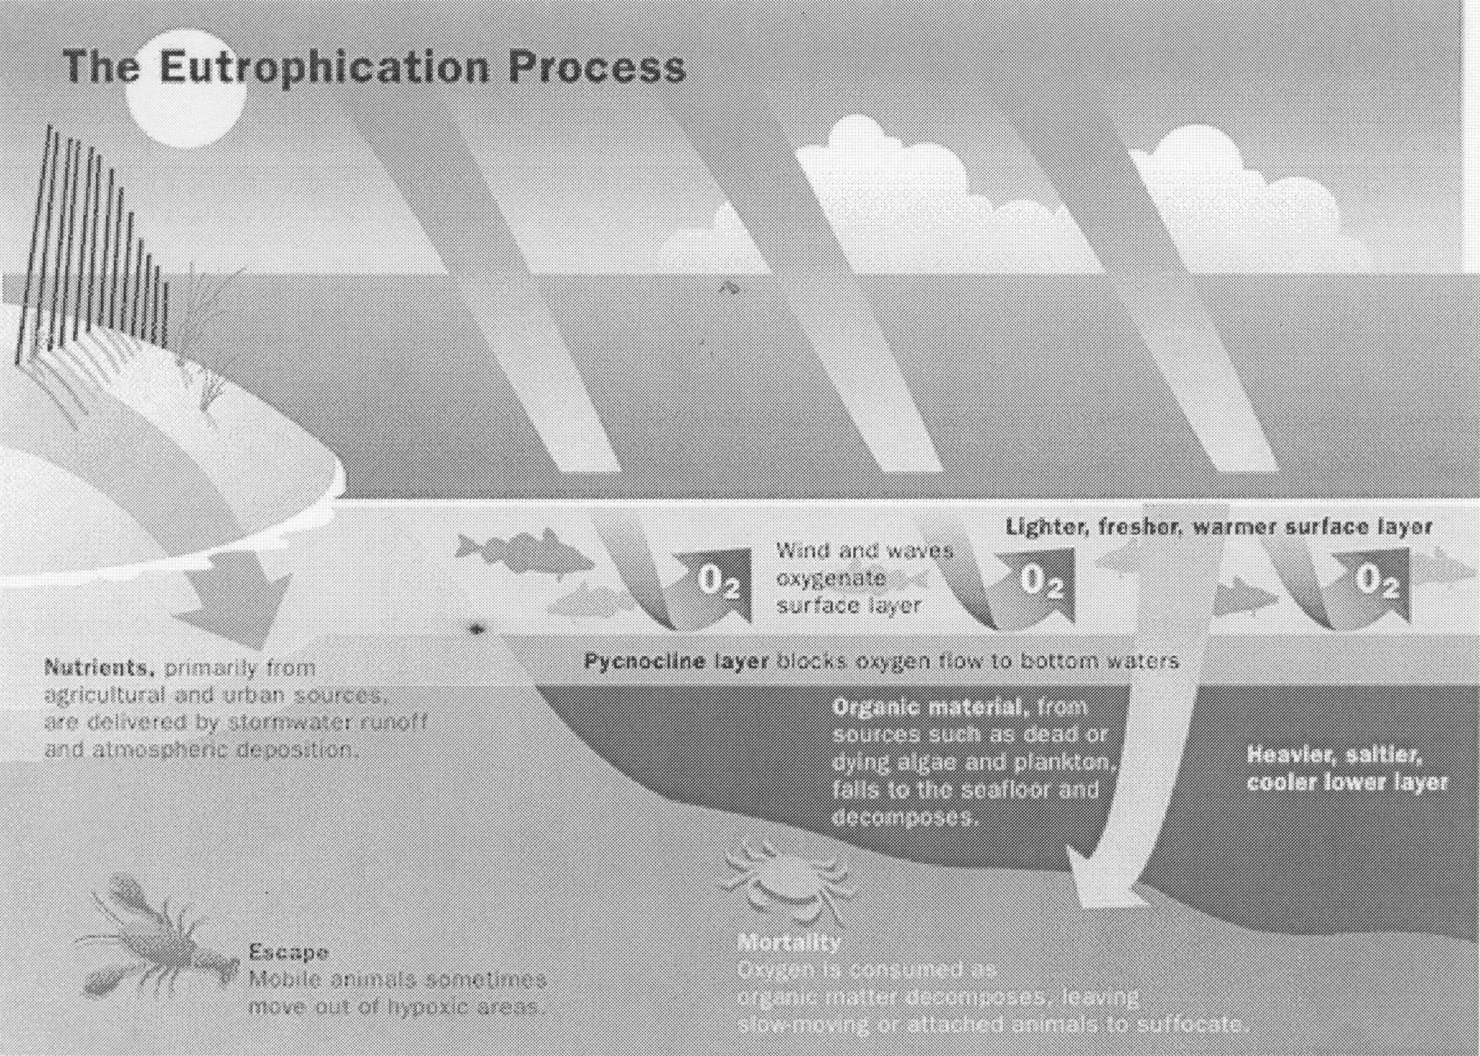
Eutrophication

Slide 7
Water Pollution Point source vs. non-point source
POINT Source
Non point source
Pollution from a single source such as pipes dumping toxic waste into a river.
Controlled by legislation such as the Clean Water Act , passed by Congress in 1970.
Pollution that does not come from a single source such as runoff.
The largest amount of water pollution.
No one claims responsibility!

Slide 8
Point source or Non-point source
Point sources Non-point sources
Wastewater treatment facilities Urban runoff
Factories Agricultural runoff
Oil spills Construction runoff
Leaking pipes Litter
Power plant waste water
Leaking UST’s
Now you decide!
Is it point or non-point ?

Slide 9
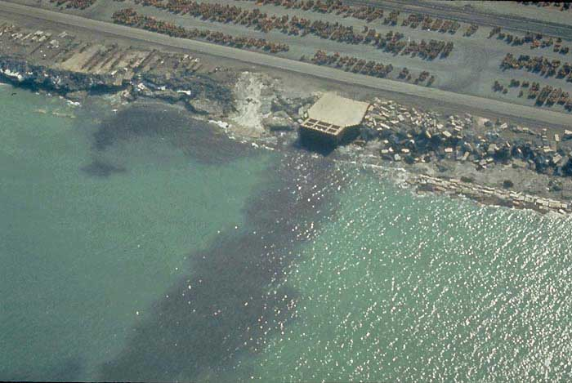

Slide 10
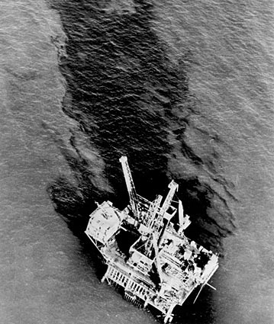

Slide 11
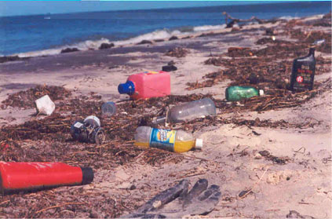

Slide 12
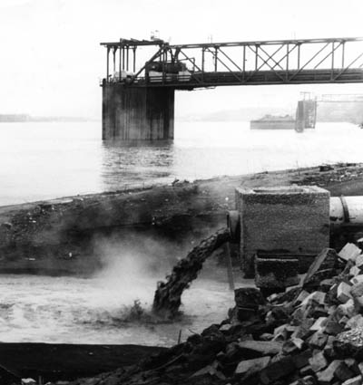

Slide 13
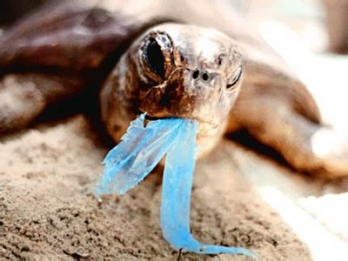

Slide 14
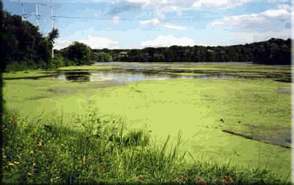

Slide 15
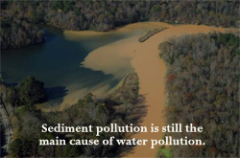

Slide 16
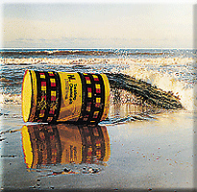

Slide 17
3- 2-1- Summarize
Write 3 different types of pollutants.
Compare the two sources of pollution (point and nonpoint).
Write one definition water pollution.

Slide 18
Whats Your delemma

Slide 19
Sources of Pollution Foldable
Create a 3 tab foldable.
Label each tab : Human Waste, Industrial Waste, and Chemical Run Off
On the inside, identify the types of pollutants for each source. Use pp. 117 – 120 to help you.
Describe at least 2 details related to the type or cause of the pollution.

Slide 20
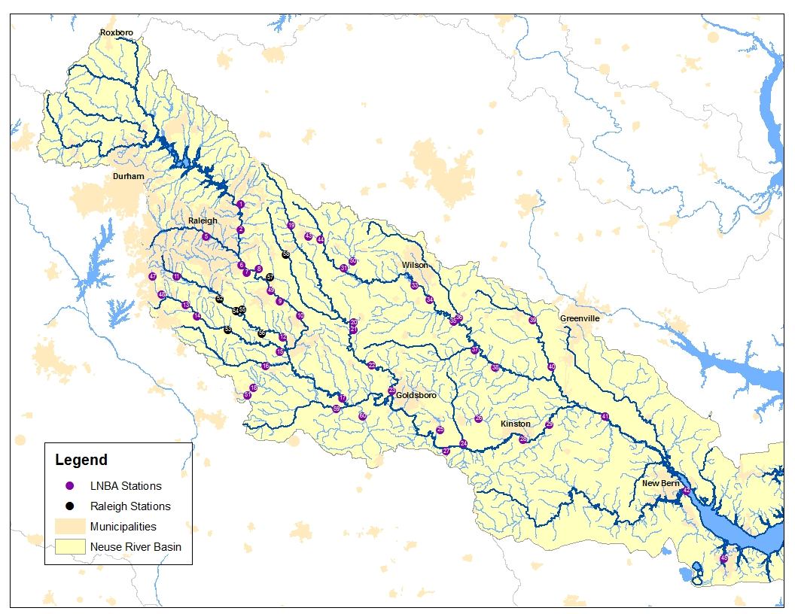
A River Runs Through It

Slide 21
Point or NonPoint??
Read your scenario. Can you determine if it is a point source or a nonpoint source?
What are some potential solutions?
Hint: Look on the back for help.

Slide 22
A River Runs Through It
Underline the pollutants involved in the story.
Record point and nonpoint sources in data table.
Complete the conclusion questions and vocabulary.

Slide 23
Classwork
Using the book and your “Poisoned Water” Notes complete your guided reading questions. You will need to use pp. 114- 123.

Slide 24
Neuse River Basin videos
http://www.youtube.com/watch?v=eHeUN6rr_us&feature=player_detailpage#t=1s
http://www.youtube.com/watch?v=1rFdIOuJlKU
http://www.youtube.com/watch?v=UNM8c1Me8PM&feature=context&context=C3b8ffa5ADOEgsToPDskKOBNoAhkT3O4xS2pZngD_k
http://www.ncsu.edu/wq/videos/stormwater%20video/SWvideo.html

