Slide 1
Water An Introduction to Hydrology
Chapter 2
Section 1, 2, 3

Slide 2
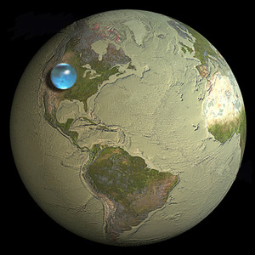
How much of the Earth’s surface is water?
Earth is a Water Planet so…
75% of the Earth's Surface Is WATER.

Slide 3
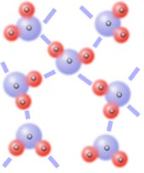
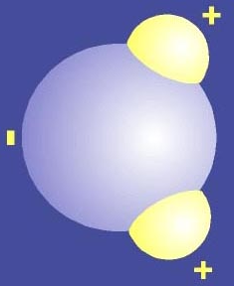
What is it about water’s structure that makes it unique?
The structure makes it a polar molecule.
A polar molecule is a molecule with positive and negative charges on their ends.
What are the charges of the hydrogen atoms?
What are the charges of the oxygen atom?
Are polar molecules attracted to each other?

Slide 4
What physical properties make water unique?
Capillary Action- the force of attraction between water molecules allows water to move through porous material.
Surface Tension-the tightness of the surface of the water caused by the attraction between water molecules.

Slide 5
Capillary Action in Action
How does water get to the leaves of the tree?

Slide 6
Surface Tension, Huh?
This is a water strider. How does it walk on water?

Slide 7
More Properties?
3.Universal Solvent-Many substances ( the solute) can dissolve in water ( the solvent). Polar molecules will dissolve polar molecules.
4. High Specific Heat Capacity-Water has a high specific heat which means it takes a long time to heat or cool. This causes changes in climate around the world and helps to create the currents in the ocean.

Slide 9
Even More Properties?
It’s density is 1 g/ ml.
The density can change if the temperature changes or salt is added to the water.
The density of ice is less than the density of water. This is called the density anomaly.

Slide 10
Density Examples
Based on each density, predict whether the object will float, sink, or become suspended in water.
a. 0.2 g/ ml ______ b. 2.3 g/ml ______
c. 0.99 g/ml ______ d. 1.0 g/ml ______
e. 0.5 g/ml ______ f. 1.9 g/ml ______

Slide 11
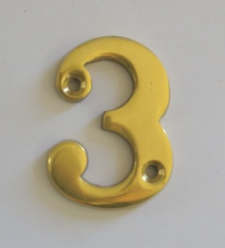
3-2-1 Summarize!!!
Write 3 facts you wrote in your notes in complete sentences.
Write 2 facts given to you verbally that you did NOT write down in complete sentences.
Write 1 question that presented itself to you while taking notes.

Slide 12
Water Property Scenarios
Water Striders are able to walk on water with out sinking.
I like to mix a lot of sugar in my iced tea.
The paper towel soaked up the spill quickly.
The iceberg floats along currents in the Arctic Sea.
The window was covered with water droplets after it rained.
Properties of Water
Capillary Action
Universal Solvent
Density
Adhesion
Cohesion
Surface Tension

Slide 13
Water on Earth
Essential Questions
How is water distributed in the Earth’s Hydrosphere?
How does Earth’s water move through the Hydrosphere?

Slide 14
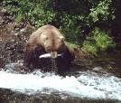
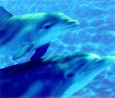
Why is water important?
It is used to carry out living process’s such as photosynthesis, respiration, osmosis, and diffusion.
It provides a habitat for living organisms.
. It helps to balance Earth’s global temperatures.

Slide 15
How much freshwater and saltwater is found on Earth?
2000 ml represents the amount of water on Earth.
97% is salt water. How much water would that represent? (.97 x 2000ml)
How much is freshwater?

Slide 16
How much freshwater and saltwater is found on Earth?
97 % of the water is salt water found in the oceans.
3 % of the water is fresh water.
Of that 3% of fresh water
76% is in the form of ice.
23% is in groundwater
< 1% is in surface water (lakes and streams)

Slide 17
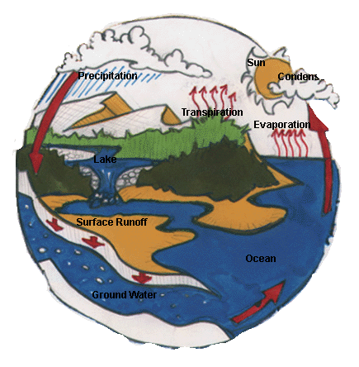
Why is the water cycle an important part of the hydrosphere?
The Water Cycle continually recycles freshwater from the Oceans to the surface of the land.
It distributes water throughout the globe.

Slide 18
What processes are involved in the Hydrologic Cycle?
Four processes involved:
Evaporation from water on land and oceans forms water vapor.
Transpiration is the evaporation of water from plants during photosynthesis.
Condensation forms clouds by changing the water vapor to liquid water drops.
Precipitation in the form of rain, snow, sleet, or hail adds freshwater to the Earth’s surface.

Slide 19
What drives the Hydrologic Cycle?

Slide 20
THE SUN!

Slide 21
3-2-1 Summarize!!!
Write 3 facts you wrote in your notes in complete sentences.
Write 2 facts given to you verbally that you did NOT write down in complete sentences.
Write 1 question that presented itself to you while taking notes.

Slide 22
Sources of Freshwater
List and compare the different types of freshwater resources.
Where does Sanford get its drinking water?

Slide 23
What are the parts of a River System?
A river system is made up of a larger river and the tributaries that run into it.
A watershed is the land area that surrounds the river system and supplies water to the river system.
A divide is a landform that separates two watersheds. (ex. Hills, mountains, etc.)

Slide 24
Compare a Lake to a Pond
Both are considered to be still bodies of water.
POND
Small
Muddy bottom
Diverse number of organisms
Contains plants throughout the pond
LAKE
Large
Sandy bottom
Plant and organisms around the shoreline
waves

Slide 25
How do lakes and ponds change over time?
Seasonal changes
Eutrophication
As the water in a lake warms and cools throughout the year it mixes causing nutrients to rise to the surface.
This is called Lake Turnover.
A long term change.
Nutrients such as nitrogen and phosphorus cause a growth in plants.
Plants and sediments from run off fill in the pond.

Slide 27
What is a wetland?
By definition a wetland is a land area that is covered by a shallow layer of water during some or part of the year.

Slide 28
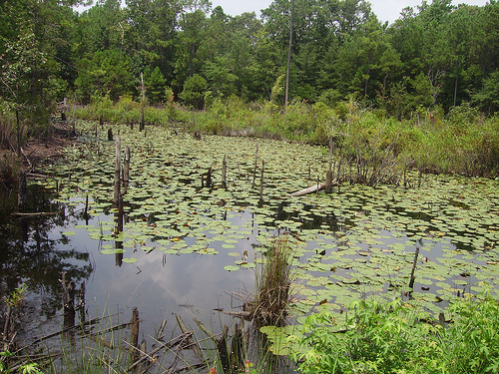
What types of wetlands are there?
Swamps- flooded forests with trees such as the cypress
Bogs- They are damp mossy areas
Marshes- shallow grassy areas covered by shallow water.

Slide 29
Why are wetlands important?
For animals
They provide a habitat for the animals living in the wetlands.
They contain unique plants and animals.
Example- Venus Fly Trap and the pitcher plant.
For people
They help to control floods by absorbing excess runoff from precipitation.
They act as natural filters. Pollution settles in the wetlands and is absorbed by its plants.

Slide 30
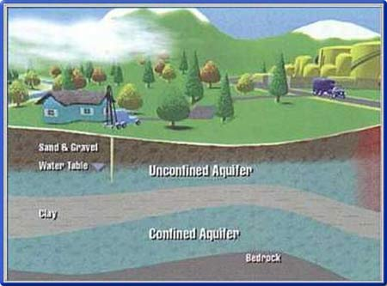
What is groundwater?
The water found in cracks and pores in sand, gravel and rocks below the earth’s surface
http://www.drillwell.com/client_images/groundwater.jpg

Slide 31
What is an aquifer?
A permeable rock layer underground that is contains freshwater.

Slide 32
3-2-1 Summarize!!!
Write 3 facts you wrote in your notes in complete sentences.
Write 2 facts given to you verbally that you did NOT write down in complete sentences.
Write 1 question that presented itself to you while taking notes.

Slide 33
Water Video

Slide 34
Wetlands
What are they and why are they important?

Slide 35
Wetland Video

Slide 36
Water Pollution
What is it?
Where do we find it?
What can we do about it?

Slide 37
What is Water Pollution?
The addition of any substance that causes a negative effect on water or the living things that depend on the water.

Slide 38
Freshwater Pollutants
Kind of Pollutants | Examples | Sources
Disease causing organisms | E. coli, Giardia, bacteria | Human and animal waste, runoff from farms
Pesticides and fertilizers | DDT, nitrates, phosphates | Runoff from farm fields, golf courses
Industrial chemicals | PCB’s, Carbon tetrachloride | Factories
Metals | Lead, Mercury, Copper | Factories
Petroleum products | Oil, Gasoline | Road runoff,

Slide 39
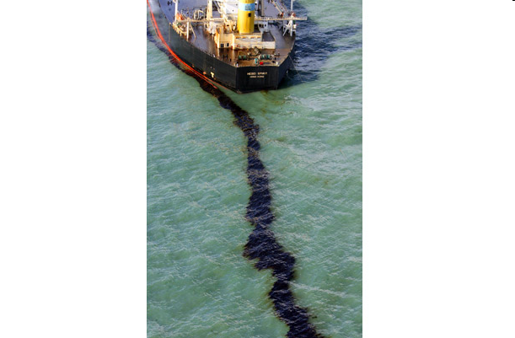
How can you classify pollution sources?
A.
Point Source of pollution- A specific source of pollution.
Non-point source of pollution- A non specific source of pollution.
B.

Slide 40
Which sources are Non- point Sources of Pollution? Point Sources?

Slide 41
Which are point sources of pollution?

Slide 42
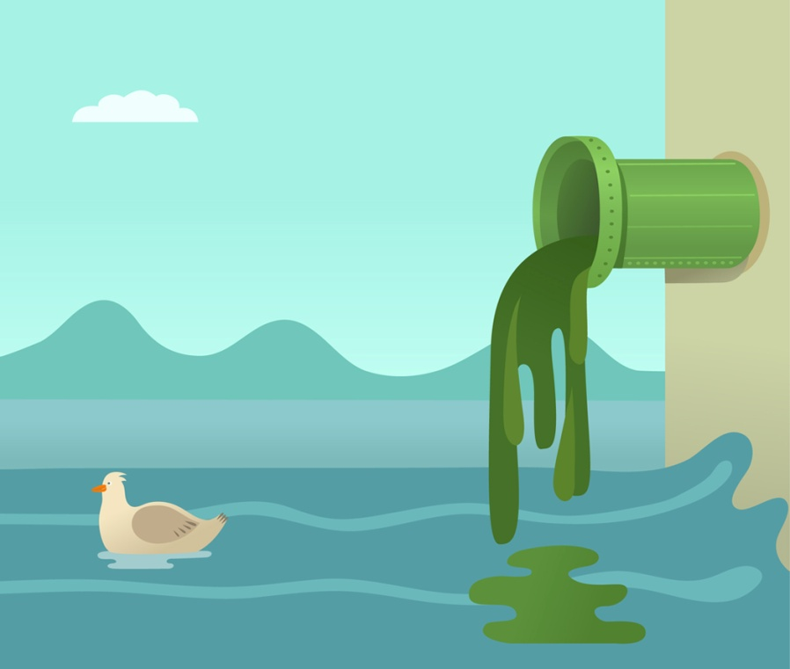
What are the three sources of water pollution?
Human waste
Industrial waste
Chemical Runoff

Slide 43
How do human wastes pollute our water?
During floods sanitary sewers overflow and run into surface waters such as creeks and rivers.
BE CAREFUL WHERE YOU PUT A SEPTIC TANK! A septic tank too close to a creek or aquifer will cause sewage contamination.

Slide 44
How do industries pollute our waters?
Chemicals- Toxic chemicals are released into the water either purposely or accidentally.
Smoke and exhaust- The burning of coal and oil releases Sulfur dioxide. As a result acid rain is produced.
Heat Pollution- Industries use water to cool the machinery and return it to the lake. This increases the temperature of the lake.

Slide 45
How does chemical runoff pollute our waters?
Runoff from farms- pesticides and fertilizers used on farms runoff from the fields into the creeks.
Runoff from the roads- Oil and gasoline from cars drain into creeks and streams.

Slide 46
Solving pollution problems involves cleaning up existing problems as well as preventing new ones.
What do you think this means?

Slide 47
Which is easier: Preventing pollution or Cleaning up water pollution?

Slide 48
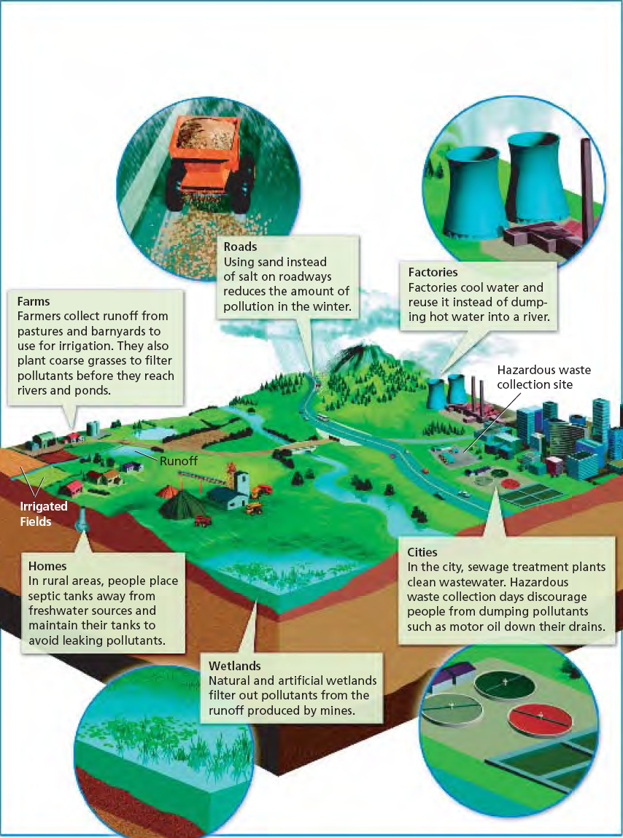
What are ways we can prevent pollution?
Using sand instead of salt on the roads.
Farmers can plant Grasses and Trees around Ponds and Streams.
Use of Wetlands to filter pollutants from mines.
Factories cool the water instead of dumping it into a river or lake.
Can you think of another?

Slide 49
3-2-1 Summarize!!!
Write 3 facts you wrote in your notes in complete sentences.
Write 2 facts given to you verbally that you did NOT write down in complete sentences.
Write 1 question that presented itself to you while taking notes.

Slide 50
The River of Life

Slide 51
Water Treatment- Drinking and Wastewater
Describe the process used to treat our drinking and wastewater.
Describe alternate ways to obtain freshwater.

