Slide 1
Weekly Warm ups
August 28- Sept. 4, 2018

Slide 2
August 28, 2018 Day 2
Warm up ?’s
Things to Do at the beginning of class…
Turn in your forms to be signed including syllabus, student information and handbook form.
Sign up for my Remind
@rkow02
Work on your warm up.
Pick up your handouts.
Watch EXCEL video

Slide 3
August 29, 2018 Day 3
Warm up ?’s
Things to Do at the beginning of class…
List three safety rules important to this class.
List three examples of safety equipment in my room.
Work on your warm up.
Turn in your safety contract.
Sign up for my Remind
@rkow02

Slide 4
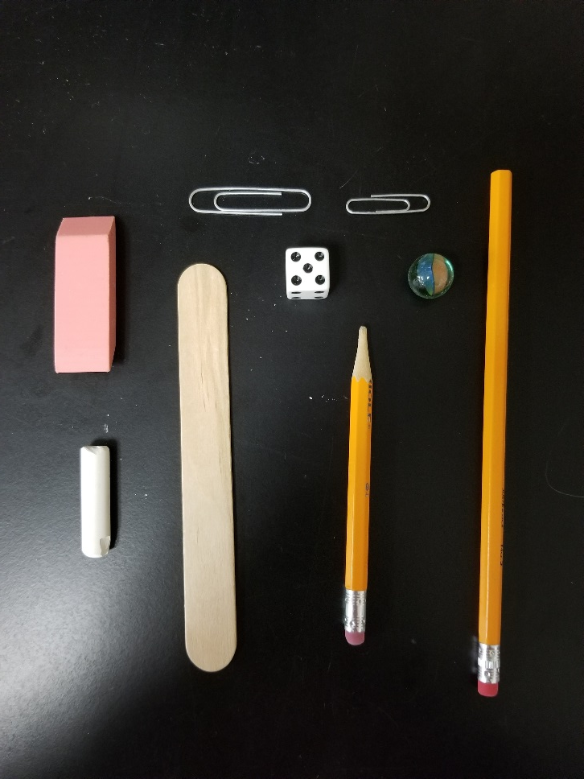
August 30, 2018 Day 4
Warm up ?’s
Things to Do at the beginning of class…
Using the dichotomous key identify the silly name for the following items.
Work on your warm up.
Turn in your homework. Make sure your NAME is on it.
Turn in your safety contract.
Sign up for my Remind
@rkow02

Slide 5
August 31, 2018 Day 5
Warm up ?’s
Things to Do at the beginning of class…
What is the difference between an observation and an inference?
List 2 types of observations.
Work on your warm up.
Turn in your safety contract.
Turn in your homework.
Sign up for my Remind
@rkow02

Slide 6
September 4, 2018 Day 6
Warm up ?’s
Things to Do at the beginning of class…
List the 5 skills of a scientist.
Turn the following observation into an inference.
“The bird has small wings.”
Work on your warm up.
Turn in your safety contract.
Glue in pp. 5 and 6 in your notebook.
Turn in your homework.
Sign up for my Remind
@rkow02

Slide 7
September 5, 2018 Day 7
Warm up ?’s
Things to Do at the beginning of class…
List 5 measurements you may make in science.
How do you find the density of an object?
Work on your warm up.
Turn in Your warm up.
Turn in your homework.
Sign up for my Remind
@rkow02

Slide 8
September 6, 2018 Day 8
Warm up ?’s
Things to Do at the beginning of class…
What tools are needed to calculate density?
A liquid has a volume of 25 ml and a mass of 5 grams. What is its density?
Work on your warm up.
Turn in your warm up.
Turn in your homework.
Sign up for my Remind
@rkow02

Slide 9
September 7, 2018 Day 9
Quiz on Monday
(pp. 1-8 in your notebook)
Warm up ?’s
Things to Do at the beginning of class…
What tools are needed to calculate density?
A liquid has a volume of 5 ml and a mass of 25 grams. What is its density?
Work on your warm up.
Turn in your warm up.
Turn in your homework.
Turn in your homework.
Sign up for my Remind
@rkow02

Slide 10
September 10, 2018 Day 10
Warm up ?’s
Things to Do at the beginning of class…
Find the volume of a liquid measuring 40 grams and has a density of 2 g/ml?
What is the density of water?
Work on your warm up.
Turn in your safety contract.
Turn in your homework.
Sign up for my Remind
@rkow02

Slide 11
September 18, 2018 Day 13
Test on Friday
(pp. 1-12 in your notebook)
Warm up ?’s
Things to Do at the beginning of class…
Take 5 minutes to make your measurements of your creatures.
Work on your warm up.
Turn in your homework. MAKE SURE YOUR NAME IS ON IT.
Record homework in your agenda.

Slide 12
September 20, 2018 Day 14
Test on Friday
(pp. 1-12 in your notebook)
Warm up ?’s
Things to Do at the beginning of class…
Take 5 minutes to make your measurements of your creatures.
Complete the handout on p. 11.
Work on your warm up.
Glue in pp. 11 and 12 in your notebook.
Turn in your Density Problem corrections.
Record homework in your agenda.

Slide 13
September 20, 2018 Day 14
Test on Friday
(pp. 1-12 in your notebook)
Warm up ?’s
Things to Do at the beginning of class…
Take 5 minutes to make your measurements of your creatures.
Complete the handout on p. 11.
Work on your warm up.
Glue in pp. 11 and 12 in your notebook.
Turn in your Density Problem corrections.
Record homework in your agenda.

Slide 14
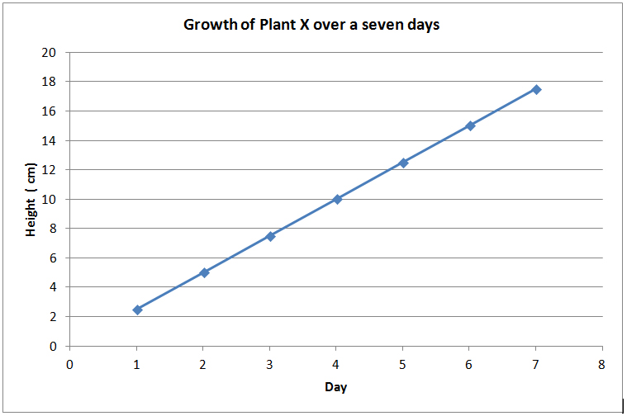
September 21, 2018 Day 15
Warm up ?’s
Things to Do at the beginning of class…
List three different types of graphs.
Given the graph list the independent and dependent variable.
Work on your warm up.
CLEAR OFF YOUR DESK WHEN YOU ARE DONE.

Slide 15
September 25, 2018 Day 17
Warm up ?’s
Things to Do at the beginning of class…
What do you think the most abundant substance is on Earth?
Why do you think it is so special?
Work on your warm up.
Turn in your creature lab.

Slide 16
September 26, 2018 Day 19
Warm up ?’s
Things to Do at the beginning of class…
Compare the terms adhesion and cohesion.
Hint: Look at the background information in your station handout.
Work on your warm up.
Glue in p. 14 in your notebook.

