Slide 1
Weekly Warm ups
October 1- 12, 2018

Slide 2
October 1, 2018 Day 22
Warm up ?’s
Things to Do at the beginning of class…
Describe the water cycle using the words evaporation, transpiration and precipitation.
Work on your warm up.
Glue in p. 16 in your notebook.
Turn in your anchor assignment.

Slide 3
October 2, 2018 Day 22
Warm up ?’s
Things to Do at the beginning of class…
Identify the property of water based on the scenario.
My mom used water to make Kool-aid, tea, and Crystal Light. All of the powders dissolved completely in water.
Water striders are able to walk on water without sinking.
I tried to mix the oil with the water, but no matter what I did the two liquids would not mix.
Work on your warm up.
Turn in your water cycle story.

Slide 4
October 3, 2018 Day 22
Warm up ?’s
Things to Do at the beginning of class…
What part of the water cycle does freshwater come from?
What is the evaporation of water from plants?
Work on your warm up.

Slide 5
October 4, 2018 Day 22
Warm up ?’s
Things to Do at the beginning of class…
Why is water important for people? List three reasons.
How do people influence the quality of water?
Work on your warm up.

Slide 6
October 5, 2018 Day 26
Warm up ?’s
Things to Do at the beginning of class…
What happens if we pollute our surface water?
Work on your warm up.

Slide 7
October 8, 2018 Day 27
Warm up ?’s
Things to Do at the beginning of class…
Based on what you read last week why is it important that we are good stewards of our water resources.
Give at least two reasons.
Work on your warm up.
Glue pp. 18 and 17 in your notebook.

Slide 8
October 9, 2018 Day 28
Warm up ?’s
Things to Do at the beginning of class…
What does a water footprint mean?
Compare direct and indirect uses of water.
Work on your warm up.
Turn in your water footprint.
Record your homework

Slide 9
October 10, 2018 Day 29
Warm up ?’s
Things to Do at the beginning of class…
What are ways we can conserve water?
Work on your warm up.
Record your homework

Slide 10
October 15, 2018 Day 30
Warm up ?’s
Things to Do at the beginning of class…
List natural sources of freshwater.
What is the ultimate source of freshwater?
Work on your warm up.
Turn in last weeks warm up to the bin.

Slide 12
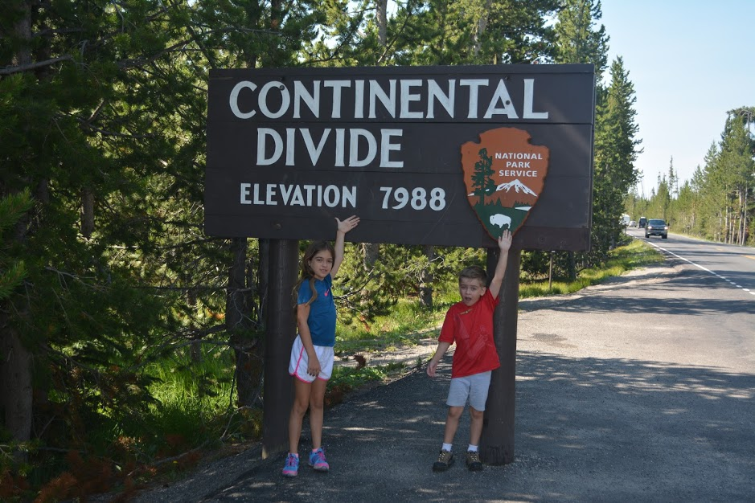

Slide 13
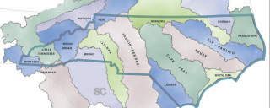

Slide 14
October 12, 2018 Day 31
Warm up ?’s
Things to Do at the beginning of class…
Define a divide.
How does elevation determine where a river flows?
Work on your warm up.
Record your homework

Slide 15
Things to do
Get into your groups.
Open up the document Guided Questions and research them. You answered one of them with the video you watched yesterday.
You will need to share the document with me and your team mates.
Work on the questions the remainder of the period.

Slide 16
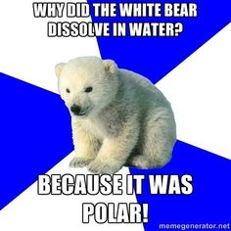

Slide 17
